Slide 1
Bracketology
www.AJKDBlog.org
March 1-31, 2024

Slide 2
Slides Prepared by the
NephMadness Executive Committee
Anna Burgner
Elena Cervantes
Matthew Sparks
Samira Farouk
Anna Vinnikova
Jeffrey Kott
Michelle Lim
Timothy Yau

Slide 3
What To Do
Review the Regions & Teams on AJKDBlog
Submit your picks by March 31, 2024, on Tourneytopia
Discuss on social media using #NephMadness
Claim CME/MOC credit through NKF PERC by May 31, 2024

Slide 4
The BRP Has Already Chosen the Winning Bracket
To win, predict what the BRP picked &
thinks will bring the most practice change to nephrology!
Tom Oates
Sylvia E. Rosas
Bjørn Helge Haug
Jodi Smith
Richard Knight
Matt James
Michelle A. Josephson
Kirk Campbell
Andrea Sofía Alvarez Muñoz

Slide 5
The next 2 slides will help you use Zoom
to fill out your group bracket
Pro Tips:
Submit all brackets at nephmadness.com
Submit individual & group brackets
Submit a back-up bracket (2 brackets per person)
Use “Quick Picks” if you can’t decide!

Slide 6
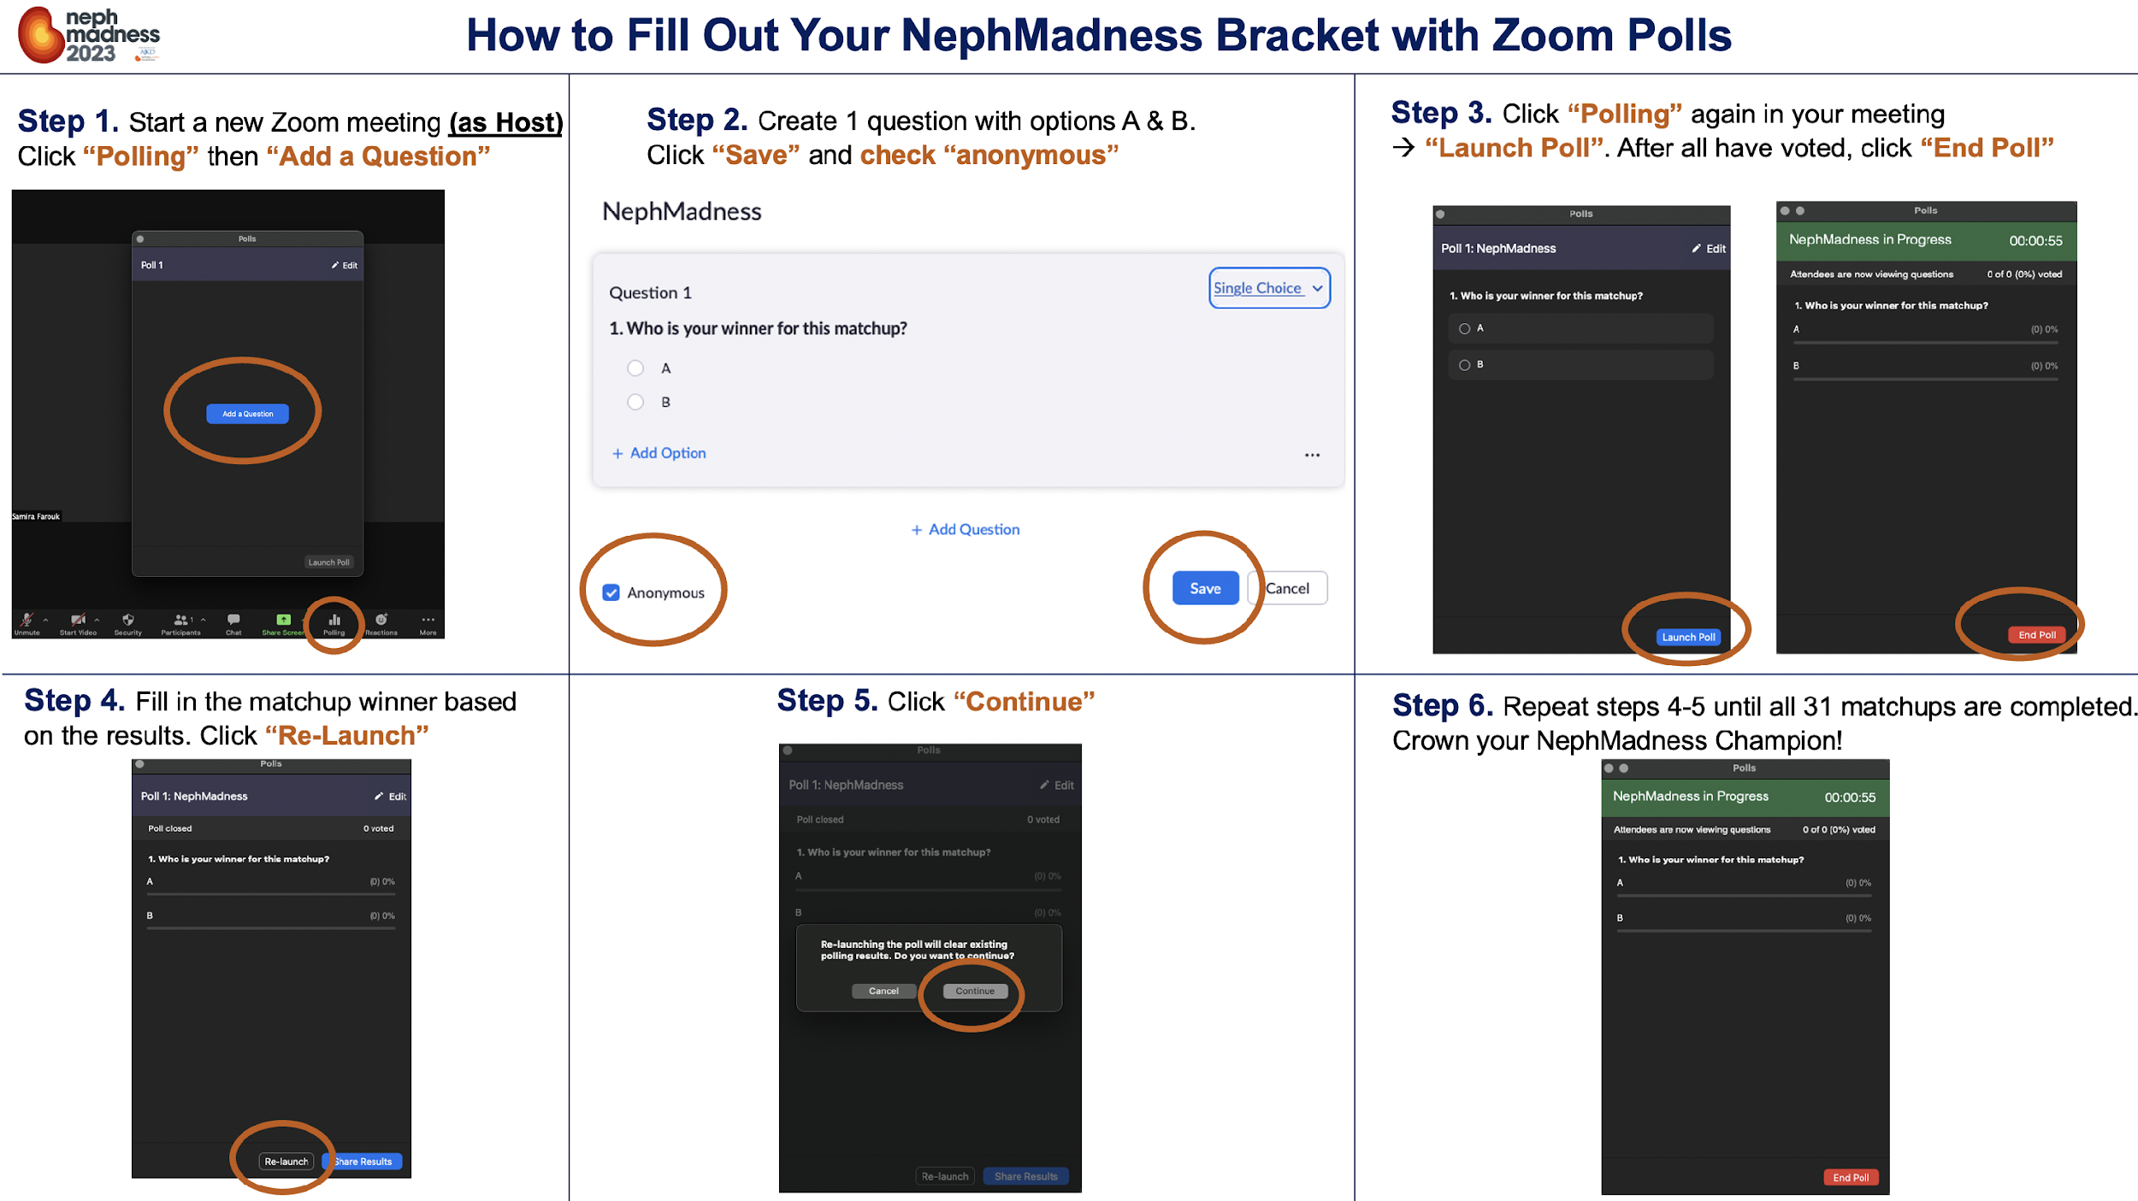
How to Fill Out Your NephMadness Bracket with Zoom Polls

Slide 7
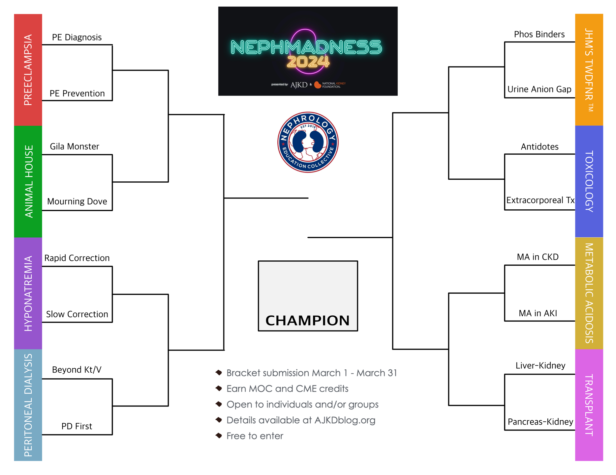
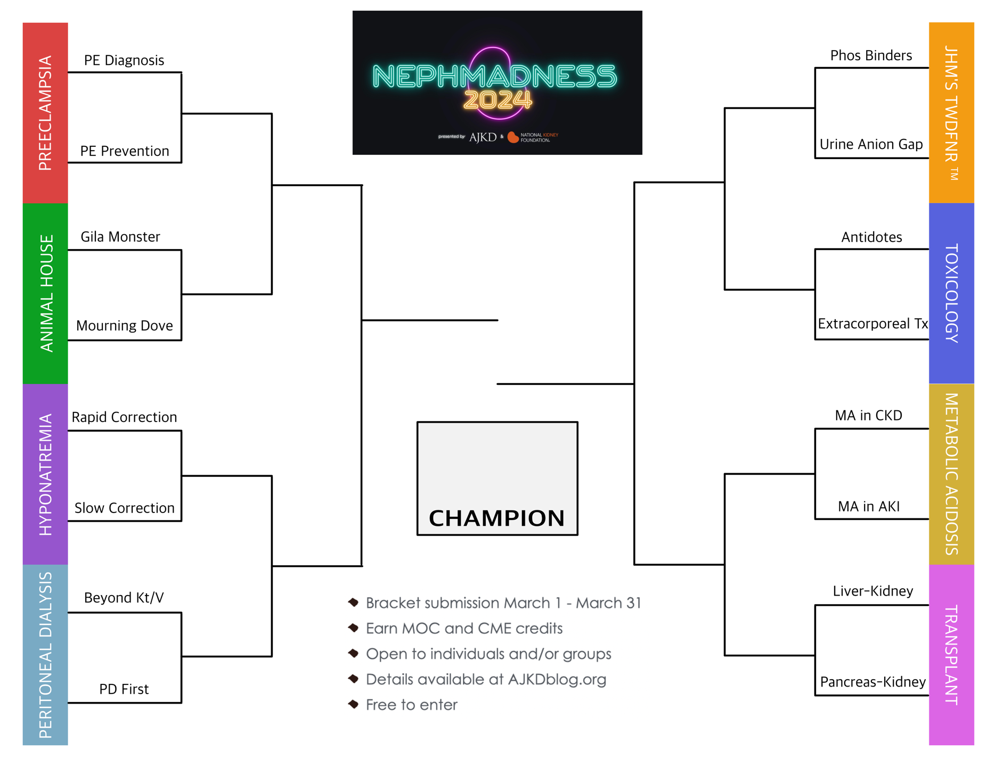
The A-B choices would look like this in the bracket:
A
A
…
A
…
A
B
…
A
A
…
B
A
A
…
…
B
…
B
A
B
…
B
B
A
A
…
A
…
A
…
B
…
…
B
B
B
A
A
…
…
B
B
B
B

Slide 8
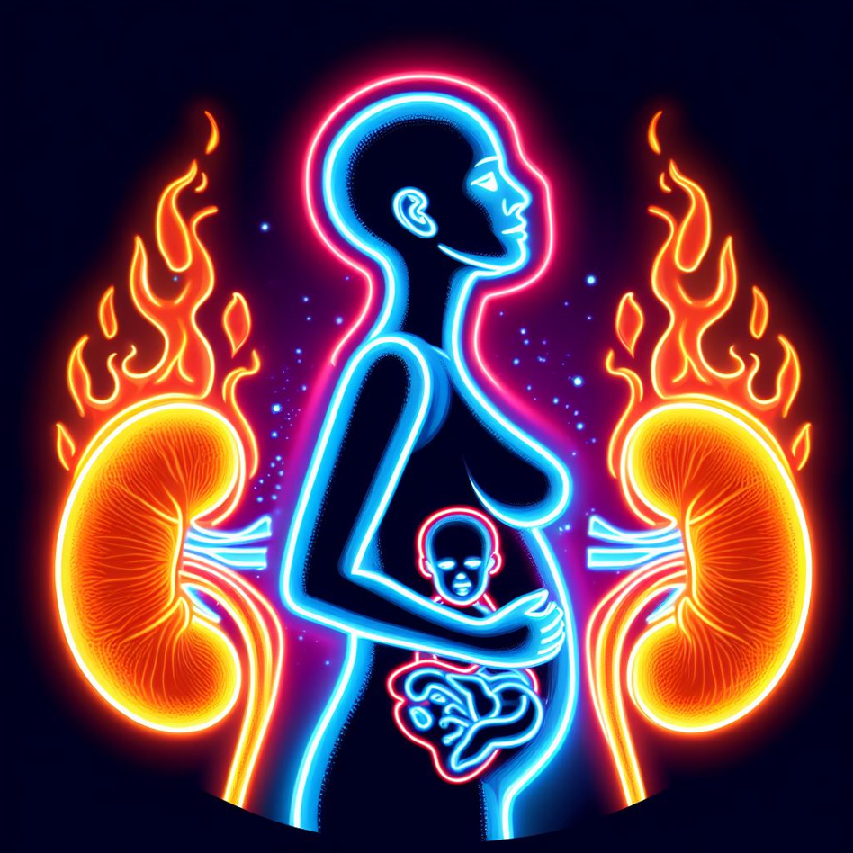
Preeclampsia
Writers:
Gilda Portalatin
Connor Grantham
Experts:
Michelle Hladunewich
Jessica Tangren
Region Execs:
Anna Burgner
Samira Farouk
Notes:
Image generated by Evan Zeitler using Image Creator from Microsoft Designer, accessed via https://www.bing.com/images/create, January, 2024. After using the tool to generate the image, Zeitler and the NephMadness Executive Team reviewed and take full responsibility for the final graphic image.

Slide 9
Diagnosis and Treatment of Preeclampsia
Notes:
Copyright: Fernando Astasio Avila/Shutterstock, https://www.shutterstock.com/image-photo/burning-building-fire-wildfire-house-roof-2340592381

Slide 10
Preeclampsia: A Pregnancy Specific Hypertensive Disease w/ Multisystem Involvement
Diagnosis based upon clinical criteria:
>20 weeks’ gestation
New onset hypertension(SBP >140 OR DBP >90)
AND
New onset proteinuria ( >300 mg/24 hours of a spot urine protein: creatinine ratio >0.3 g/g)
OR
End organ dysfunction (thrombocytopenia, liver dysfunction, new renal insufficiency, pulmonary edema, new onset cerebral or visual disturbances)
Diagnosis is difficult in women with preexisting kidney disease, hypertension, and/or proteinuria
Understanding the pathophysiology has led to biomarkers to help the diagnosis of and may lead to treatment of preeclampsia, namely the sFLT-1/PlGF ratio

Slide 11
Preeclampsia Pathophysiology
Normal development of placenta requires extensive angiogenesis
Normal placenta produces a balance of proangiogenic (VEGF, PlGF) and antiangiogenic factors (sFlt-1)
sFLT-1 helps to maintain the appropriate depth of the placenta in the uterine wall
PlGF is important for spiral artery remodeling and developing the placental capillary network
In preeclampsia a trigger leads to an imbalance with an excess of antiangiogenic factors present
Trigger likely related to placental hypoperfusion/hypoxia/ischemia
sFLT-1 levels are increased in women with preeclampsia or those who are soon to develop preeclampsia
PlGF levels are decreased in women with preeclampsia or those who are soon to develop preeclampsia
Trials ongoing with novel therapeutic strategies based upon this pathophysiology
sFLT-1 ligands, small interefering RNA based therapies to reduce sFLT-1 production, and apheresis paired with columns utilizing monoclonal antibodies to selectively deplete sFLT-1

Slide 13
Preeclampsia Risk Factors, Prevention & Long-Term Sequelae
Notes:
Copyright: NOWIK my stock/Shutterstock, https://www.shutterstock.com/image-photo/matches-fire-on-black-background-710447887

Slide 14
Preeclampsia Risk Factors
Preeclampsia affects up to 5% of all pregnancies
Contributes to 70,000 maternal and 500,000 fetal deaths annually world-wide
Incidence in preeclampsia increasing, as risk factors increase
Every woman with CKD is at risk for preeclampsia
Long term complications include:
Increased risk of cardiovascular disease, heart failure, stroke, diabetes, kidney disease, mental health disorders, and vascular dementia
High Risk Prior history of preeclampsia Preexisting chronic hypertension Type 1 and Type 2 diabetes mellitus Multifetal gestation Chronic kidney disease Systemic lupus erythematosus Antiphospholipid antibody syndrome Moderate Risk Nulliparity Family history of preeclampsia Maternal age of 35 years or older Obesity Socio-demographic characteristics Personal history of being born low birth weight, being small for gestational age, and past pregnancy complications In vitro conception

Slide 15
Preeclampsia Prevention
Two main ways to decrease the risk of preeclampsia:
1) Low dose Daily Aspirin
- Recommended for patients with 1 high risk or 2 moderate risk factors
- Start between 11-13 weeks’ gestation
2) Treat chronic hypertension in pregnancy to a goal <140/90 mmHg
In addition, in patients with CKD to decrease risk of preeclampsia:
Seen prior to pregnancy and have kidney disease treated and proteinuria suppressed
Those with lupus nephritis should be counseled to wait till their nephritis has been quiescent for at least 6 months and be maintained on hydroxychloroquine throughout pregnancy
Those with other GN’s should also have been treated and be in remission prior to pregnancy.

Slide 16
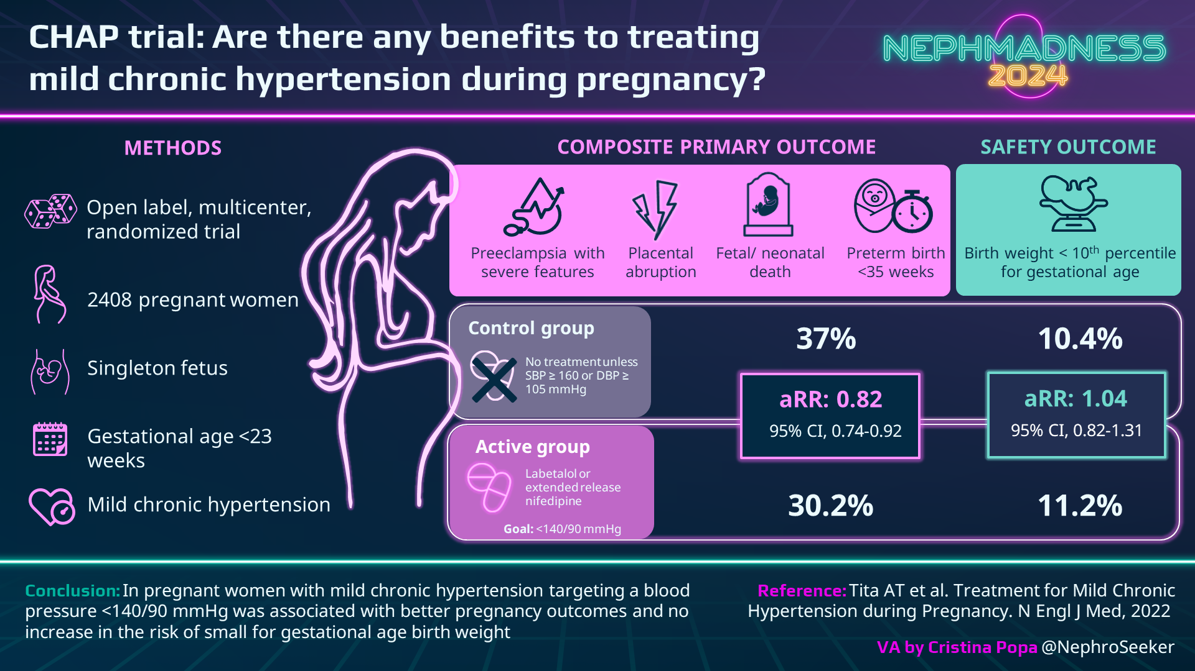

Slide 17
EFFLUENT EIGHT ROUND
Pick Your Champion for the Preeclampsia Region
vs
Diagnosis and Treatment of Preeclampsia
Preeclampsia Risk Factors, Prevention and Long-Term Sequelae

Slide 18
Animal House 4
Writer:
Tiffany Truong
Expert:
Kelly Hyndman
Region Execs:
Anna Vinnikova
Matt Sparks
Notes:
Image generated by Evan Zeitler using Image Creator from Microsoft Designer, accessed via https://www.bing.com/images/create, January, 2024. After using the tool to generate the image, Zeitler and the NephMadness Executive Team reviewed and take full responsibility for the final graphic image.

Slide 19
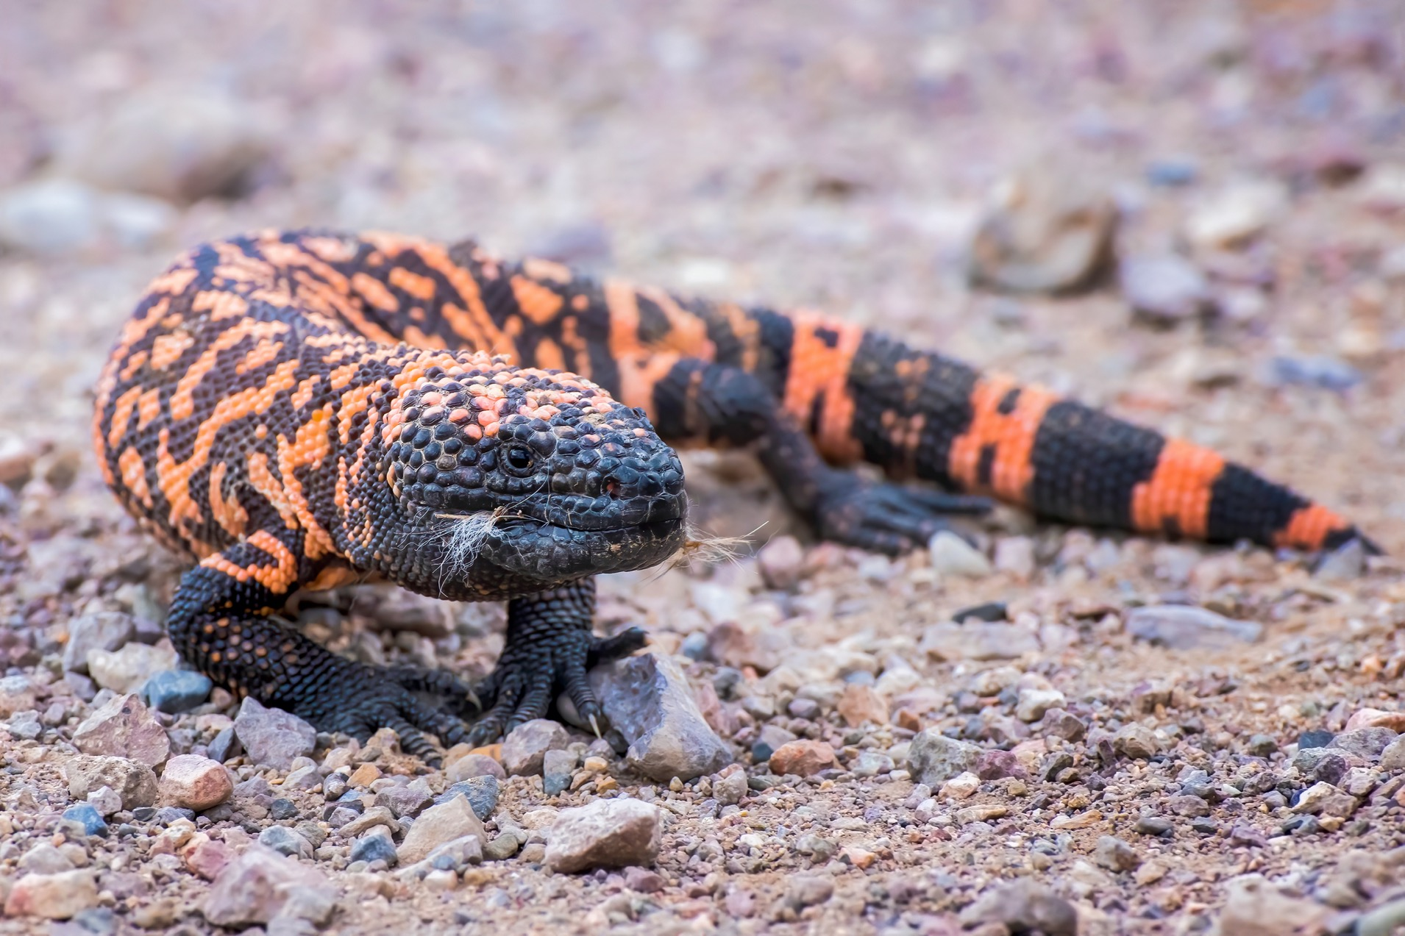
Gila Monster
Notes:
Copyright: Erin Donalson / Shutterstock, https://www.shutterstock.com/image-photo/close-low-angle-venomous-gila-monster-1872989194

Slide 21
Incretin-based therapies
GLP1- R agonists: Improve BG, BP, proteinuria, weight, inflammation, fibrosis, CV outcomes
DPP-4 inhibitors: Improve BG only

Slide 23
Mourning Dove
Notes:
Image courtesy of Ajit Bhamra.

Slide 26
EFFLUENT EIGHT ROUND
Pick Your Champion for the Animal House 4 Region
vs
Gila Monster
Mourning Dove

Slide 27
Hyponatremia Correction
Writers:
Naman Gupta
Alisha Sharma
Graham Gipson
Expert:
Mirjam Christ-Crain
Region Execs:
Anna Vinnikova
Tim Yau
Notes:
Image generated by Evan Zeitler using Image Creator from Microsoft Designer, accessed via https://www.bing.com/images/create, January, 2024. After using the tool to generate the image, Zeitler and the NephMadness Executive Team reviewed and take full responsibility for the final graphic image.

Slide 28
Rapid Correction
Notes:
Copyright: fuyu liu/Shutterstock, https://www.shutterstock.com/image-photo/background-highspeed-train-motion-blur-outdoor-98042648

Slide 29
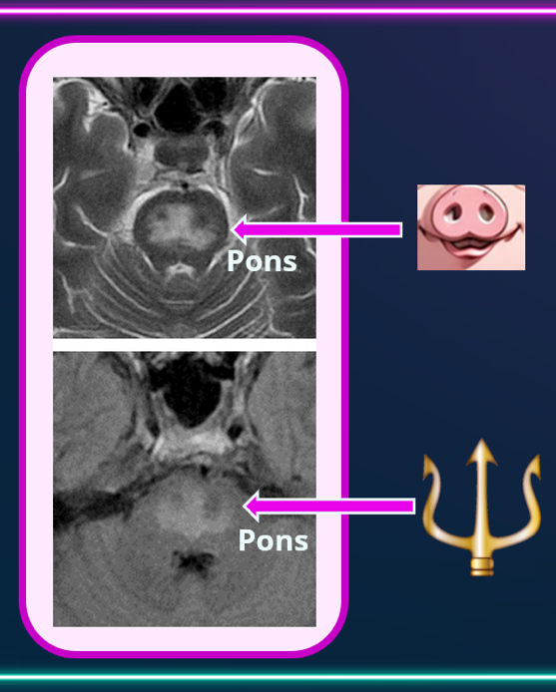
Hyponatremia Correction & Osmotic Demyelination Syndrome (ODS)
Radiologic features of ODS
Central Pontine Myelinolysis
(Classic variant of ODS):
Characterized by piglet or trident signs in the pons on MRI,
Finding can be delayed up to 3 weeks
Consensus on slow correction of severe chronic hyponatremia has developed to avoid ODS
Per US Guidelines:
- Max 10-12 meq/L/24 hrs in average-risk patients
- Min 4-6 meq/L/24 hrs in high-risk patients
ODS is the result of osmotic damage to glial cells, when
↑ in intracellular tonicity (like in hyponatremia correction) >>>
ability of glia to adapt by taking in osmolytes (in alcohol use, malnutrition, hypophosphatemia etc.)
Strict correction limits:
- stole the spotlight from multifactorial nature of ODS
- complicated hyponatremia management
Several “disruptor” papers recently challenged the status quo:
- suggested that ODS is ultra-rare
- that it is hardly ever associated with hyponatremia correction rate
- that slow correction rate is associated with worse outcomes

Slide 32
Slow Correction
Notes:
Copyright: DarSzach/Shutterstock, https://www.shutterstock.com/image-photo/warning-cones-on-road-during-evening-2167624299

Slide 34
More Thoughts Pro Slow Correction
The “disruptor” papers would do well to beef up the rigor of their kinetics analysis
They form a nice springboard for further investigations but offer only flimsy justification for abandonment of slow correction
A Hyponatremia Intervention Trial (HIT) is currently ongoing; will answer the question whether poor outcomes of hyponatremia are due to hyponatremia itself, its treatment or the underlying disease
For now, we should recognize ODS for the danger it is, appreciate its rarity while remembering its favored prey, and when compelled to act, heed the ancient wisdom of festina lente, or ‘haste makes waste’

Slide 35
EFFLUENT EIGHT ROUND
Pick Your Champion for the Hyponatremia Correction Region
vs
Rapid Correction
Slow Correction

Slide 36
Peritoneal Dialysis
Writer:
Timothy Hopper
Experts:
Janice Lea
Jeff Perl
Region Execs:
Matt Sparks
Jeff Kott
Notes:
Image generated by Evan Zeitler using Image Creator from Microsoft Designer, accessed via https://www.bing.com/images/create, January, 2024. After using the tool to generate the image, Zeitler and the NephMadness Executive Team reviewed and take full responsibility for the final graphic image.

Slide 37
Peritoneal Dialysis First
Notes:
Copyright: Phawat/Shutterstock, https://www.shutterstock.com/image-photo/silver-trophy-award-competition-smoke-dark-2174951187

Slide 38
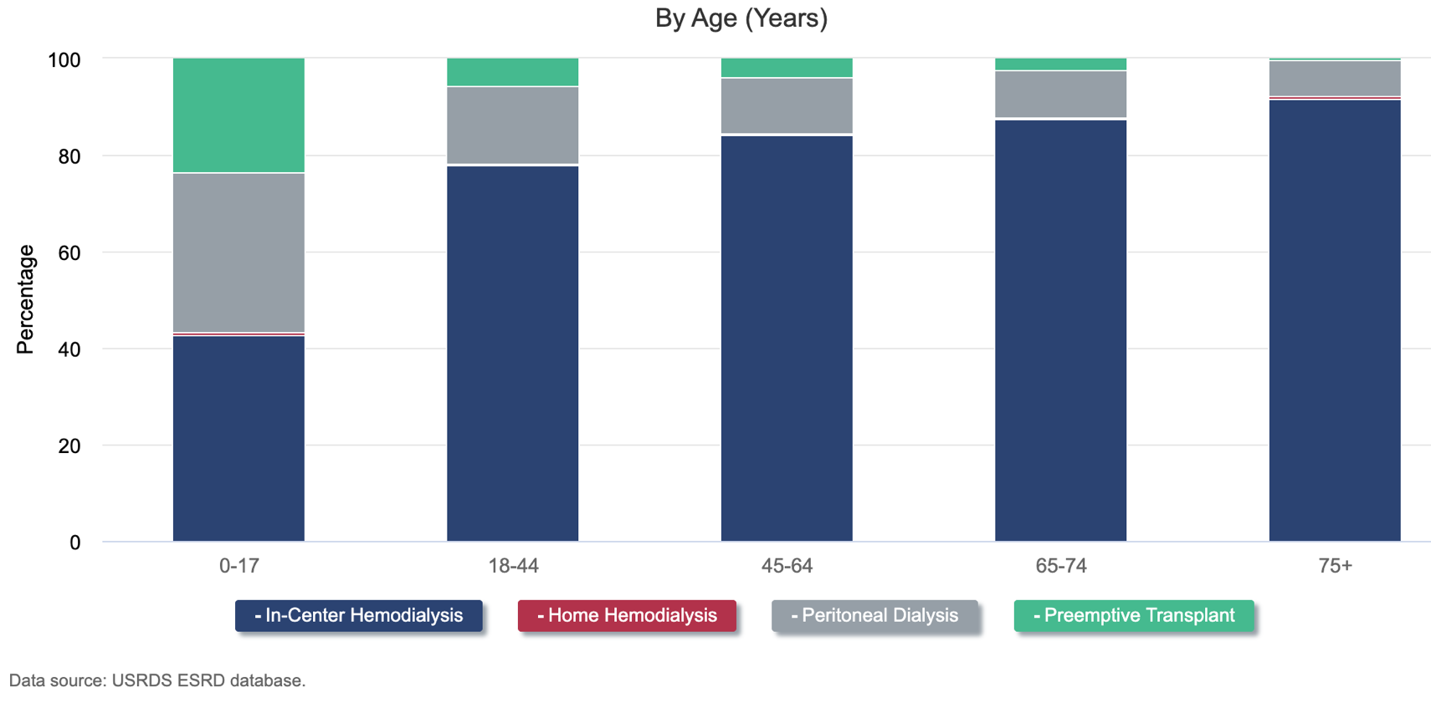
Dialysis Modality Selection: Expectations or Reality?
Patients who receive thorough pre-kidney failure education
-45% choose peritoneal dialysis (PD) (Golper et al. NDT 2001)
However, as of 2021 only 13% of patients starting dialysis are initiated on PD (USRDS)

Slide 39
PD First
Systems Challenges
-Pre-kidney failure education
-Changes to the structure of outpatient dialysis units
-Continued evolution towards value-based care
-Starting individuals on peritoneal dialysis as the first modality
Approaches to achieve PD first
-Incremental PD- less-intensive PD start that factors in residual kidney function, mitigates the change to patients’ lifestyles while helping navigate the transition from stage 5 CKD to dialysis-dependence -Urgent Start PD- starting PD acutely just after PD catheter placement
-PD Catheter Placement Timing
Tunneled PD catheter
Starting with PD as 1st modality has the potential to increase the
number of patients receiving PD

Slide 42
Beyond Kt/V
Notes:
Copyright: Canities/Shutterstock, https://www.shutterstock.com/image-photo/sunrise-view-planet-earth-space-sun-2292624155

Slide 43
Beyond Kt/V
-ISPD guidelines recommend a minimum threshold Kt/V of 1.7.
-Some advocate eliminating the measurement of Kt/V entirely because it does not have a clear impact on patient outcomes.
-Others consider Kt/V a useful measurement of small solute clearance that can call attention to changes in residual kidney function (RKF) or peritoneal membrane characteristics.
-There is no evidence to support that high-quality PD has a minimal Kt/V threshold.
-2020 ISPD has concluded that the traditional focus on achieving a weekly Kt/V of at least 1.7 has been misplaced.
-importance of shared decision-making
-Patient priorities: increasing flexibility with time/reducing fatigue, infections, mortality

Slide 46
EFFLUENT EIGHT ROUND
Pick Your Champion for the Peritoneal Dialysis Region
vs
Peritoneal Dialysis First
Beyond Kt/V

Slide 47
Things We Do For No Reason
Writer:
Imran Chaudhri
Experts:
Tony Breu
Lenny Feldman
Farrah Daccueil
Region Execs:
Jeff Kott
Samira Farouk
Notes:
Image generated by Evan Zeitler using Image Creator from Microsoft Designer, accessed via https://www.bing.com/images/create, January, 2024. After using the tool to generate the image, Zeitler and the NephMadness Executive Team reviewed and take full responsibility for the final graphic image.

Slide 48
Phosphate Binders
Notes:
Copyright: DenisNata/Shutterstock, https://www.shutterstock.com/image-photo/colorful-file-folders-isolated-on-white-376011874

Slide 49
Hyperphosphatemia Typically Develops in Patients with CKD Due To: ↑Dietary Phosphate Load + ↓ GFR
Dietary restriction of phosphate is the initial management strategy
Phosphate (PO₄³⁻) binders can be used when dietary restriction not sufficient
The goal in the outpatient setting is to lower elevated phosphorus levels “towards the normal range” (KDIGO) or aim for a Ca*Ph < 55 (KDOQI)
HyperP triggers a hormonal cascade, beginning with fibroblast growth factor 23 (FGF23), which has numerous adverse effects on the body:
Abnormal bone remodeling
Cardiovascular morbidity & mortality
Worsening of acidosis & inflammation
Phosphate Binders:
Bind enteric phosphate
Are with each meal, only binding a certain amount of phosphate per meal
Can be calcium-based or non-calcium based

Slide 50
Visual Abstract of Factors that Affect Serum Phosphate Levels

Slide 51
Dietary Phosphate Consumption is Typically Lower in Hospitalized Patients
Patients in the hospital may have:
Poor Oral Intake
Diets Tailored to Kidney Function
Continuous Tube Feeds
Phosphate binders only work on enteric phosphate in a bolus feed fashion:
In hospitalized patients, their efficacy is limited
They will not affect a phosphate load from intrinsic sources (e.g. Tumor lysis syndrome, catabolic state)
Phosphate binders have adverse effects:
Contribute to pill burden (hospitalized patients may be already taking many medications)
Are large and difficult to swallow (dysphagia is common in hospital)
Cause GI side effects (Nausea, Vomiting, Diarrhea, Rarely Bowel Obstruction)
Are Costly

Slide 52
Urine Anion Gap
Notes:
Copyright: Marquess789/Shutterstock, https://www.shutterstock.com/image-photo/man-jump-through-gap-between-hill-710654119

Slide 53
Visual Abstract of Renal Acid/Base Physiology

Slide 54
Urinary Anion Gap (UAG) = Urinary (Na + K) – Cl
Urinary chloride is interpreted as surrogate for urinary ammonium and thus is used to determine the kidney’s role in non-anion gap acidosis
A negative (-) UAG thus suggests gastrointestinal loss of alkali and preservation of the kidney’s ability to excrete acid (high urine Cl⁻) through the urine (Ne-“gut”-ive)
A positive (+) UAG typically implies the kidney is unable to generate ammonium (NH4⁺), leading to altered distal acidification of the urine (low urine Cl⁻)
Direct urinary ammonium measurement it is not widely available as the test is time-consuming & has been difficult to run...

Slide 55
The Many Limitations of the UAG Interpretation
It implies that there are no additional anions in the urine other than chloride
In the setting of anion-gap metabolic acidosis, anions such as lactic acid and ketones can be excreted in the urine
In toluene ingestion, toluene metabolizes into the anion hippurate which is excreted in the urine
Proximal renal tubular acidosis leads to impaired bicarbonate (anion) reabsorption → bicarbonaturia
In meat eaters: ↑dietary K⁺ intake + phosphate & sulfur-containing amino acids (metabolized to sulfuric acid) → ↑ UAG, but also increased urinary ammonium (NH4⁺)
UAG use is limited in CKD
Impaired generation of NH4⁺ with loss of kidney function
Impaired reabsorption of additional anions (sulfites, other organic anions)
Only a few studies directly correlate UAG with urinary NH4⁺ across healthy, CKD, & kidney stone formers - and there is little correlation UAG & urinary NH4⁺
Direct measurement of urinary ammonium is becoming easier!
There has been a significant movement in the nephrology community to petition laboratories to adopt direct measurement of urinary ammonium

Slide 56
EFFLUENT EIGHT ROUND
Pick Your Champion for the Things We Do For No Reason Region
vs
Phosphate Binders
Urine Anion Gap

Slide 57
Toxicology
Writer:
Jorge Eduardo Gaytan Arocha
Experts:
Marc Ghannoum
David S. Goldfarb
Diane Calello
Region Execs:
Elena Cervantes
Anna Burgner
Notes:
Image generated by Evan Zeitler using Image Creator from Microsoft Designer, accessed via https://www.bing.com/images/create, January, 2024. After using the tool to generate the image, Zeitler and the NephMadness Executive Team reviewed and take full responsibility for the final graphic image.

Slide 58
Antidotes and Supportive Therapies
Notes:
Copyright: Maya Kruchankova/Shutterstock, https://www.shutterstock.com/image-photo/bottle-magic-potions-magical-forest-2168815979

Slide 59
Antidotes
Over 2 million cases of human exposure to poisons were reported to the American Association of Poison Control Centers (AAPCC) in 2022
Supportive care is always the first step, and it includes assessing vital functions and initial volume repletion for hypotension correction and toxin elimination (e.g., baclofen, methotrexate, lithium). Sodium bicarbonate enhances the elimination of certain poisons through urine alkalinization (e.g. salicylates, methotrexate)
Acetaminophen, the predominant cause of drug overdose in the US, is effectively countered by N-acetylcysteine (NAC), which inhibits CYP2E1 preventing N-acetyl-p-benzoquinone imine (NAPQI) formation and restoring glutathione function. Indications for use include:
Single ingestion >150 mg/kg or 7.5 grams
Unknown ingestion time with serum acetaminophen concentrations >10 mg/L
History of ingestion with any evidence of liver injury

Slide 60
Antidotes
Fomepizole is a strong inhibitor of alcohol dehydrogenase (ADH), preventing the metabolism of toxic alcohols (e.g. methanol and ethylene glycol) into harmful metabolites
Fomepizole is a potent inhibitor of CYP2E1 and may inhibit Jun-N-terminal kinase (JNK, an enzyme involved in hepatotoxicity, therefore, this antidote has also been used in high-risk acetaminophen poisoning
Ethanol has a strong affinity for ADH and serves as an alternative to fomepizole when unavailable. Administered IV or orally, it aims to achieve an ethanol level of 100 mg/dL or ¼ to 1/3 of the serum methanol or ethylene glycol concentrations, expressed in mg/dL.
For methotrexate (MTX) poisoning, leucovorin is the primary antidote as it bypasses the dihydrofolate reductase blockade induced by the poison. Urine alkalinization helps eliminate the drug. In cases of AKI and high drug concentrations (variable based on the time post-high dose MTX), glucarpidase, a recombinant bacterial enzyme that rapidly converts extracellular MTX into inactive metabolites, is typically needed, administered as a single dose of 50 units/kg

Slide 62
Extracorporeal Therapies
Notes:
Copyright: NoonBuSin/Shutterstock, https://www.shutterstock.com/image-photo/water-splash-washing-machine-drum-584289709

Slide 63
Extracorporeal therapies (ECTR)
Hemodialysis (HD) was introduced in 1913 for salicylate clearance, but the ECTR’s role in poisoning management has regional variations and remains a topic of debate
The EXtracorporeal TReatments In Poisoning (EXTRIP) workgroup recommends ECTRs when there are clear signs of severe toxicity, impaired endogenous clearance, and plausible toxin dialysance
HD is the preferred ECTR, irrespective of hemodynamics due to its impact on drug clearance influenced by poison properties. Clearance is optimized using high-flux dialyzers, high blood flow, longer treatment times

Slide 64
Extracorporeal therapies (ECTR)
Continues Kidney Replacement Therapy (CKRT) is not the initial choice since its clearance is substantially lower than what a single session of hemodialysis can provide. CKRT after an initial HD session to manage the rebound can be a practical option (though re-dialyzing the patient is still preferred)
Other less common ECTR options include the following:
Hemoperfusion removal via charcoal or resin cartridge
Therapeutic Plasma Exchange (TPE), separates plasma and exchanges it for albumin or fresh frozen plasma. It can be effective for highly protein-bound and large poisons
Peritoneal dialysis has a limited role in acute poisoning (max clearance <20 mL/min)

Slide 66
EFFLUENT EIGHT ROUND
Pick Your Champion for the Toxicology Region
vs
Antidotes and Supportive Therapies
Extracorporeal Therapies

Slide 67
Metabolic Acidosis
Writers:
Marco Thierry
Taha Mohamed
Expert:
Nimrit Goraya
Region Execs:
Tim Yau
Elena Cervantes
Notes:
Image generated by Evan Zeitler using Image Creator from Microsoft Designer, accessed via https://www.bing.com/images/create, January, 2024. After using the tool to generate the image, Zeitler and the NephMadness Executive Team reviewed and take full responsibility for the final graphic image.

Slide 68
Metabolic Acidosis in CKD
Notes:
Copyright: La_Mar/Shutterstock, https://www.shutterstock.com/image-photo/amazing-lemons-fruits-on-lemon-tree-2263329681

Slide 69
Metabolic Acidosis in CKD
Develops with lower GFRs due to diminished capacity to reabsorb bicarbonate and excrete ammonium
CKD patients with metabolic acidosis have:
Adverse bone health
Decreased muscle mass
Progression of CKD
Higher incidence of cardiovascular events
Bicarbonate supplementation can be given to neutralize excess acid and increase serum bicarbonate, but does it affect outcomes?
Newer drugs recently developed (veverimer - hydrochloric acid binders) but outcomes not superior and agents not available

Slide 71
Metabolic Acidosis in CKD
Sodium bicarbonate tablets - 650 mg → roughly 8 mEq NaHCO3
Typical dose 2 tabs BID will provide about 30 mEq of bicarb/day
Can also reduce daily acid load by altering diet to include less animal protein and more fruits/vegetables
Animal protein → metabolized to sulfuric acid
Fruits/vegetables → metabolized to citrate
Encouraging fruits/vegetables in CKD:
ameliorate metabolic acidosis
lower BP
improve HbA1C
did not raise serum potassium in small trials

Slide 72
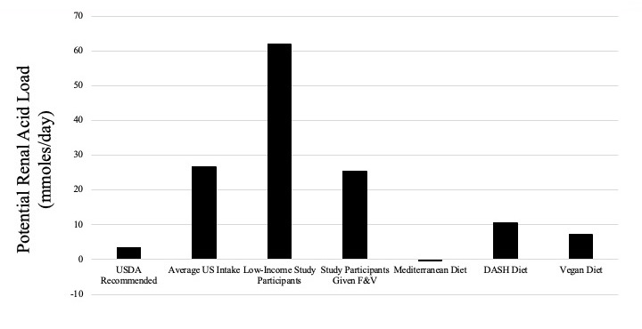
Notes:
Courtesy of Dr. Nimrit Goraya (University of Texas at Austin Dell Medical School).

Slide 73
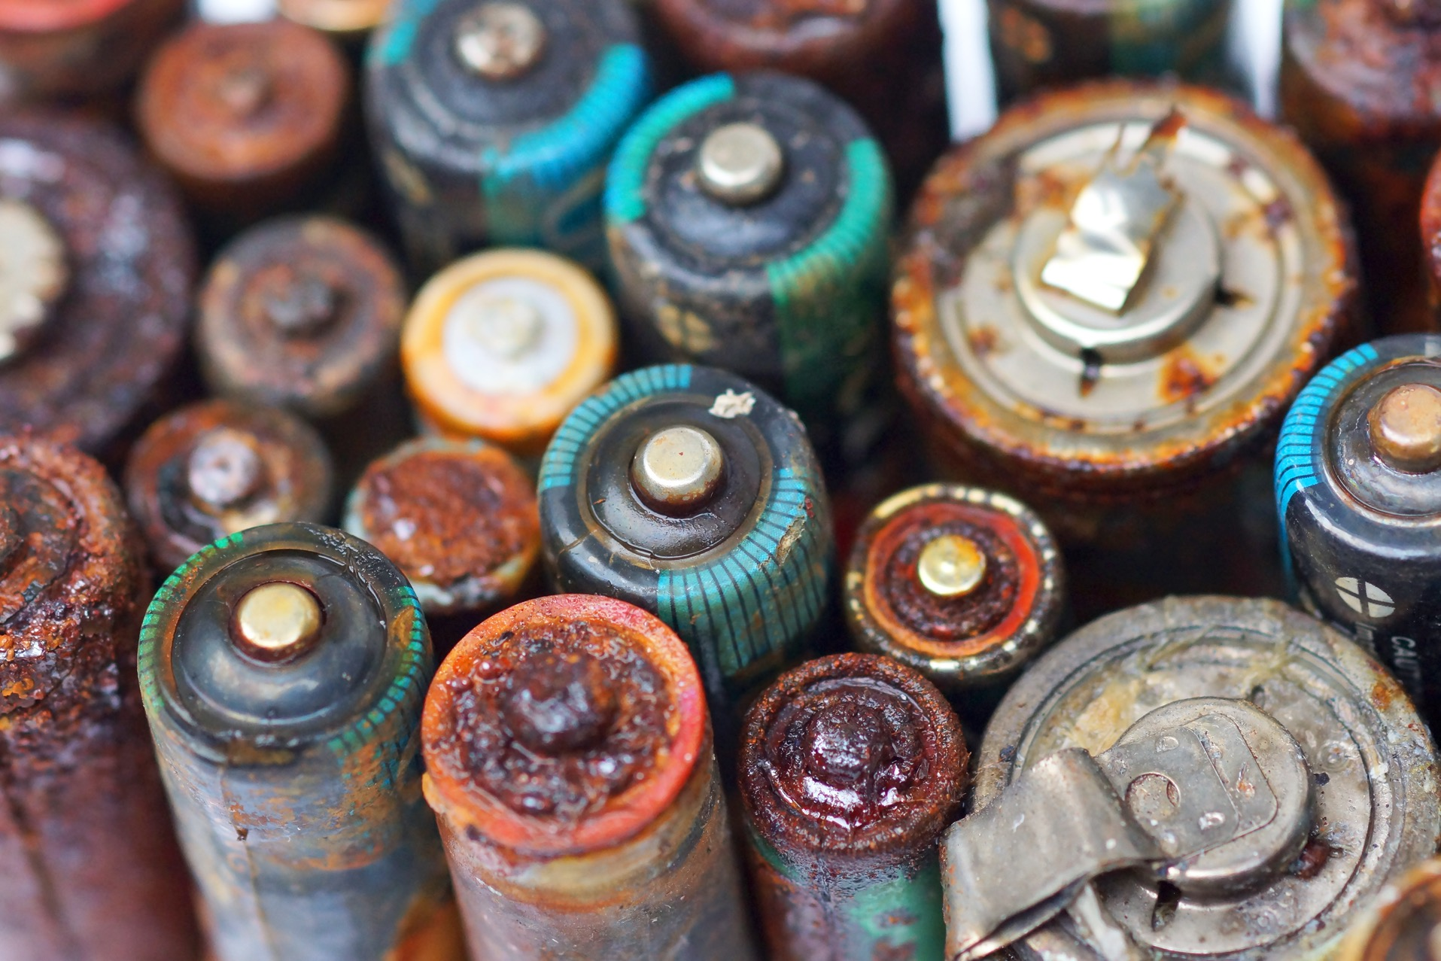
Metabolic Acidosis in AKI
Notes:
Copyright: wk1003mike/Shutterstock, https://www.shutterstock.com/image-photo/old-battery-leak-isolated-hazardous-waste-1158227962%22

Slide 74
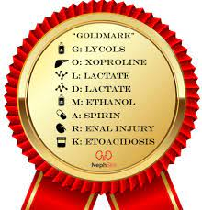
Metabolic Acidosis in AKI/ICU
MUDPILES
GOLDMARK
M ethanol
U remia
D iabetic ketoacidosis
P araldehydes
I soniazid
L actic acidosis
E thylene Glycol
S alicylates
G lycols (ethylene and propylene)
O xoproline (pyroglutamic acidosis from Tylenol)
L - lactic acidosis
D - lactic acidosis (short gut syndrome)
M ethanol
A spirin
R enal failure
K etoacidosis (starvation, DKA)

Slide 75
Bicarbonate and RRT for Metabolic Acidosis in the ICU
Typically considered when pH < 7.2 due to animal studies showing reduced LV contractility and vasodilation/lower BP in animal studies
However, limited human data (BICAR-ICU) does not show any mortality benefit in shock
Bicarbonate administration has the following effects outside of pH:
volume
hypernatremia if hypertonic bicarb (e.g. 4.2%) administered
hypocalcemia
hypokalemia
increased pCO2
RRT for severe metabolic acidosis often required to deliver sufficient bicarbonate and prevent volume and electrolyte imbalances - higher doses 35 ml/kg/hr often required
ICU trials looking at early vs late start RRT (e.g. AKIKI, STAART) show that metabolic acidosis is the primary indication for dialysis in approximately 20% of patients

Slide 78
EFFLUENT EIGHT ROUND
Pick Your Champion for the Metabolic Acidosis Region
vs
Metabolic Acidosis in CKD
Metabolic Acidosis in AKI

Slide 79
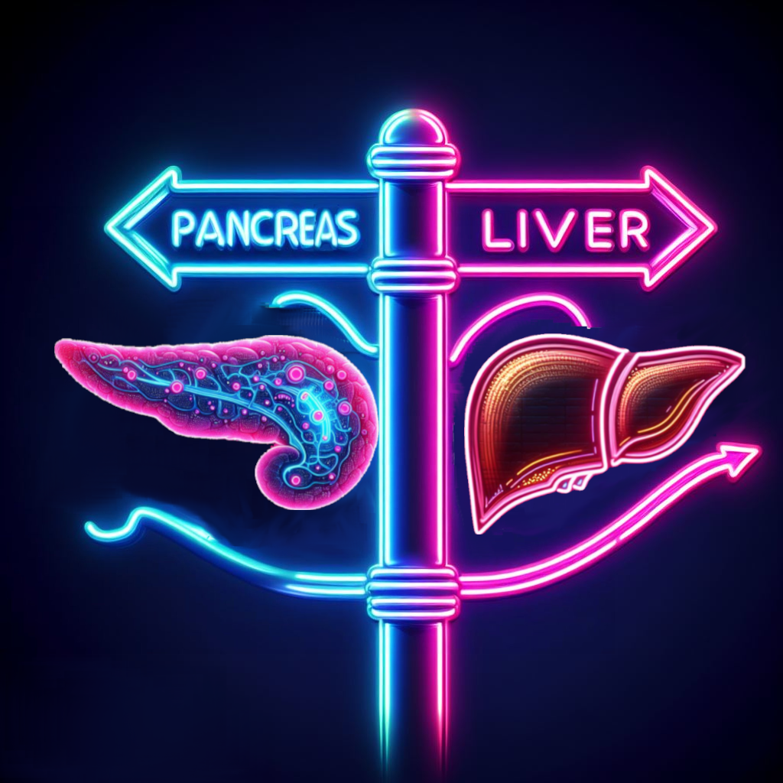
Dual Organ Transplant
Writers:
Sam Kant
Manal Alotaibi
Expert:
Roslyn Mannon
Region Execs:
Samira Farouk
Matt Sparks
Notes:
Image generated by Evan Zeitler using Image Creator from Microsoft Designer, accessed via https://www.bing.com/images/create, January, 2024. After using the tool to generate the image, Zeitler and the NephMadness Executive Team reviewed and take full responsibility for the final graphic image.

Slide 80
Liver-Kidney
Notes:
Copyright: LedyX / Shutterstock, https://www.shutterstock.com/image-photo/beautiful-flowers-yellow-dandelions-nature-warm-1906984516

Slide 81
VA #1: SLK criteria

Slide 82
AKI Prevalence is High Among Patients With Cirrhosis
In 2021, 780 simultaneous liver-kidney (SLK) transplants (8% of all liver transplants) were performed for both adults & pediatric patients
Up until 2017, there were no standardized medical criteria to help make this decision, raising concerns that high quality kidneys were being allocated to candidates who may have regained kidney function following liver transplant alone (LTA) – check out the new criteria introduced in 2017 on the next slide
SLK-kidneys are usually significantly higher quality than those used for kidney transplantation alone, with a mean kidney donor profile index (KDPI) below 35% in 2014
Determining the cause of AKI (and if kidney function will recover after LTA) in patients with cirrhosis is hard…and distinguishing between hepatorenal syndrome (HRS), acute tubular necrosis (ATN), & other intrinsic kidney diseases is crucial. The fractional excretion of sodium may not always help, and biopsies may be risky due to potential higher risk of bleeding.
Recipients of SLK have lower rates of both acute cellular and antibody-mediated rejection, thought to be due to the immunomodulatory properties of the liver on the immune system (antibody sink?!)

Slide 83
VA #2: 2023 study

Slide 84
Pancreas-Kidney
Notes:
Copyright: BigBlueStudio/Shutterstock, https://www.shutterstock.com/image-photo/bees-on-honeycomb-1172702116

Slide 85
Diabetic Kidney Disease is the Most Common Cause of ESKD
Individuals eligible for kidney transplantation who are also insulin dependent (T1 or T2DM) can be considered for one of the options below:
Immunosuppression for pancreas allografts is “off label” use and the 1st ever consensus conference for pancreas transplantation was held in 2019
About 1,000 pancreas transplants were performed in the US in 2021: 80% SPK, 23% in those with T2DM. Recipients of PAK (after LDKA) have both increased kidney and pancreas allograft survival compared to SPK recipients
Some anatomy: donor pancreas + a piece of their duodenum is goes into the recipient. Drainage of pancreatic enzymes (where the duodenum connects) can be either via the bladder or jejunum (“enteric”). Bladder drainage can lead to metabolic acidosis, cystitis, volume depletion…so 90% are now enterically drained
Rates of early pancreatic graft failure (within 3 months) can be up to 10% - most common cause is thrombosis
Pancreas rejection is usually asymptomatic & presents most commonly with ↑ serum levels of pancreatic enzymes (amylase, lipase). Inflammation impacts the exocrine component before causing islet cell injury. Treatment follows Banff criteria guidelines, as is done for kidney transplant rejection
↑ pre-transplant c-peptide levels (suggestive of higher levels of endogenous insulin production) may be associated with poorer post-transplant outcomes
SPK is the “express lane” to kidney transplantation due to shorter wait times compared to DDKA alone
SPK (simultaneous pancreas-kidney) transplantation
Deceased donor kidney transplant alone (DDKA)
Living donor kidney transplant alone (LDKA)
Pancreas AFTER kidney transplant (PAK, typically after a LDKA)

Slide 87
VA#2: Paper

Slide 88
EFFLUENT EIGHT ROUND
Pick Your Champion for the Dual Organ Transplant Region
vs
Liver-Kidney
Pancreas-Kidney

Slide 89
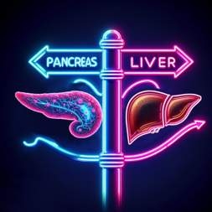
From Your Effluent 8,
Pick Your Filtered 4

Slide 90
From Your Filtered 4,
Pick Your Left & Right Kidneys
?
?
?
?

Slide 91
Crown your
NephMadness 2024
CHAMPION:

Slide 92
Thanks for playing & good luck!
Submit brackets by March 31, 2024, on Tourneytopia
Claim CME and MOC credit through NKF PERC by May 31, 2024
Discuss on social media using #NephMadness
Important Dates:
March 1, Friday (7:00 am Eastern): Bracket entry opens
March 31, Sunday (11:59 pm Eastern): Deadline for entering contest
April 2, Tuesday: Effluent 8 results
April 4, Thursday: Filtered 4 results
April 5, Friday: Left & Right Kidney results
April 8, Monday: NephMadness Champion crowned

