Slide 1
Bracketology
www.AJKDBlog.org
March 1-31, 2025

Slide 2

Slides Prepared by the
NephMadness Executive Committee
Matthew Sparks
Anna Burgner
Anna Vinnikova
Elena Cervantes
Jeffrey Kott
Ana Catalina Alvarez-Elías
Dia Waguespack
Krithika Mohan

Slide 3
What to do
Review the Regions & Teams on AJKDBlog
Submit your picks by March 31, 2025, on Tourneytopia
Discuss on social media using #NephMadness
Claim CME/MOC credit through NKF PERC

Slide 4

The BRP Has Chosen the Winning Bracket
To win, predict what the BRP thinks will bring the most practice change to nephrology!
Roger Rodby
Deidra Crew
Kirk Campbell
Samira Farouk
Tom Oates
Meredith Atkinson
Linnys Alcántara Quiroga
Clodagh Sweeney
David Rush

Slide 5
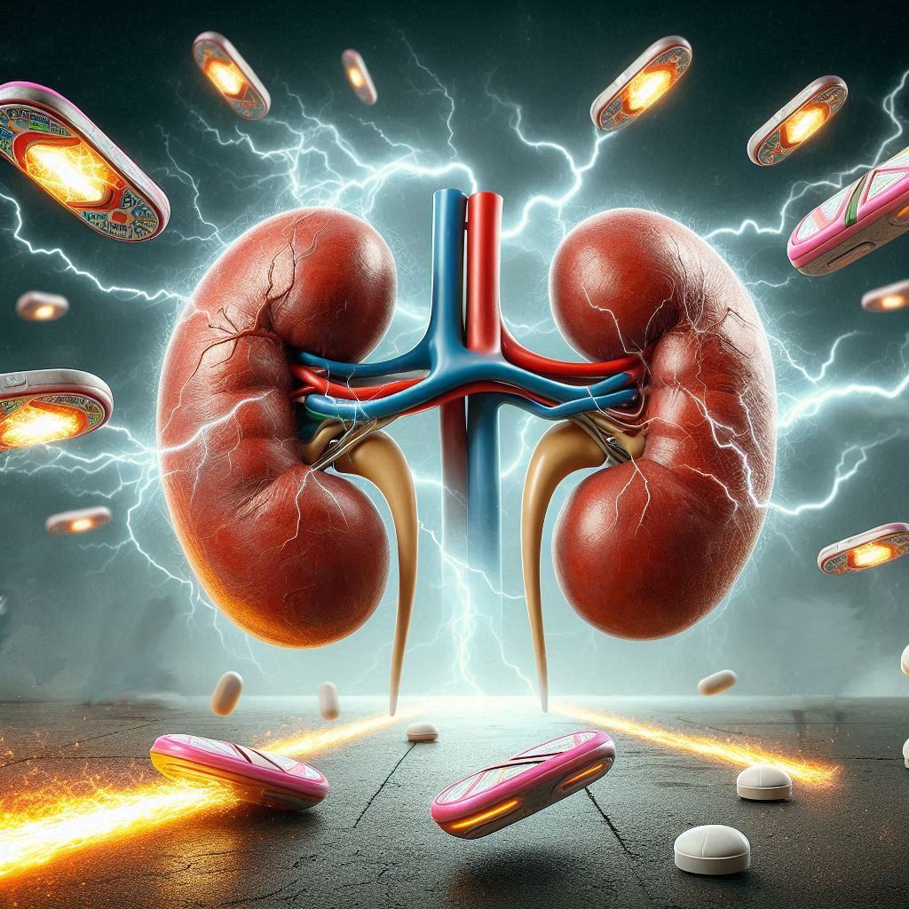
Resistant Hypertension
Writer:
Stephanie Torres Rodriguez
Expert:
Jordana Cohen
Region Execs:
Matthew Sparks
Elena Cervantes

Slide 6
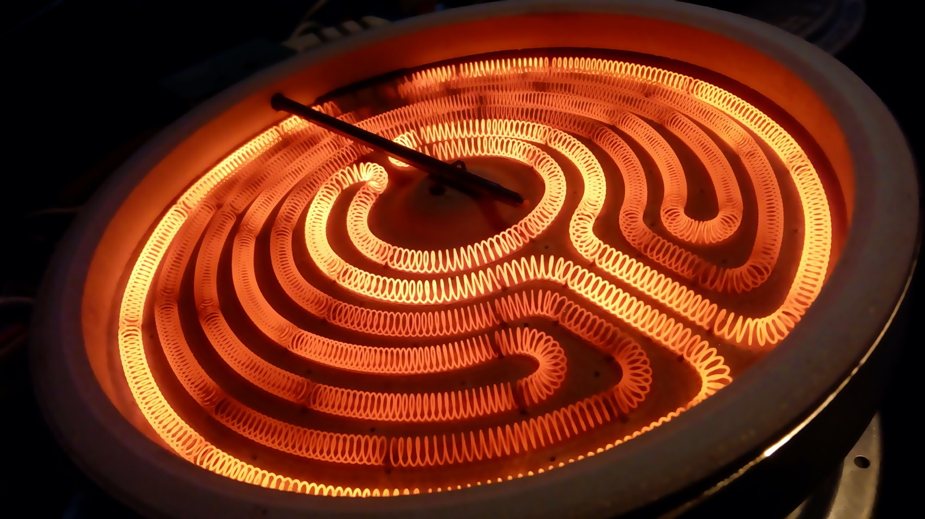
Novel Drugs for Hypertension

Slide 7
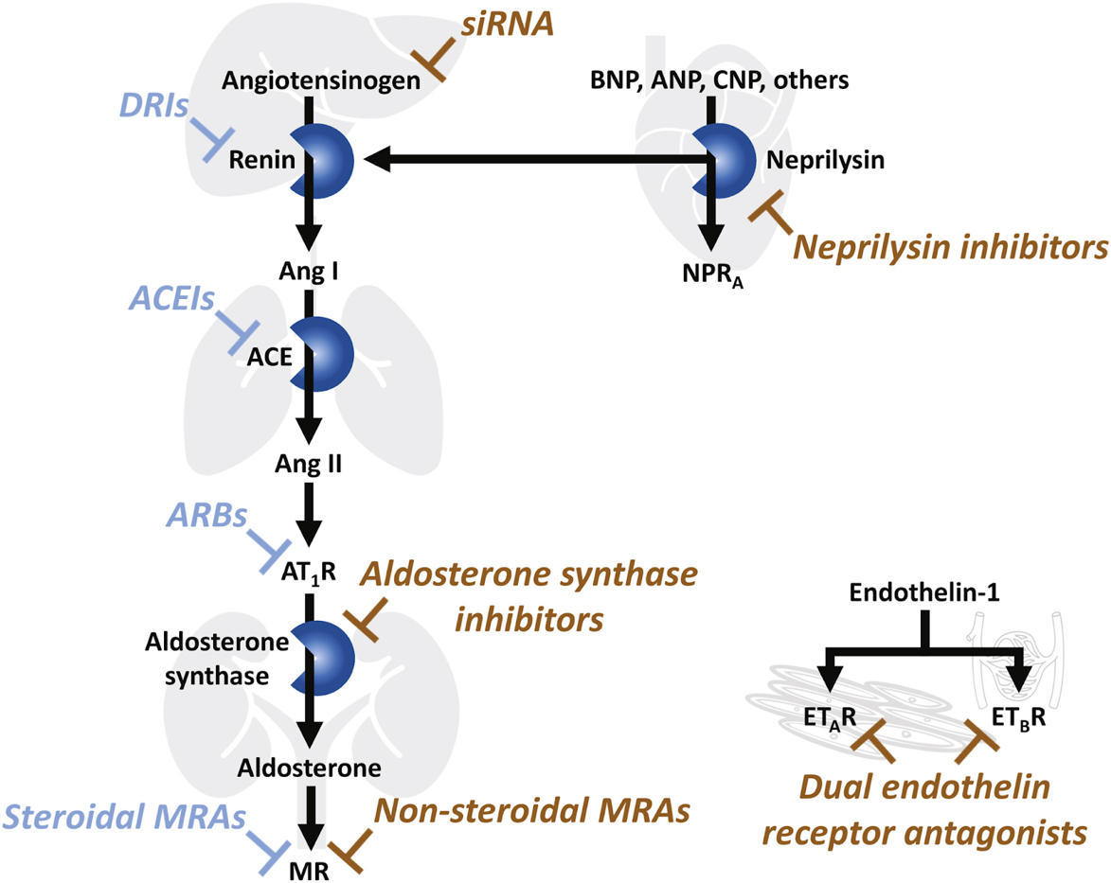
Novel Drugs for Hypertension
Definition​
Blood pressure remains above goal despite concurrent use of ≥3 anti-hypertensive agents of different classes​
If tolerated – one of the agents should be a diuretic
All agents should be prescribed at maximum recommended (or maximally tolerated) anti-hypertensive doses​
OR​
Blood pressure controlled with ≥4 medications – also is considered resistant​
Evaluate for other contributors to hypertension
Untreated obstructive sleep apnea​
Hormone dysregulation​
Hyperaldosteronism​
Thyroid disease (hypo/hyperthyroidism)​
Pheochromocytoma / paraganglioma​
Hypercortisolism (Cushing syndrome)​
Apparent mineralocorticoid excess​
Volume overload​
Aortic coarctation​
Renal artery stenosis​
Fibromuscular muscular dysplasia – 10-25% of RAS​
Atherosclerotic disease

Slide 8
Novel Drugs for Hypertension
Dual endothelin receptor antagonist: aprocitentan
Aldosterone synthase (CYP11B2) inhibitor: baxdrostat & lorundrostat
Small interfering RNA (siRNA) for angiotensinogen: zilebesiran
Glucagon-like peptide-1 receptor agonist (GLP-1 RA): semaglutide
Route
~4 mmHg
~10 mmHg
~4 mmHg
~5 mmHg anti-HTN meds
BP
Effect
Adverse effects
FDA Approved
~10-15% fluid retention
~2% hyperkalemia
~6-7% hyperkalemia
~10% injection site reaction
~30% nausea
~10% diarrhea
PO Daily
PO Daily
SQ q 6 months
SQ q week
BP
Effect
Adverse effects
BP
Effect
Adverse effects
BP
Effect
FDA Approved
Adverse effects

Slide 9
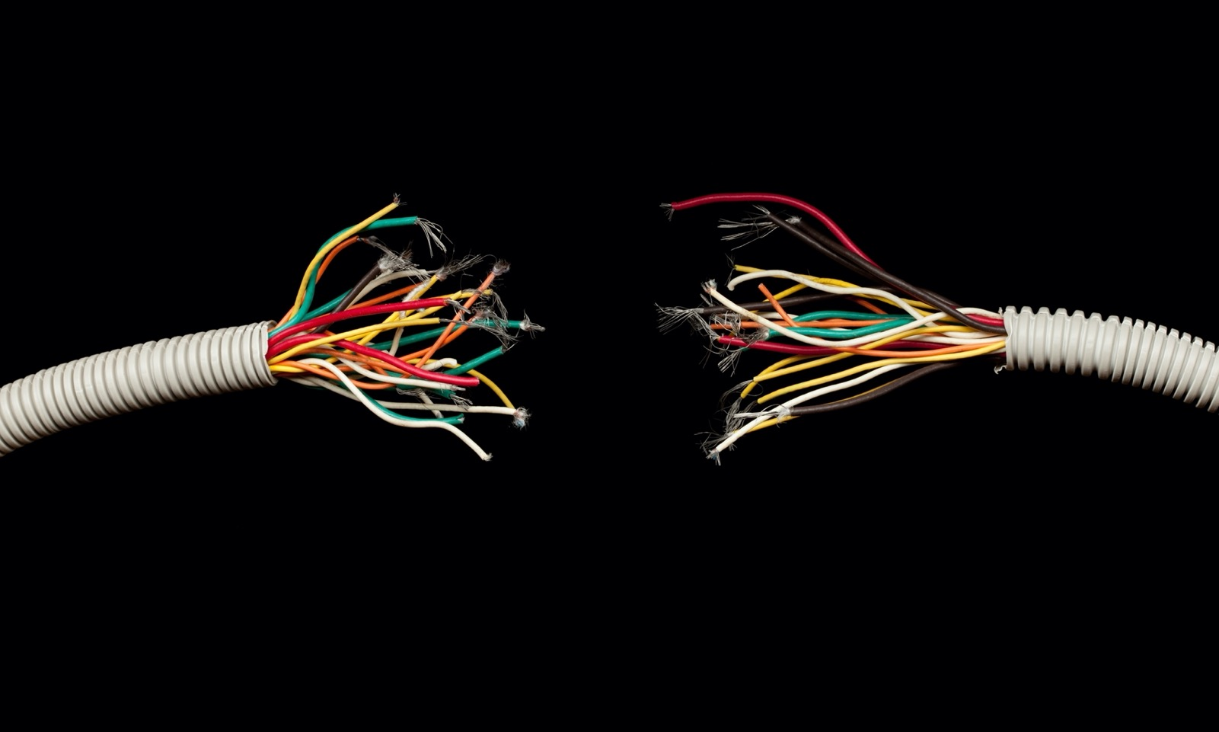
Renal Denervation

Slide 10
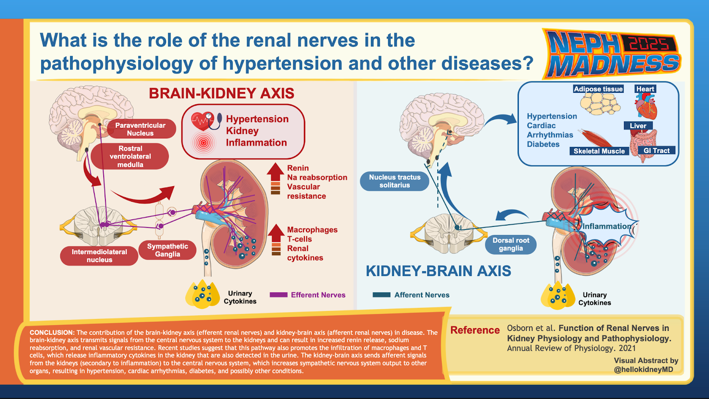

Slide 11
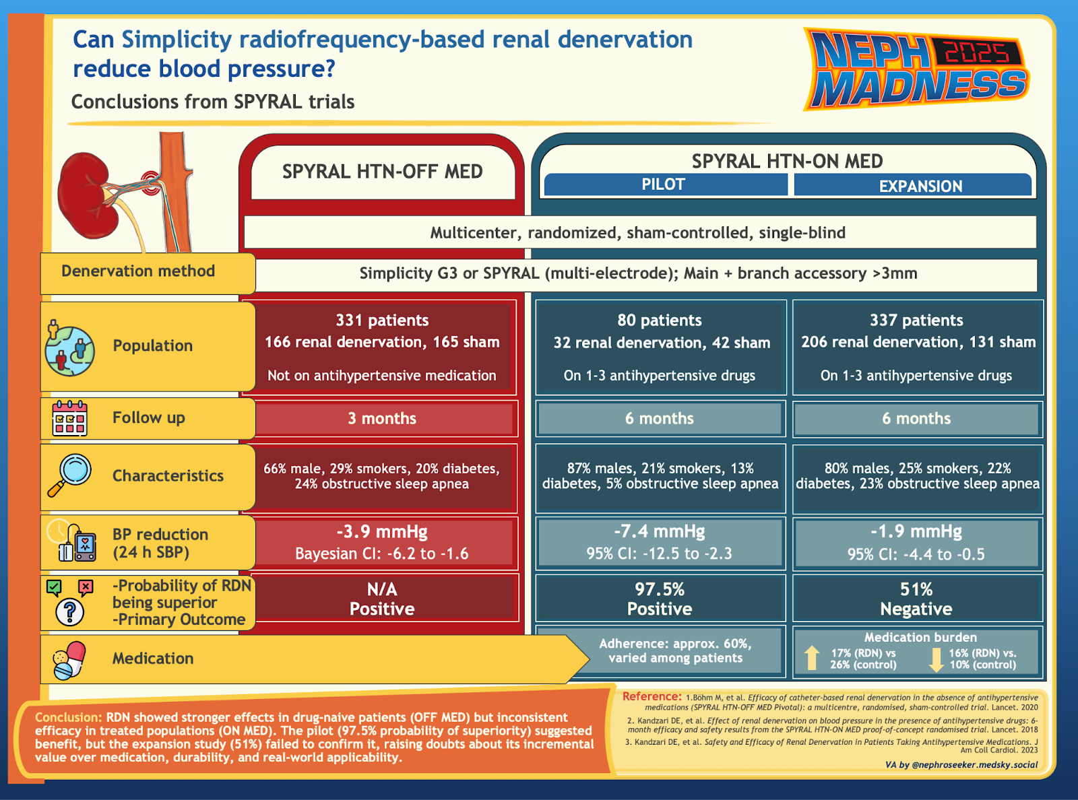

Slide 12
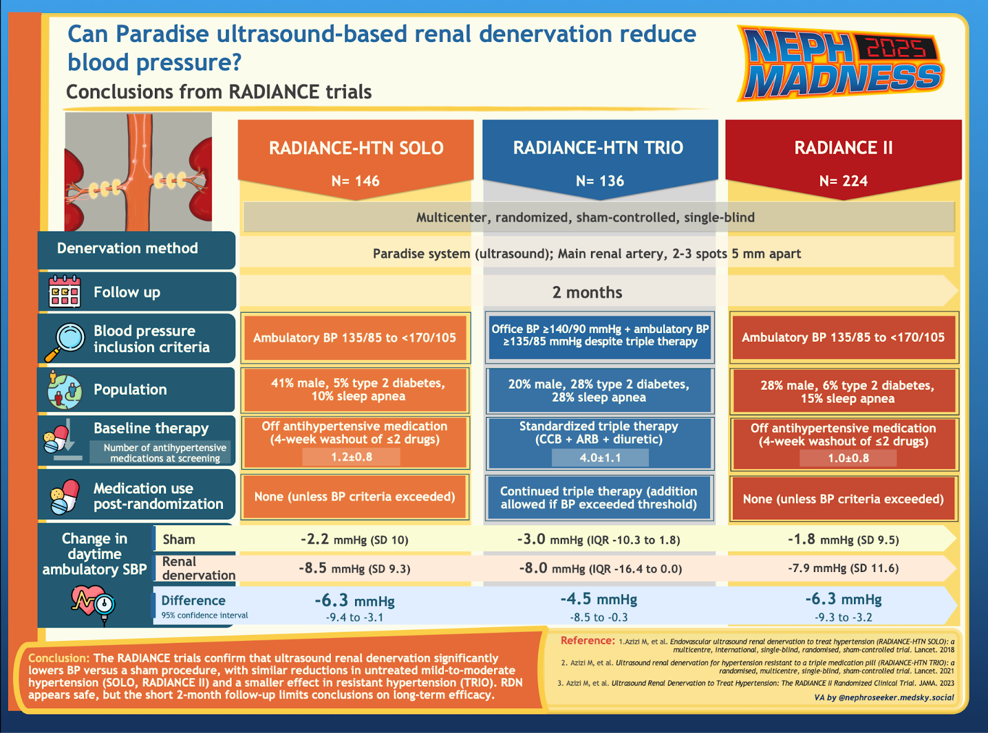

Slide 13

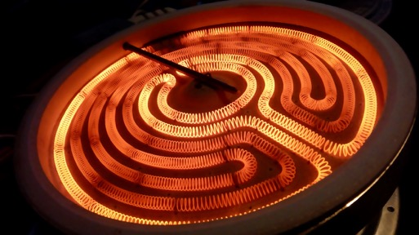

EFFLUENT EIGHT ROUND
Pick Your Champion for the Resistant Hypertension Region
vs
Novel Rx for HTN
Renal Denervation

Slide 14

Disaster Nephrology
Writer:
Rasha Raslan
Expert:
Mehmet S Sever
Region Execs:
Anna Vinnikova
Ana Catalina Alvarez-Elías

Slide 15
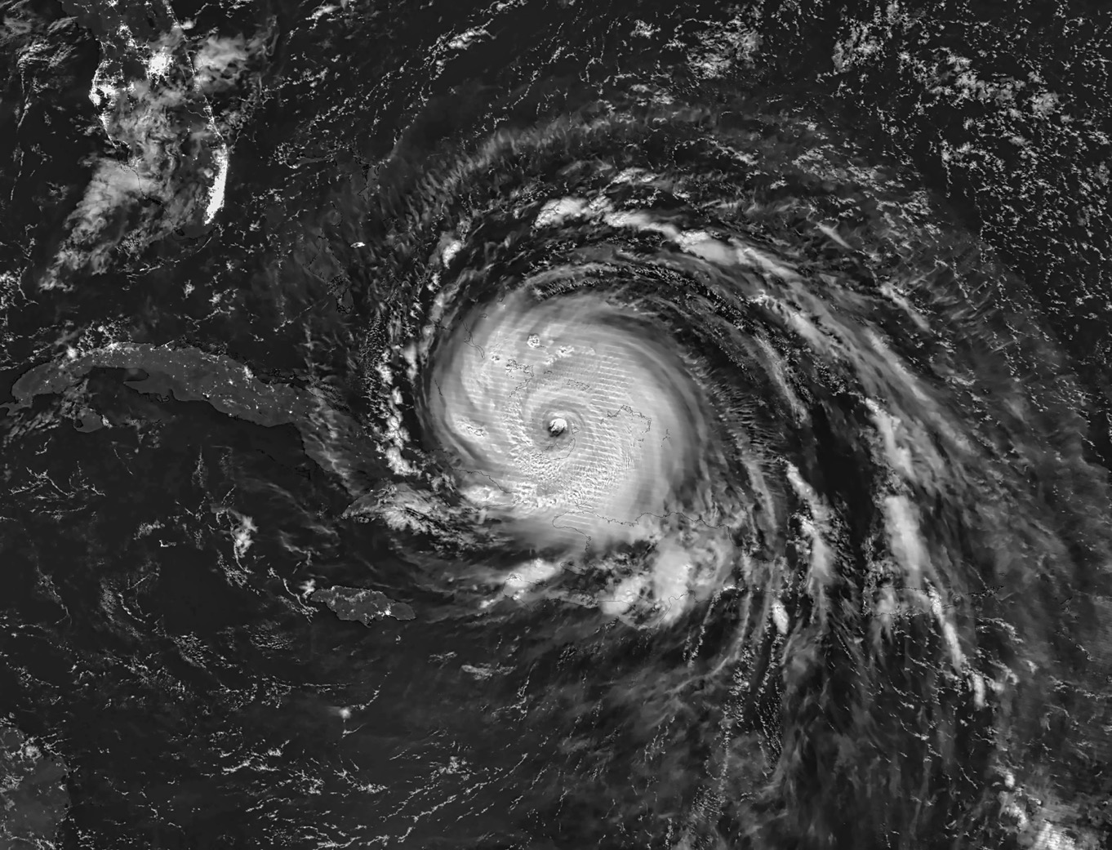
Kidney Care In Natural Disasters

Slide 16
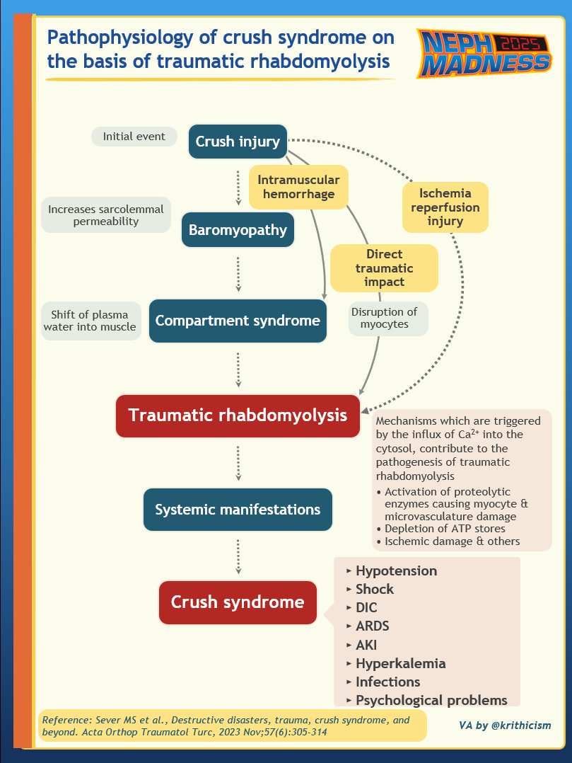
Disaster Nephrology and Crush-AKI
Disaster Nephrology is a specialized field focused on coordination of care of kidney patients during a disaster. The term evolved from the earlier “Seismo-Nephrology” dedicated to managing Crush-AKI.
AKI from crush injury was first recognized during World War 1.
World War II saw the introduction of the artificial kidney by Kolff and the first ever HD treatment.

Slide 17
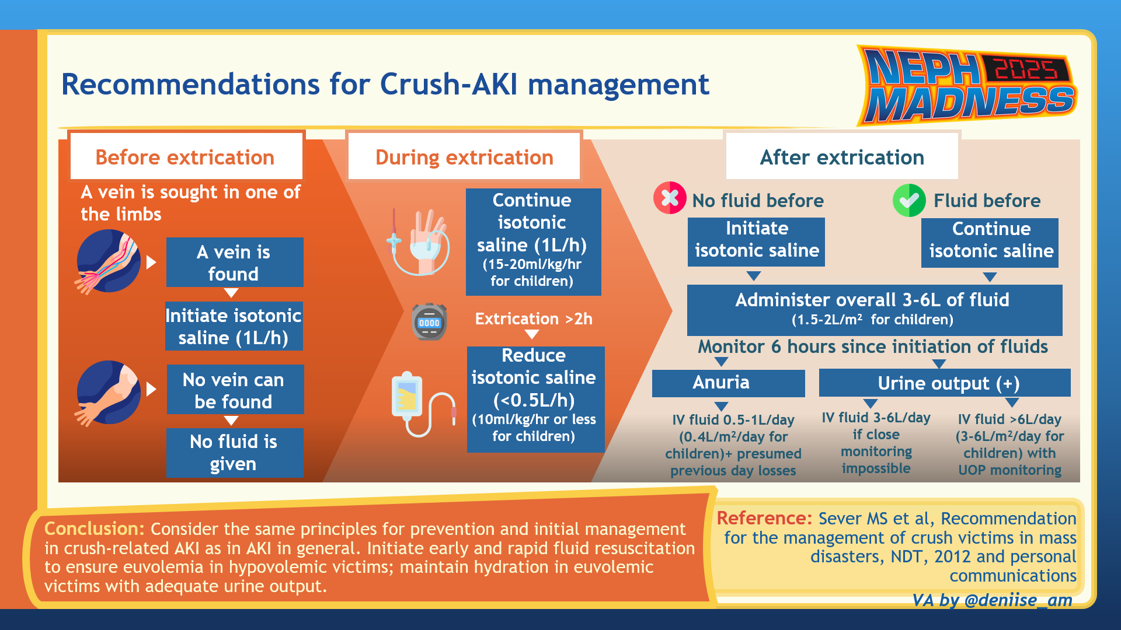

Slide 18

Kidney Impact in Natural Disasters
ACUTE KIDNEY INJURY
CKD AND ESKD
TRANSPLANT
Prerenal AKI in entrapped or bleeding victims
ATN from prolonged shock, sepsis, and transfusion reactions
Rhabdomyolysis and crush syndrome in crush victims
Loss of access to medications
Emergency disconnects from HD
Complications from missed dialysis treatments
Power and water outages
Issues with supplies delivery
Disruption of transplant activities
Loss of access to medications
Increased infectious complications

Slide 19
Kidney Care in Natural Disasters
BEFORE
DURING
AFTER
Patients:
Practice HD emergency disconnect procedures, PD manual exchanges
Emergency kits
Stockpile medications and supplies for 1-2 weeks
Dialysis facility:
Develop disaster protocols
Contracts for generators and water tankers
Disaster preparedness training
Tabletop drills
Follow protocols
Rapid triage and evacuations
Telemedicine
Arrange generators, water tankers as needed
Communication with disaster relief authorities
Re-establish care of neglected conditions
Mental healthcare for patients and staff
Evaluate disaster response, debrief, lessons learned

Slide 20

Kidney Care In Conflicts

Slide 21
Kidney Impact in Conflicts
ACUTE KIDNEY INJURY
CHRONIC KIDNEY DISEASE
TRANSPLANT
High AKI burden (hard to quantify)
Pre-renal is the most common due to dehydration or hemorrhagic shock
Nephrotoxic exposure to noxious gases and toxic agents
Limited evaluation
Difficulty with dietary and medication adherence
Poor access to treatment and supplies
Degradation of specialized care
Inability to create longer term vascular access like fistulas
Poor functionality of transplant facilities or access to specialist
Increased risk of rejection due to poor access to medications

Slide 22
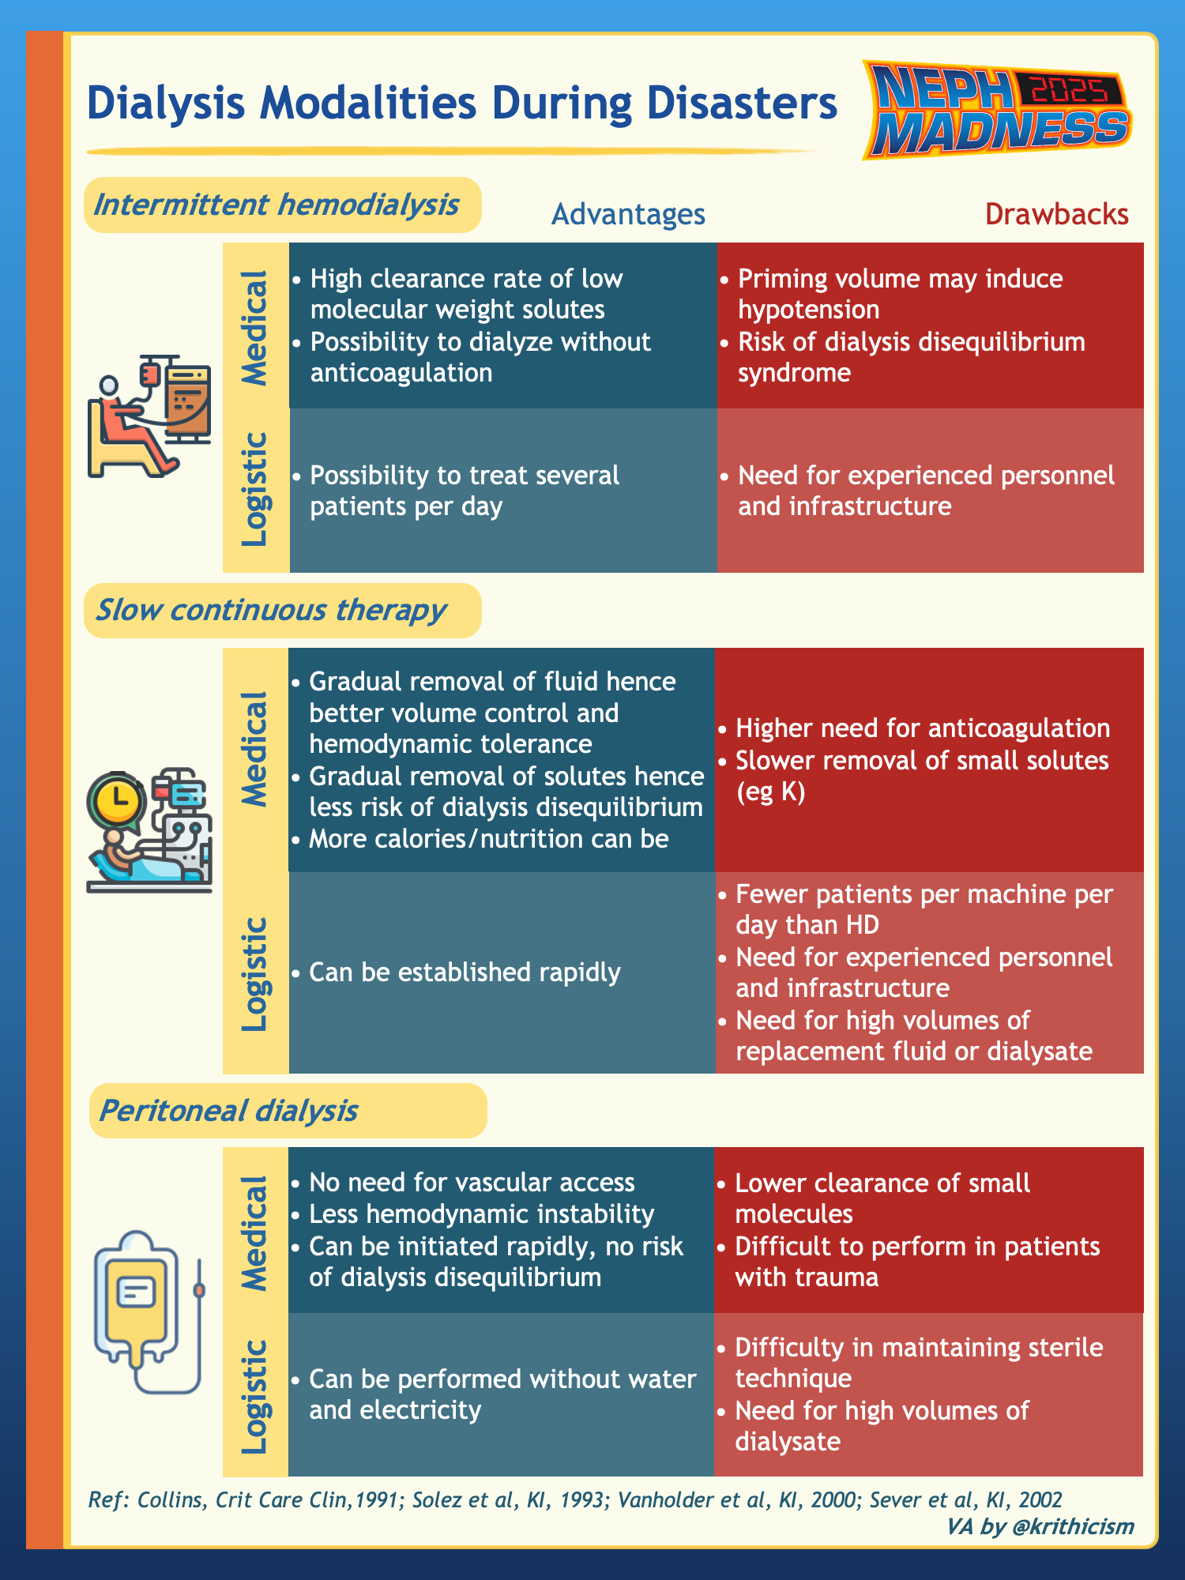
Kidney Care in Conflicts
BEFORE
DURING
AFTER
Training patients and staff on self-security issues
Training on best practices in resource-limited setting
Medication stockpiling
Training patients on emergency dietary restrictions
Field hospitals
Evacuations
Telemedicine
Rotating schedule for staff
Restoration of services
Address mental health
Debriefing

Slide 23

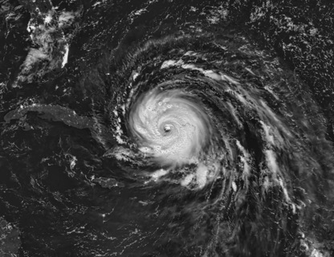

EFFLUENT EIGHT ROUND
Pick Your Champion for the Disaster Nephrology Region
vs
In Natural Disasters
In Conflicts

Slide 24

Genetics
Writer:
Matthew Gross
Expert:
Jordan Nestor
Region Execs:
Elena Cervantes
Matthew Sparks

Slide 25
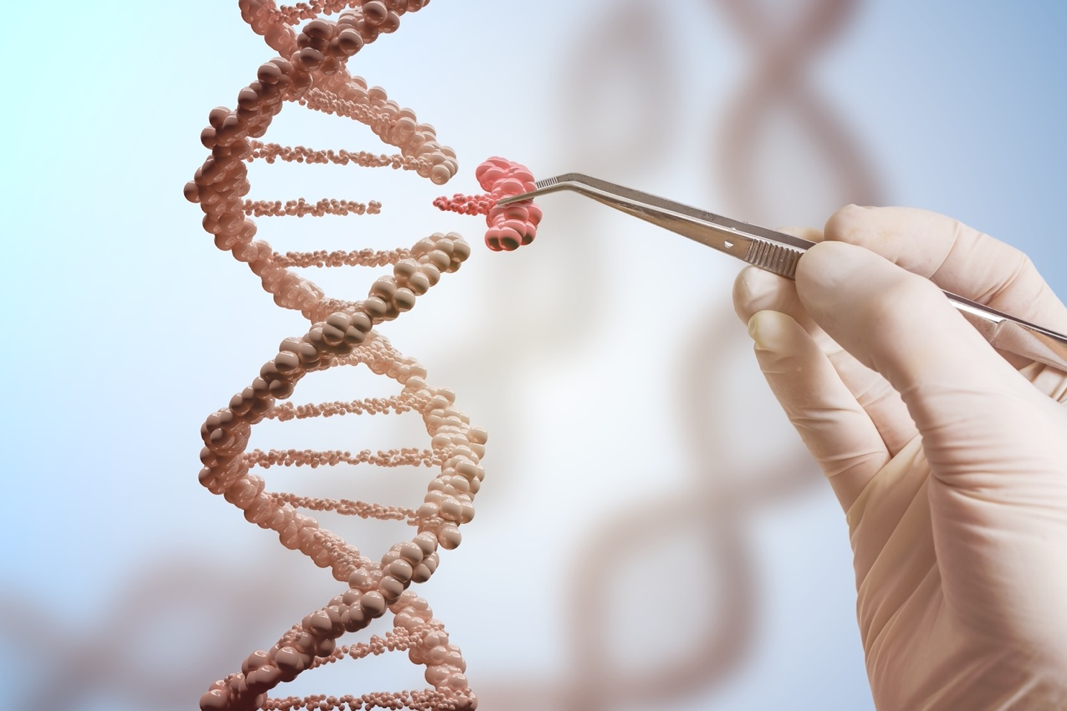
Genetics in FSGS

Slide 26
Genetics in FSGS
The following are the most common genes with mutations known to cause genetic FSGS:
Gene(s) | Function & Role | Inheritance Pattern | Clinical Significance
NPHS1 & NPHS2 | Podocyte signaling and slit diaphragm formation | Autosomal recessive | Early-onset disease, including nephrotic syndrome of the Finnish type
COL4A3/4/5 | Form a heterotrimer essential for basement membrane structure in glomerulus, cochlea, and eye | Variable in Alport’s: X-linked (COL4A5, most common), Autosomal recessive or dominant (COL4A3/A4) | Associated with Alport syndrome, thin basement membrane disease, hereditary FSGS, and auditory/ocular involvement
APOL1 (G1 & G2 risk alleles) | Lipid metabolism, apoptosis, immune regulation Innate immunity against Trypanosoma brucei, the parasite responsible for African sleeping sickness | APOL 1 G1 and G2 alleles - autosomal recessive A secondary trigger (infection, obesity, etc.) is required to have the disease | Linked to increased FSGS risk Inaxaplin, an APOL1 channel inhibitor, reduced proteinuria by 48% in Phase 2a trials; currently in Phase 3 trials
ACTN4, TRPC6, INF2 | Regulate actin dynamics and calcium influx in podocytes | Autosomal dominant | Cause hereditary FSGS, typically via gain-of-function mutations

Slide 27
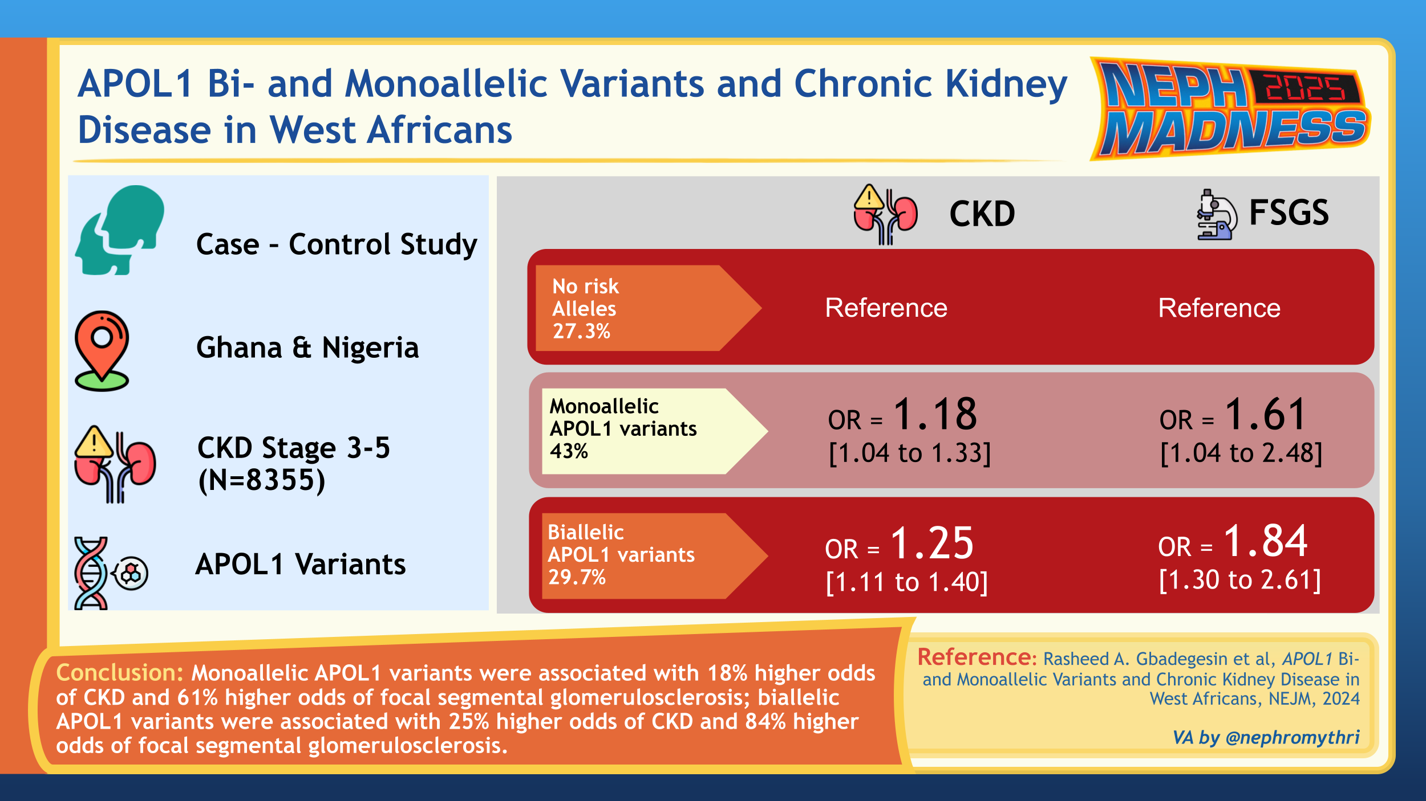

Slide 28
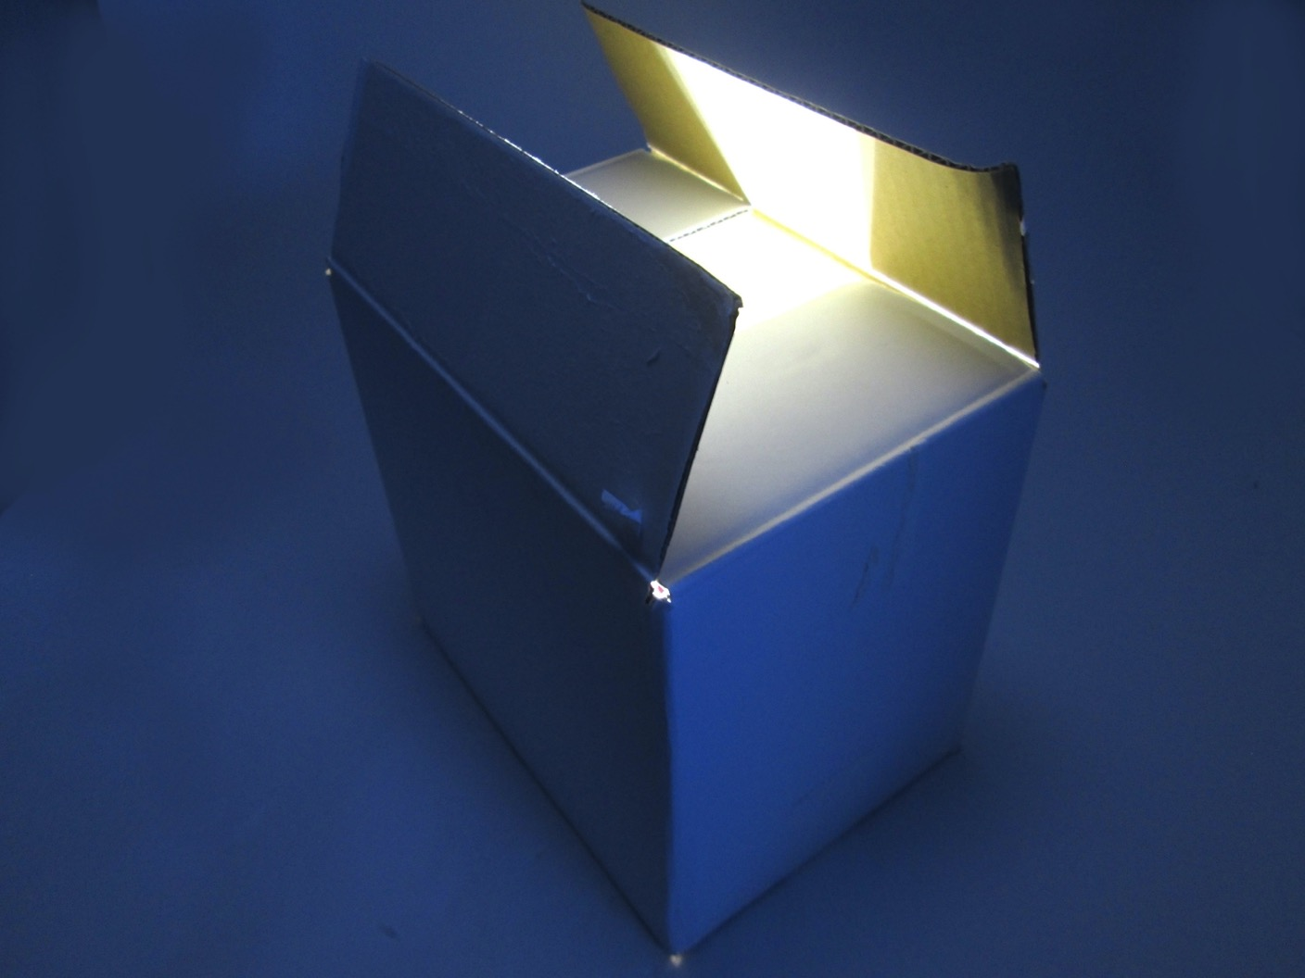
Genetic Counseling

Slide 29

Genetic Counseling
Purpose of Genetic Testing: It helps diagnose genetic kidney disease, assess risks in kidney donors, inform at-risk family members, and guide personalized treatments (i.e. post hoc analysis of the DUPLEX trial showed more proteinuria reduction with sparsentan vs irbesartan in genetic FSGS).
Testing Modalities: There are several, but curated gene panels/targeted next-generation sequencing (NGS) - which assesses for specific sets of genes- is our go-to tool in clinical practice! Whole exome sequencing (WES) analyzes the entire exome and is used in research or in patients from whom NGS was non-diagnostic.
Informed Consent Considerations: Patients should understand potential test implications, such as:
Kidney Donation and Genetic Testing: Genetic screening can be considered in living kidney donors- testing in ADPKD can be high yield while identifying APOL1 variants remains a complex issue.
Genetic Counselors: They assist in interpreting results, managing emotional and social impacts,
and guiding cascade testing for at-risk family members.
Findings & Clinical Impact | They may or may not change clinical management Variants of Unknown Significance can create anxiety in the patient and family
Additional Tests | May be required based on results
Costs | Insurance coverage varies depending on the specific test and patient scenario.
Risk of Discrimination | GINA protects against genetic discrimination in health insurance and employment, BUT it does not cover disability, life, or long-term care insurance, nor does it apply to military personnel!

Slide 30
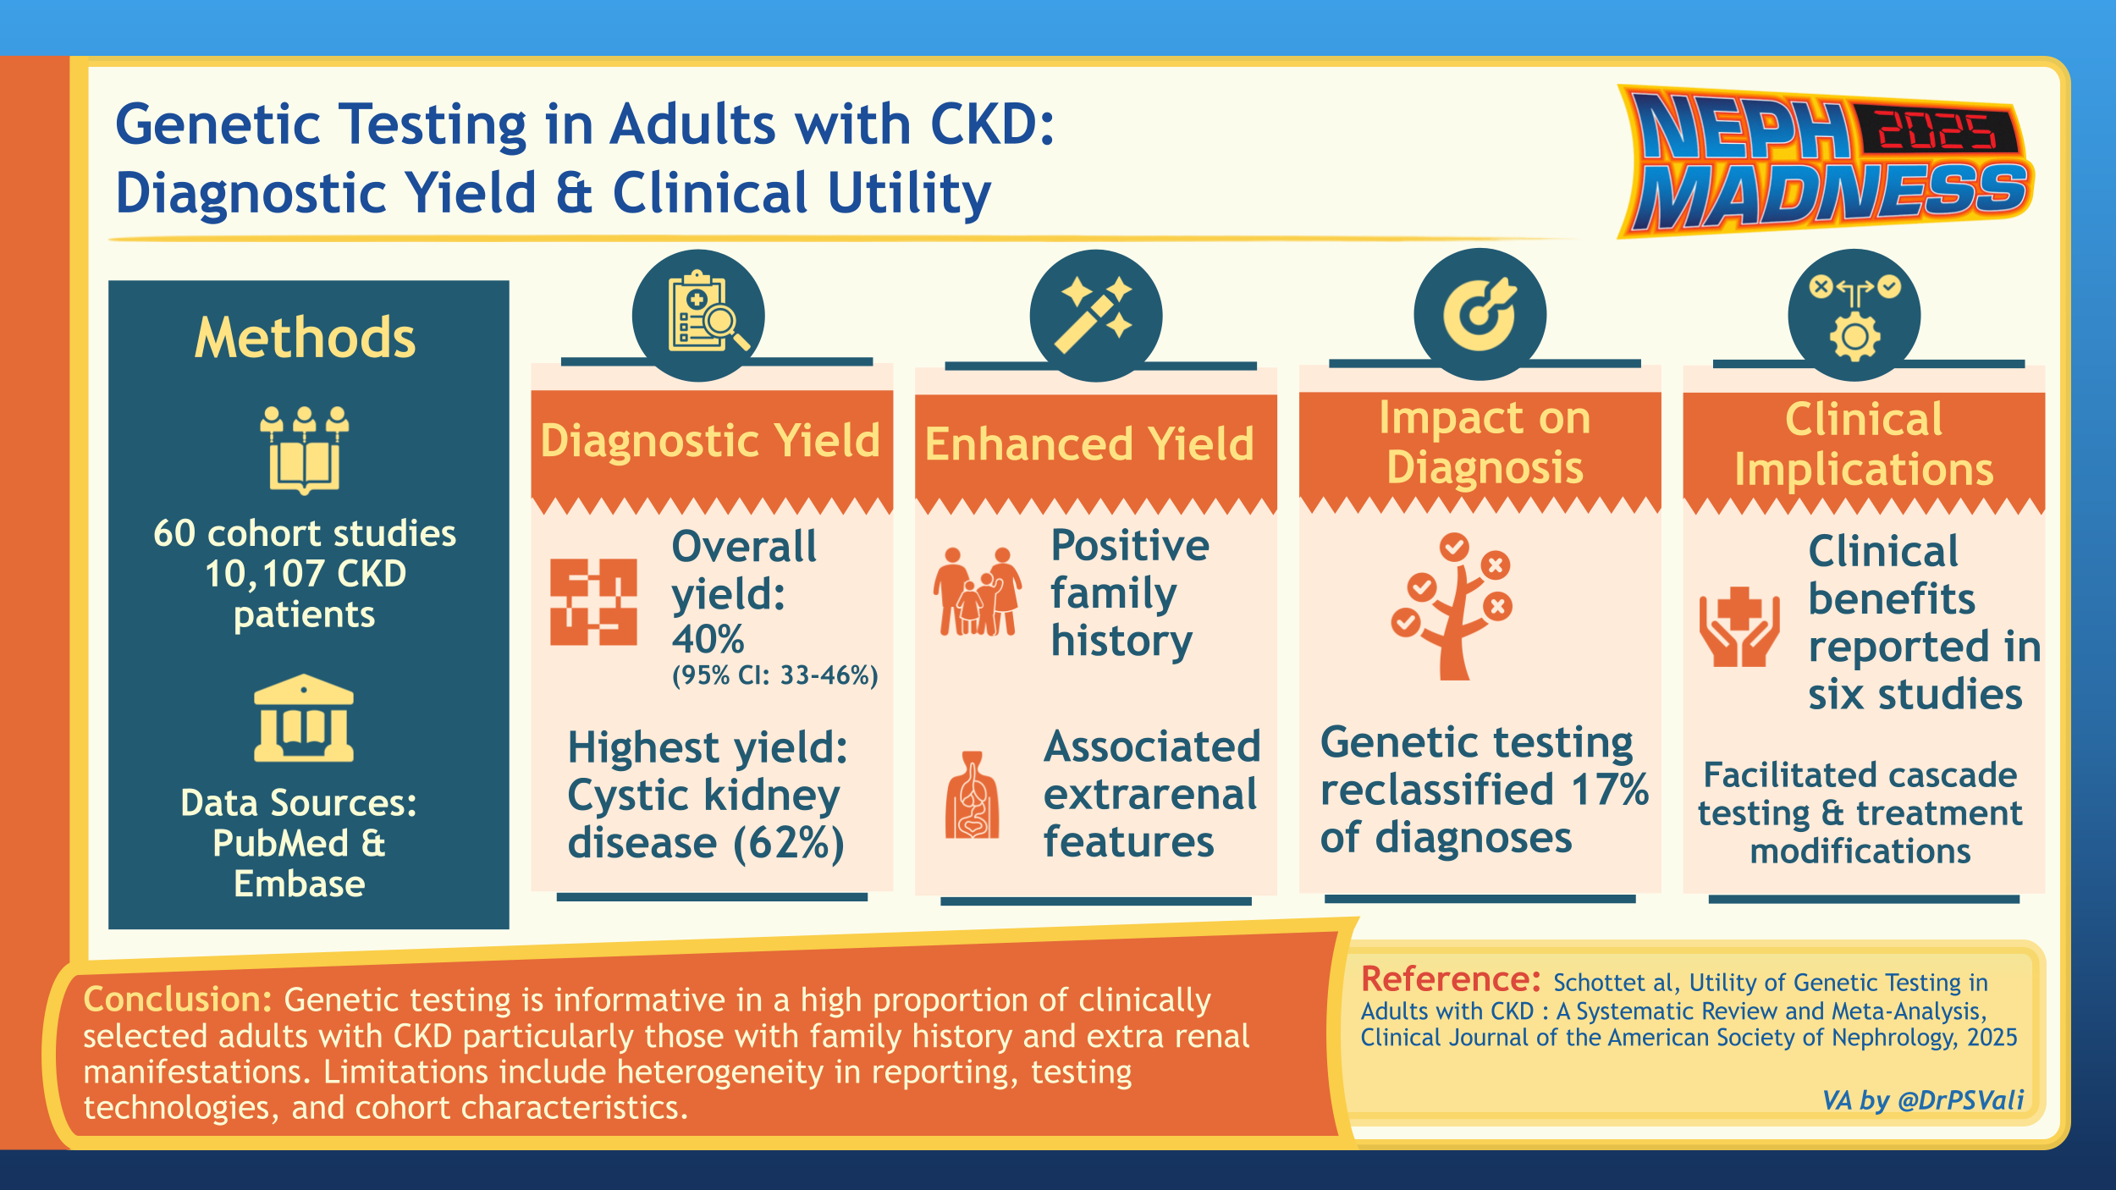

Slide 31



EFFLUENT EIGHT ROUND
Pick Your Champion for the Genetics Region
vs
Genetics in FSGS
Genetic Counseling

Slide 32
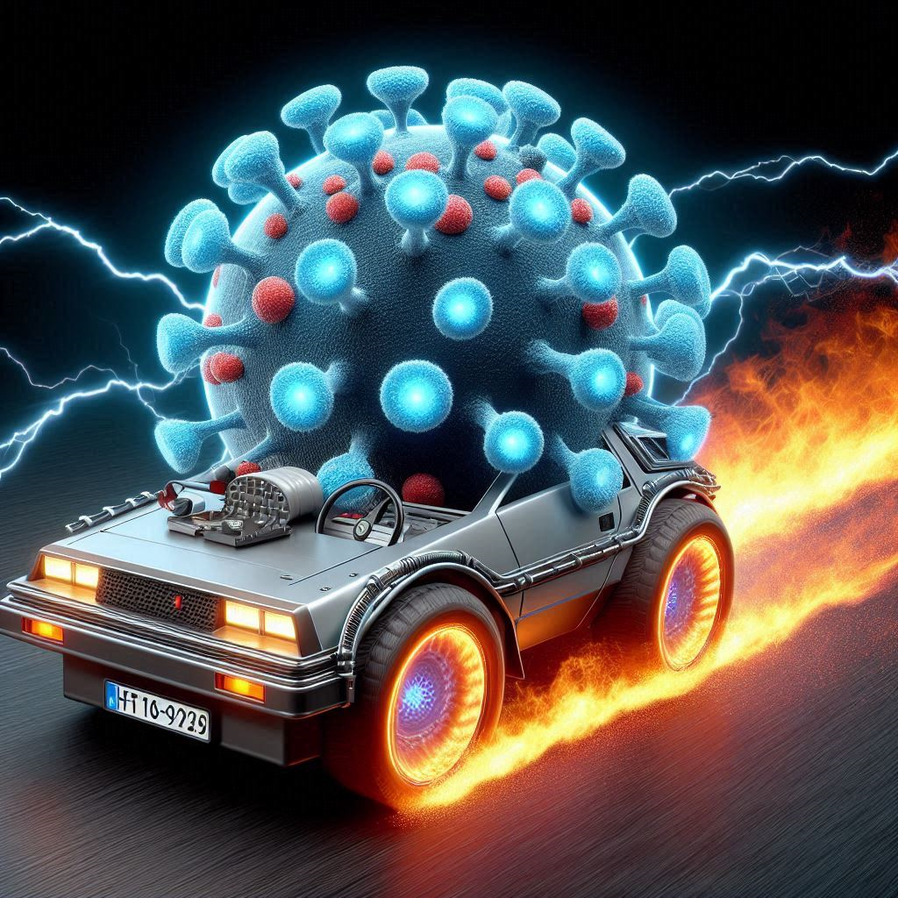
CAR-T for Kidney Disease
Writer:
Yara Mouawad
Expert:
Jeffrey Sparks
Region Execs:
Dia Waguespack
Anna Burgner

Slide 33

CAR-T for Autoimmune Disease

Slide 34

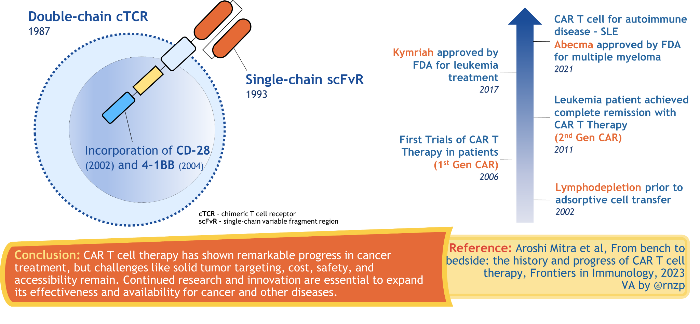
From Idea to Impact: The CAR-T Cell Journey

Slide 35

CAR-T Cell Therapy for Autoimmune Diseases
Why?
How?
Autoantibodies are directly pathogenic in select autoimmune diseases.
Targeting B-cells has proven effective.
  However, persistent B-cell infiltrates in tissue.
Based on success in cancer therapies, use expanded to autoimmune disease.
Murine model of lupus:
  Effective depletion of CD19 B-cells in inflamed tissue → decreased Ab targeting dsDNA, decreased proteinuria, and increased survival.
T-cells are collected from patients through apheresis.
CD19 CAR T-cells are generated through lentiviral transduction of the CAR encoding vector.
Cells expanded using cytokine cocktail.
Patient receive lymphodepleting chemotherapy:
  Cyclophosphamide and fludarabine
More targeted strategies (e.g. Treg in development).
NEJM 2024: Case series, 15 patients with refractory autoimmune dz (8 with SLE). Followed ~15 months. Demonstrated rapid expansion of CAR T cells and effective B cell depletion, most with B cell reconstitution at 100 days. Remained in remission off immunosuppression
*Limitations: open label, single arm small number of patients, no kidney biopsies

Slide 36

CAR-T Side Effects

Slide 37

CAR-T Cell Therapy - Side Effects and Potential Limitations
Short Term Side Effects
Long Term Side Effects
Cytokine release syndrome (CRS):
  Result of T-cell activation and cytokine release
  Severity of reaction varies.
    Symptoms: fever, respiratory failure, hypotension, possible progression to multiorgan failure, death
Immune cell associated neurotoxicity syndrome (ICANS):
  Mechanism not understood.
  Severity of reaction varies.
    Symptoms: confusion, aphasia, seizure, coma
  Supportive treatment with steroids
Cytopenias
Hypogammaglobulinemia
Infections
  Potentially impaired response to vaccinations
Malignancies
  Due to insertional mutagenesis
  Risk of T-cell malignancies appears to be lower than those undergoing traditional chemotherapy.
  Require lifelong monitoring.
The small number of patients treated with CAR T-Cells for autoimmune dz, severe toxicities have thus far been rare.
Accessibility is limited by cost, limited treatment centers, eligibility restrictions and logistical challenges.

Slide 38

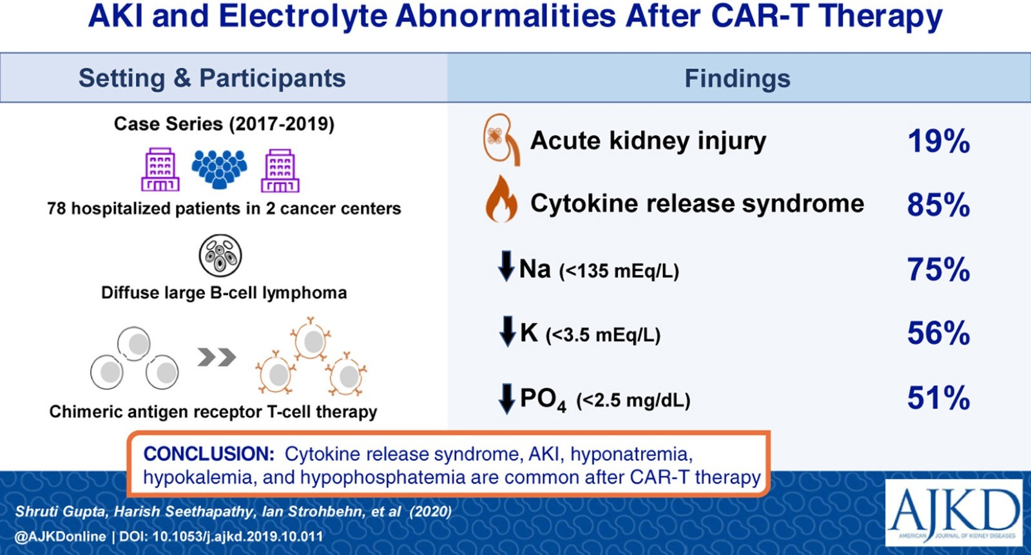
Kidney Related Considerations

Slide 39



EFFLUENT EIGHT ROUND
Pick Your Champion for the CAR-T for Kidney Dz Region
vs
CAR-T for Autoimmune Dz
CAR-T Side Effects

Slide 40
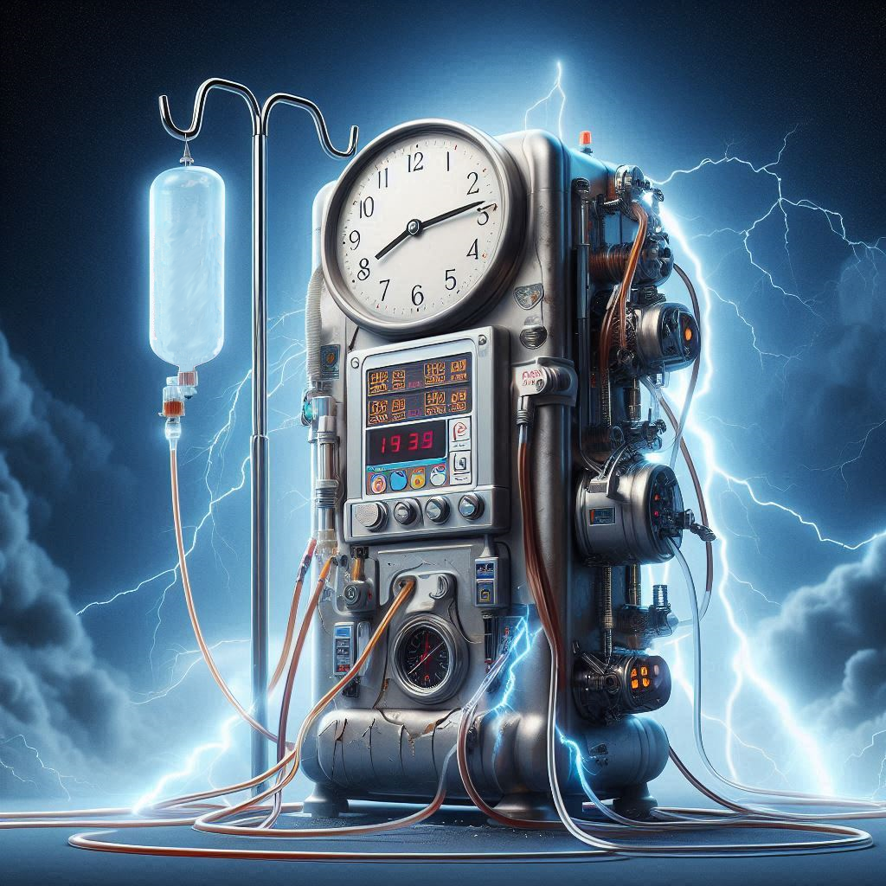
Hemodialysis
Writer:
Mansi Bapat
Expert:
Mariana Murea
Region Execs:
Jeffrey Kott
Anna Burgner

Slide 41

Hemodiafiltration

Slide 42
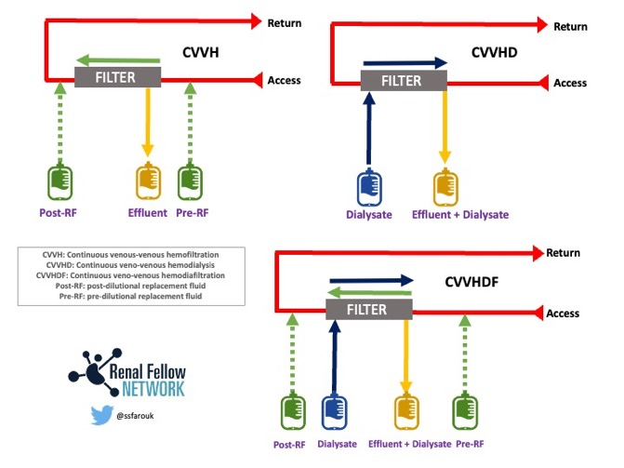
Hemodiafiltration
5 Randomized Controlled Trials have been been completed with varying results with respect to all-cause, cardiovascular, or infection related mortality
Peters et. al., a meta-analysis of 4 RCTs (not including the Convince Trial) demonstrated a 14% reduction in all-cause mortality and a 23% reduction in CV mortality compared to HD, especially those who received higher convections volumes
          Long term follow up of the patients from 4 RCTs demonstrated stable Left Ventricular Mass and Ejection Fraction in the groups that received HDF compared to Hemodialysis
There may be some evidence that HDF is cost effective, however the Quality-Adjusted Life Year (QALY), a measurement of patient’s quality and quantity of life is limited, and further research is needed.
In addition to cost effectiveness, there are several questions that remain to be answered regarding HDF
  While preliminary data has demonstrated higher convection volumes may be beneficial, no direct head-to-head trial has compared the two approaches.
  No studies have focused on individuals that have not yet started Kidney Replacement Therapy. The ideal convective volume remains unclear in this population.
Hemodiafiltration (HDF) combines diffusive with convective clearance to improve clearance of larger molecular weight molecules including certain proteins/uremic toxins (i.e. FGF-23, Advanced Glycation Endproducts) that contribute to increased cardiovascular (CV) mortality and impaired immune function in patients undergoing chronic dialysis.
HDF not only uses dialysate but replacement fluid which is infused into the patient to replace the large volume of plasma water removed through ultrafiltration.

Slide 43
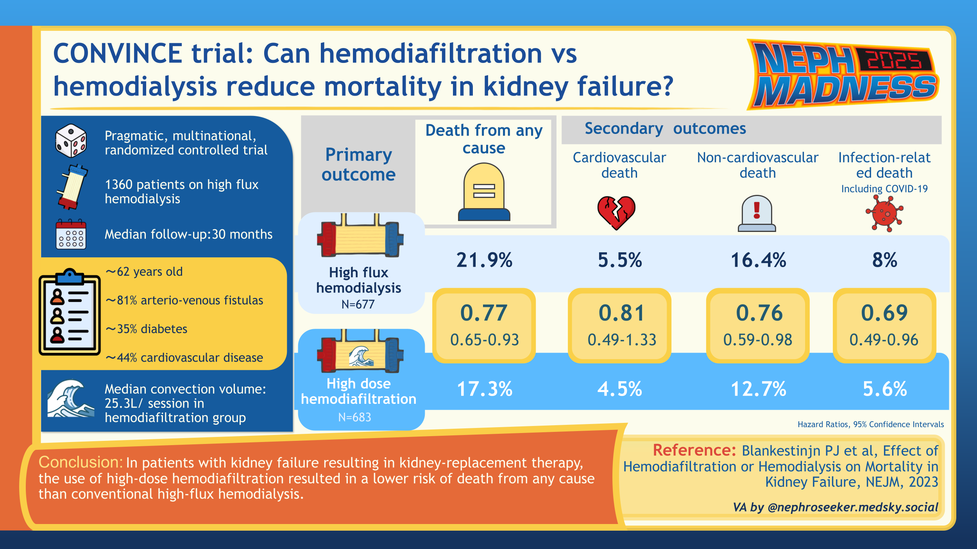

Slide 44

Incremental Dialysis

Slide 45
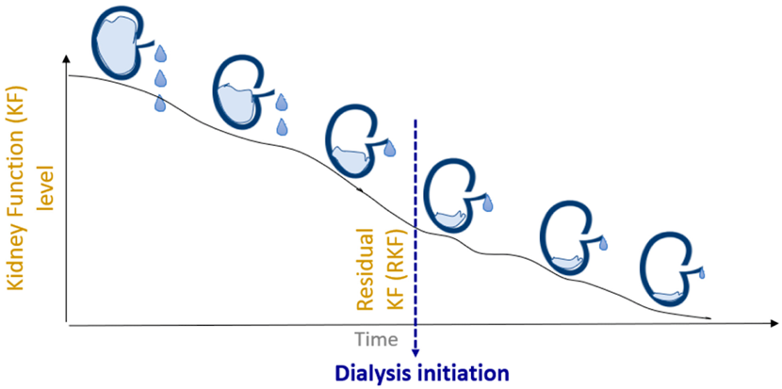
Incremental Dialysis
Incremental Hemodialysis (HD) involves adjusting the frequency or duration of a patient’s hemodialysis prescription based on their biology and symptoms and is a patient centered approach to HD compared to the traditional 3x weekly HD.
That is in contrast with Peritoneal dialysis, where residual kidney function (RKF) is factored into a patients ”dose” (Kt/V), HD prescriptions usually target a Kt/V of 1.2, not taking RKF into account.
What challenges exist? And how can we overcome them?
Uncertainty regarding patient adherence and expectations related to incremental changes in HD prescriptions.
  Repeated Patient Education
Increased workload for nephrologists and dialysis staff, who must monitor patient parameters more frequently and closely.
  Automating RKF measurement and substitution of additional care typically dedicated to HD to monitoring of RKF
Potential for reduced financial margins for dialysis stakeholders due to fewer overall HD treatments and lower financial reimbursements.
  Potentially longer patient lifespans could ultimately lead to more dialysis treatments.
Feasibility Trials have demonstrated incremental dialysis is both feasible and safe, however larger scale, randomized trials are needed
The decline in RKF differs based on the individual, and incremental dialysis would take into account the need for a higher dose of dialysis.

Slide 46
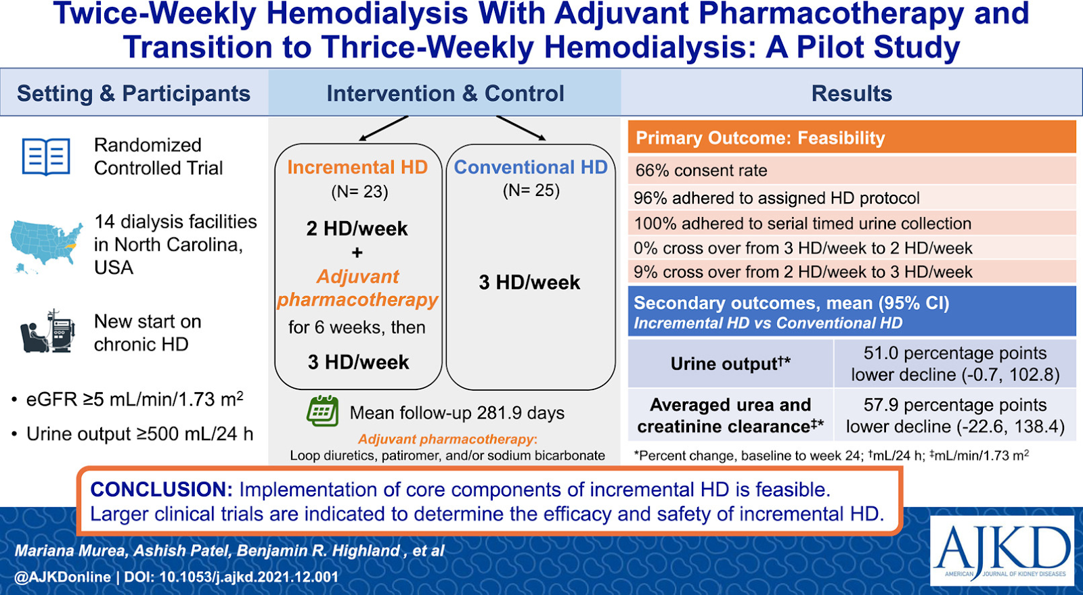

Slide 47
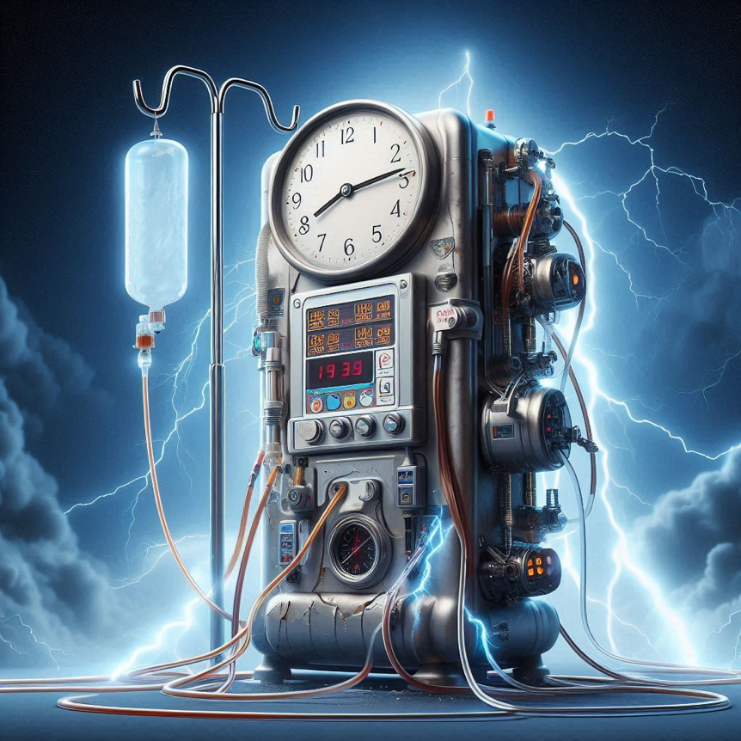


EFFLUENT EIGHT ROUND
Pick Your Champion for the Hemodialysis Region
vs
Hemodiafiltration
Incremental Dialysis

Slide 48

Green House
Writers:
Ethan Downes
Rachel Kahn
Expert:
Linda Awdishu
Region Execs:
Anna Vinnikova
Elena Cervantes

Slide 49

Tubular Toxins

Slide 50

Tubular Toxins
Why?
How?
80% of patients in the world use herbal medicines (HMs).
8% of patients with CKD use HMs on NKF “avoid in CKD” list.
HMs are not regulated or assessed for safety and efficacy.
FDA can remove supplements only if there’s proof of harm/deceptive labeling.
HMs can hurt kidneys:
Nephrotoxicity
      Contamination
      Adulteration
    Misidentification
              Drug interactions (i.e. with immunosuppressants)
Kidneys are ‘terrific’ toxin targets
Major site of drug excretion
Large volume of blood processed
Renal tubular epithelium has broad surface area and high metabolic activity relative to blood supply

Slide 51
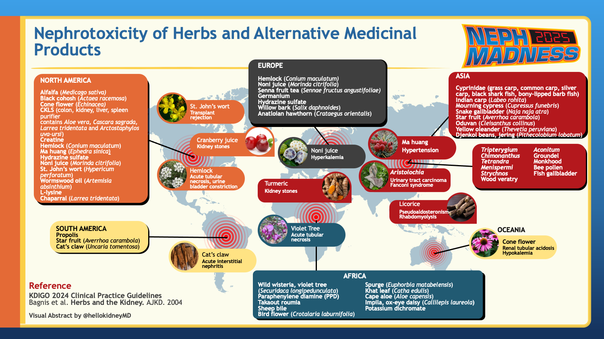

Slide 52
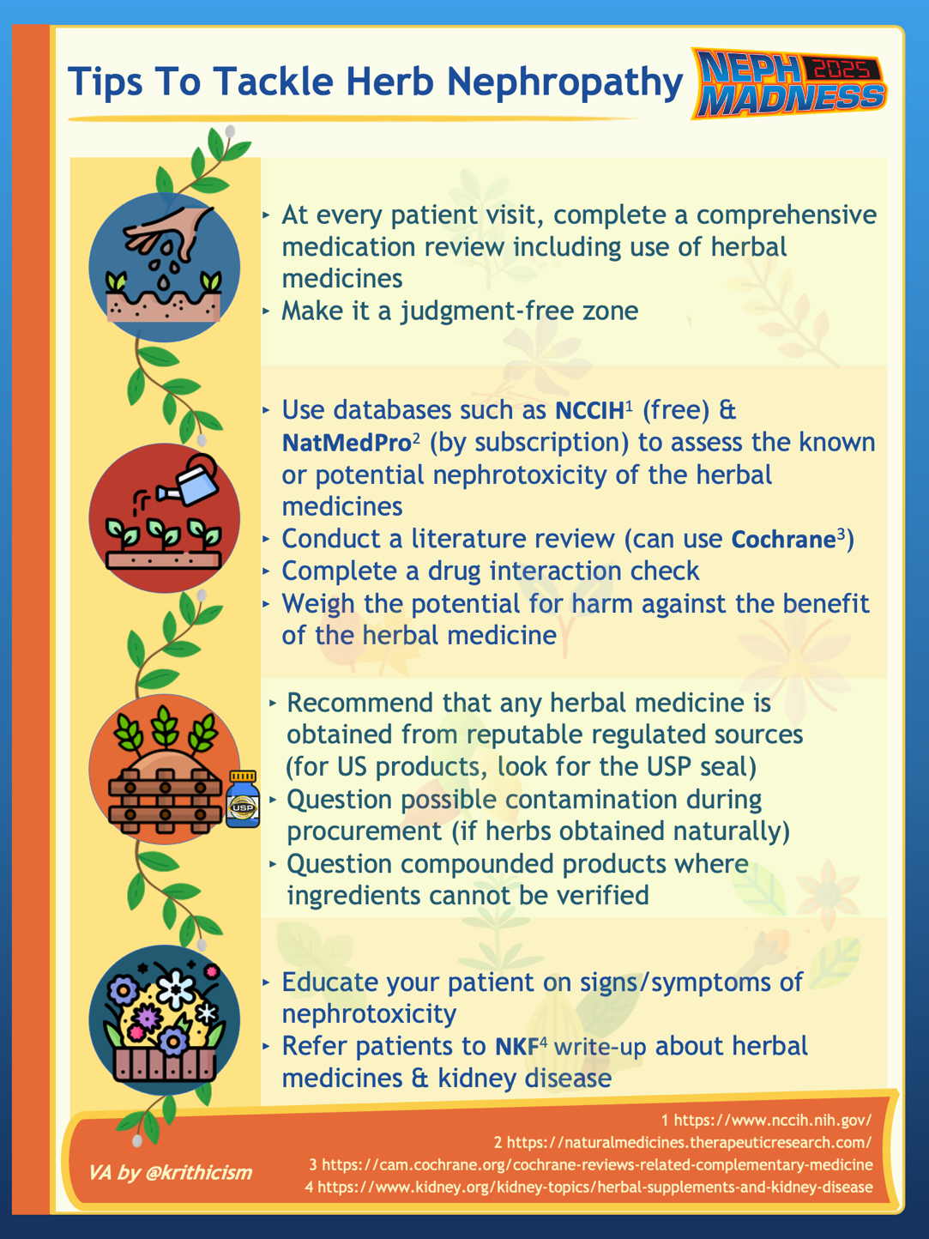
Famous Tubular Toxins
Aristolochia
Originally used in slimming regimens
Currently banned
Causes aristolochic acid nephropathy (AAN)
Urothelial carcinoma
Widely used in sweets
Alternative medicinal use as expectorant, gastroprotective and hepatoprotective agent
Causes hypertension and hypokalemia
AKI sec to hypokalemic rhabdomyolysis or tubular toxicity
proximal tubular dysfunction
rapidly progressive CKD-> ESKD
severe anemia
shrunken kidneys with fibrosis on biopsy
glycyrrhyzic acid blocks 11-β-HSD allowing cortisol to
activate MR receptors
Licorice

Slide 53

Oxalate Offenders

Slide 54
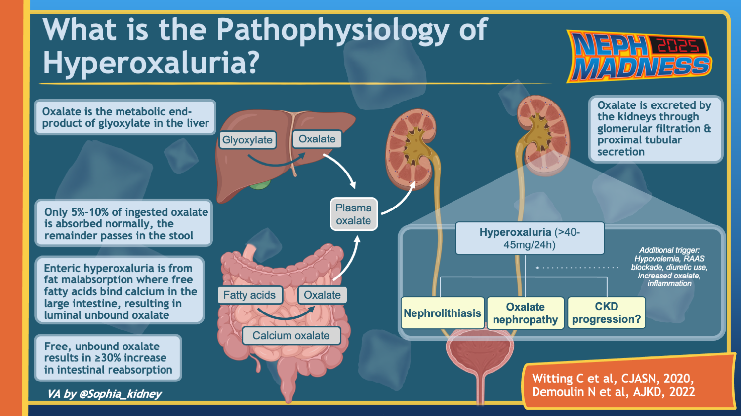

Slide 55

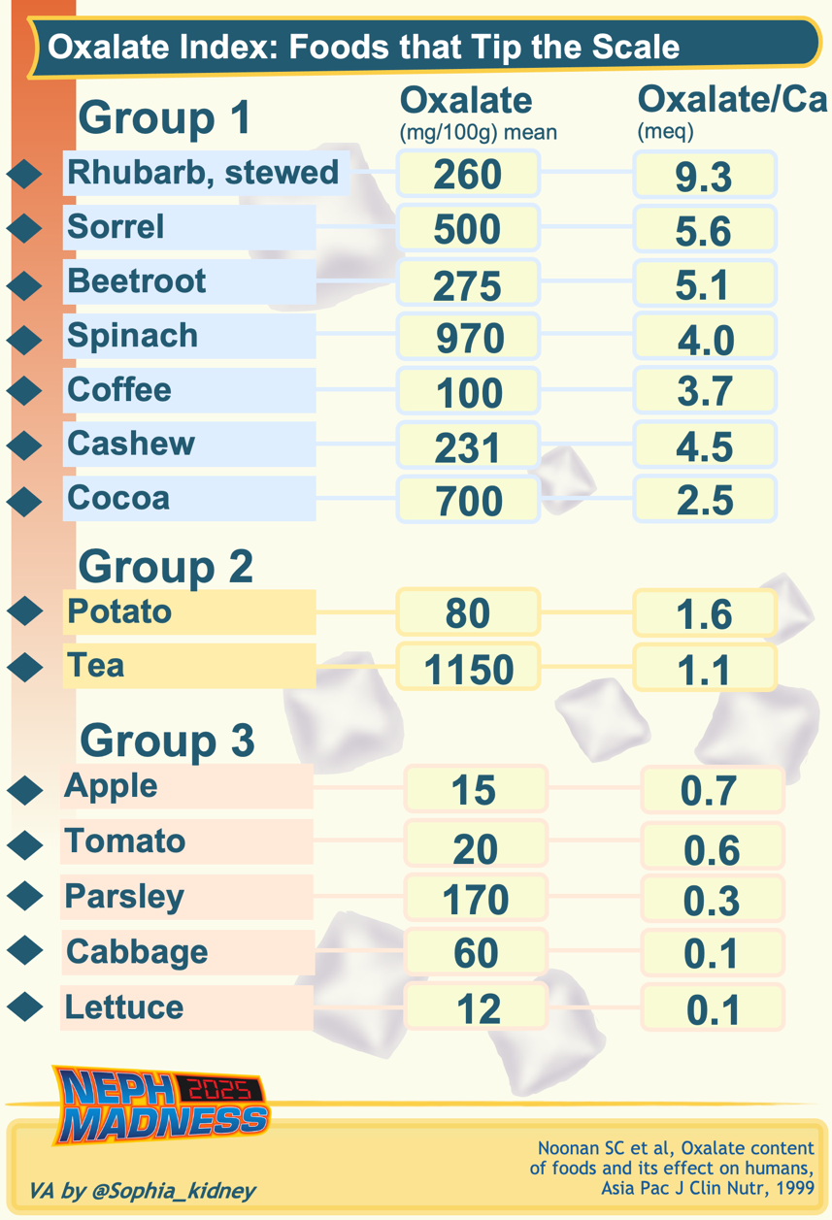




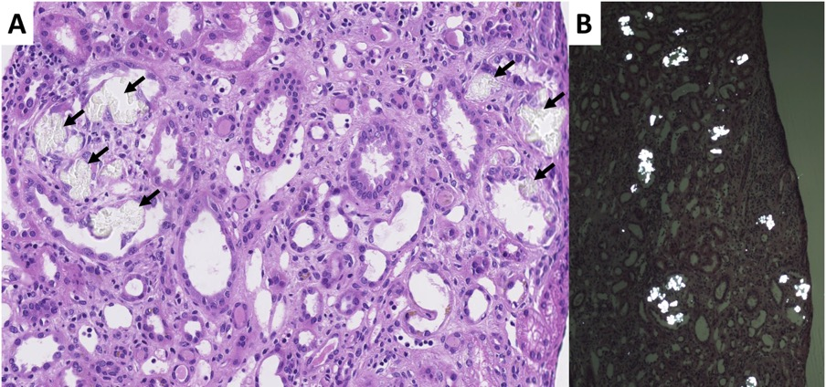
Oxalate Offenders
Oxalate is an organic acid produced by plants for protection against
Oxalate is an anti-nutrient (reduces absorption of Ca, Mg, Fe)
Famous Oxalate Offenders: star fruit, cranberries, nuts + see the VA
    Oxalate Nephropathy:
  hard ions in groundwater
  infections
  herbivores
ATN -> reabsorbed crystals initiate inflammation via NLRP3 inflammasome -> TIN ->
interstitial fibrosis
Intratubular and interstitial deposition of translucent crystals (H&E)
Crystals are birefringent under polarized light

Slide 56
Oxalate Offenders
Management of dietary hyperoxaluria
(extrapolated from Primary Hyperoxaluria)
Decrease enteric oxalate absorption
  Binders
  Removal/excretion
  Metabolism
Low oxalate diet
Adequate dietary Ca
Lanthanum
Magnesium
Hemodialysis
High fluid intake
Citrate to alkalinize urine
Oxalobacter formigenes
Oxalate decarboxylase

Slide 57



EFFLUENT EIGHT ROUND
Pick Your Champion for the Green House Region
vs
Tubular Toxins
Oxalate Offenders

Slide 58

Obesity in Kidney Transplant
Writers:
Alissa Ice
Trevor Stevens
Experts:
Swee-Ling Levea
Babak Orandi
Region Execs:
Jeffrey Kott

Slide 59

Obesity in Kidney Transplant Donors

Slide 60
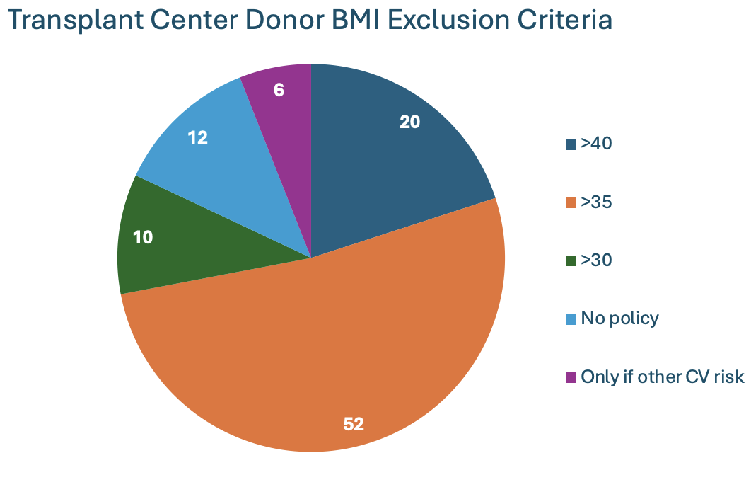
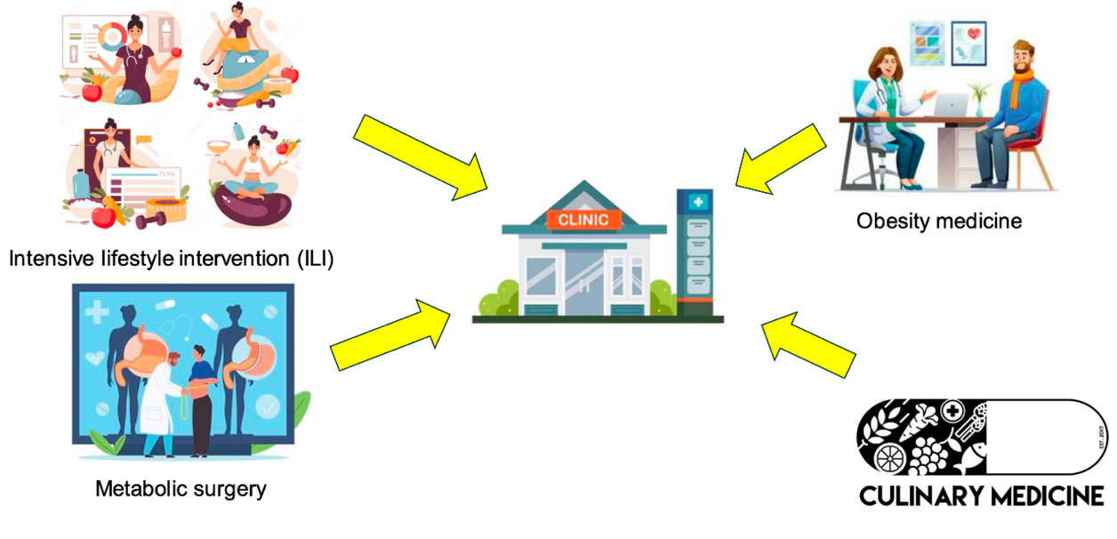
Obesity in Kidney Transplant Donors
>90,000 individuals on the kidney transplant waiting list in the U.S.
  We need to find ways to expand donor pool!
No standard BMI threshold for ability to donate
About ⅔ of donors in the U.S. have a BMI > 30 kg/m²
Obesity in kidney transplant donors increases the risk of development of ESRD 1.9 fold above non-obese donors
Treatment of obesity should be multi-modal
  Past data shows potential donors rarely are able to lose the weight
  Donors frequently (re)gain weight post donation
Therapies to promote health are essential both pre and post donation!

Slide 61
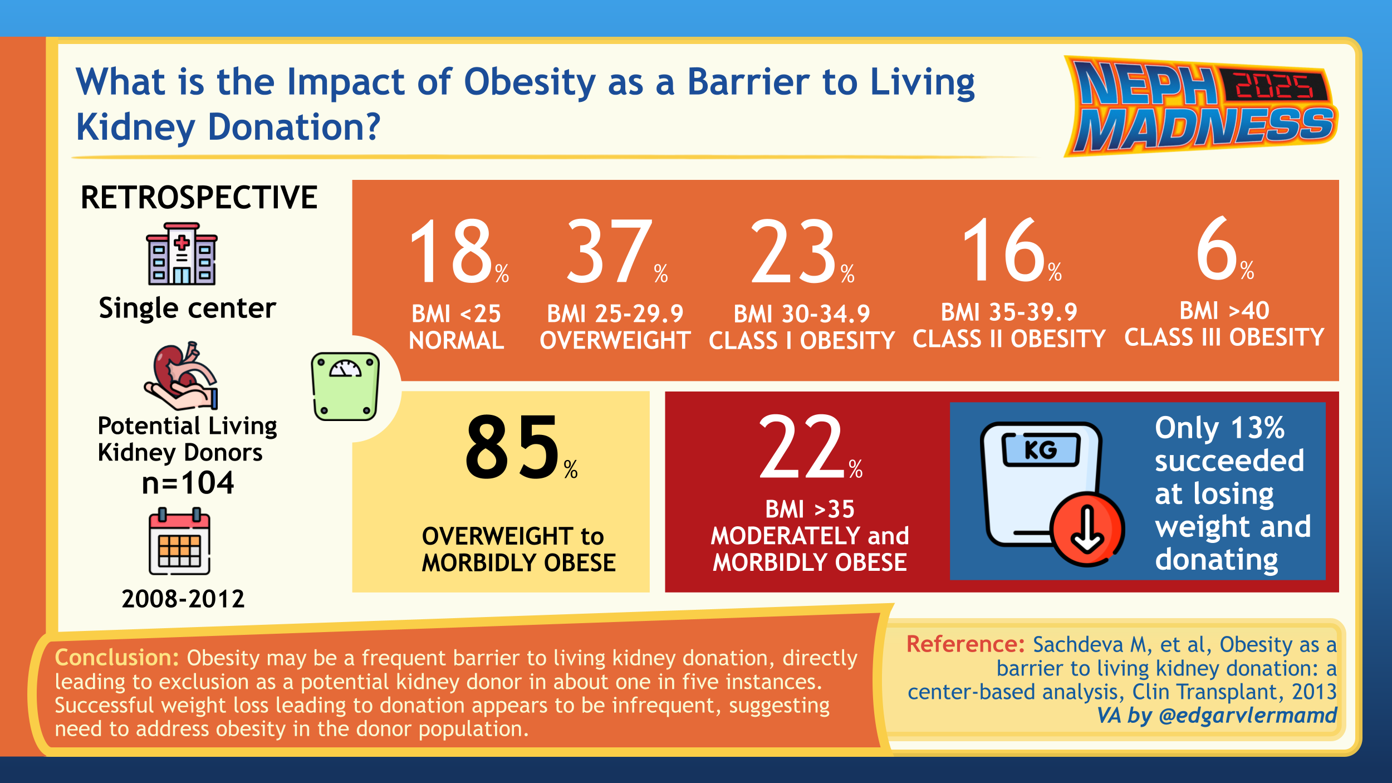

Slide 62

Obesity in Kidney Transplant Recipients

Slide 63
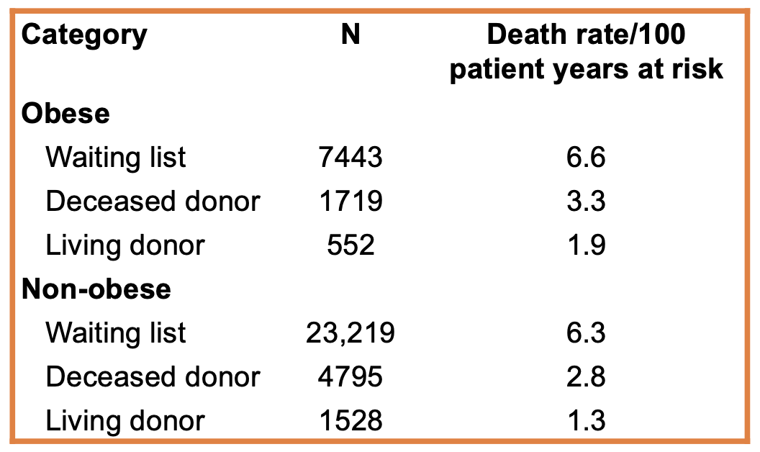
Post-Transplant Obesity
~30% of patients are obese at the time of kidney transplant
Weight gain is common post kidney transplant
Obesity increases short and long term risks post kidney transplant
  Delayed graft function
  Poor wound healing
  Cardiovascular disease
  Posttransplant diabetes mellitus
Fear of movement and low self-efficacy are common in transplant recipients
There is limited data of pharmaceutical agents in this population
  Limited data of GLP-1s, DPP4 inhibitors, and metformin suggest safety in carefully selected patients
Bariatric surgery has been shown to be effective in kidney transplant recipients.
  Higher doses of tacrolimus needed due to decreased absorption
Even with increased risks of kidney transplant in obese patients, obese kidney transplant patients still perform better than obese ESKD patients who remain on the waiting list

Slide 64
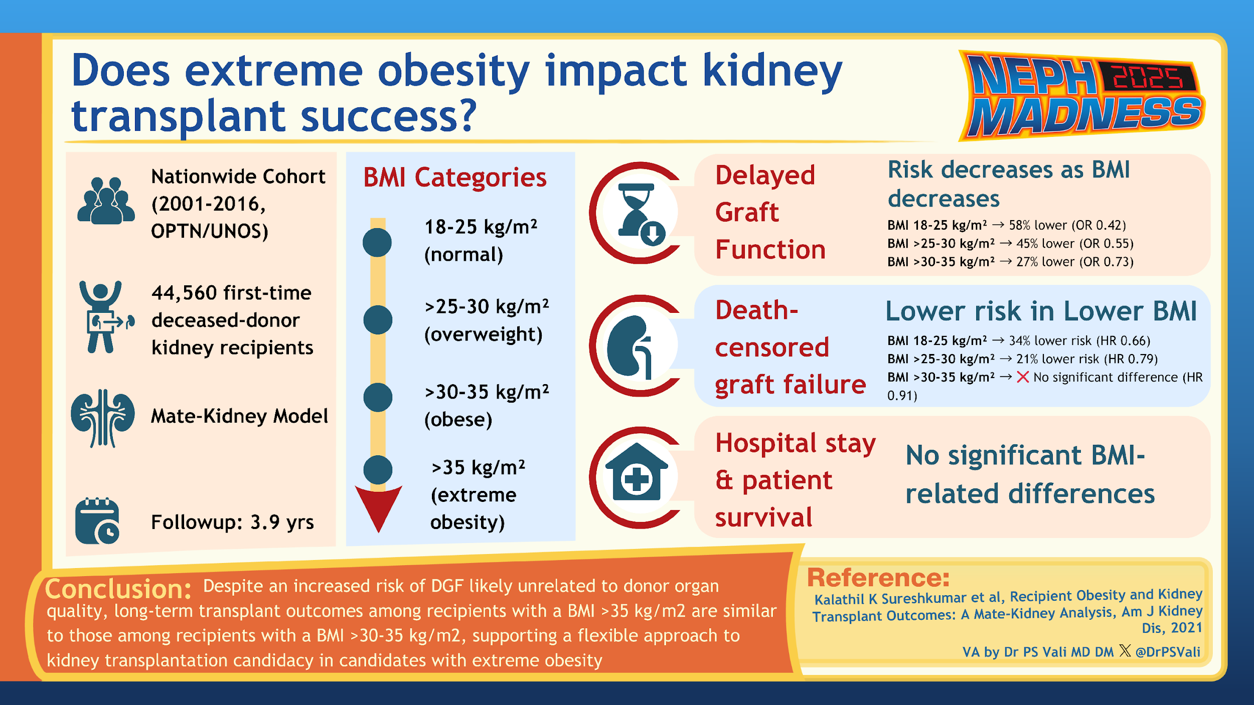

Slide 65



EFFLUENT EIGHT ROUND
Pick Your Champion for the Obesity in Kidney Transplant Region
vs
Obesity in Donors
Obesity in Recipients

Slide 66
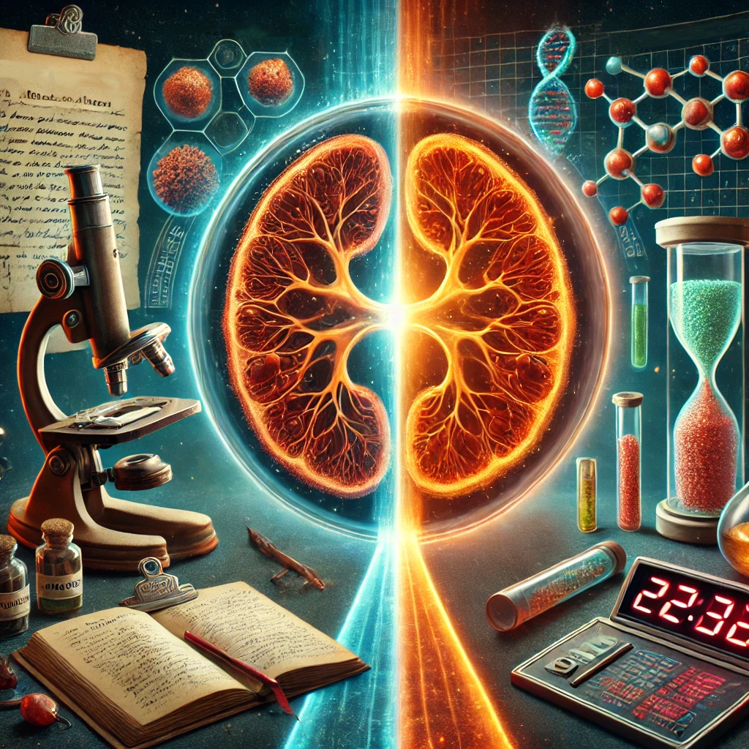
Minimal Change Disease
Writers:
Mallory Downie
Robert Myette
Expert:
Susan Samuel
Region Execs:
Ana Catalina Alvarez-Elías
Matthew Sparks

Slide 67

Minimal Change Disease Diagnosis & Pathogenesis

Slide 68
Minimal Change Disease Pathophysiology
Minimal Change Disease (MCD) is a histopathological diagnosis characterized by foot effacement of the podocytes which are part of the glomerular filtration barrier. The clinical presentation in adult and pediatric population is massive proteinuria, hypoalbuminemia and edema (nephrotic syndrome)
Diagnosis through a kidney biopsy
A d u l t s
C h I l d r e n
1-12 years
(could be older)
Diagnosis through clinical response to corticosteroid therapy. Traditionally assumed in Steroid Sensitive Nephrotic Syndrome (SSNS)
Physiopathology remains UNKNOWN!
Childhood nephrotic syndrome (NS)
according to steroid response (KDIGO Guidelines)
Steroid sensitive NS (SSNS): Complete remission after 4 weeks of treatment with recommended dose of steroids.
Frequent relapsing NS (FRNS): More than 2 relapses within 6 months or more than 4 relapses within 12 months
Steroid dependent NS (SDNS): Two relapses while in steroid therapy or within 14 days of discontinuing steroid therapy
Steroid resistant NS (SRNS): Fail to achieve remission after 4 weeks of recommended steroid
treatment
PREVIOUS THEORIES
T cell mediated
Permeable circulating factor
Genetics
NEW THEORIES
B cells mediated
Anti-Nephrin antibodies
Atypical B cells
Genetics

Slide 69
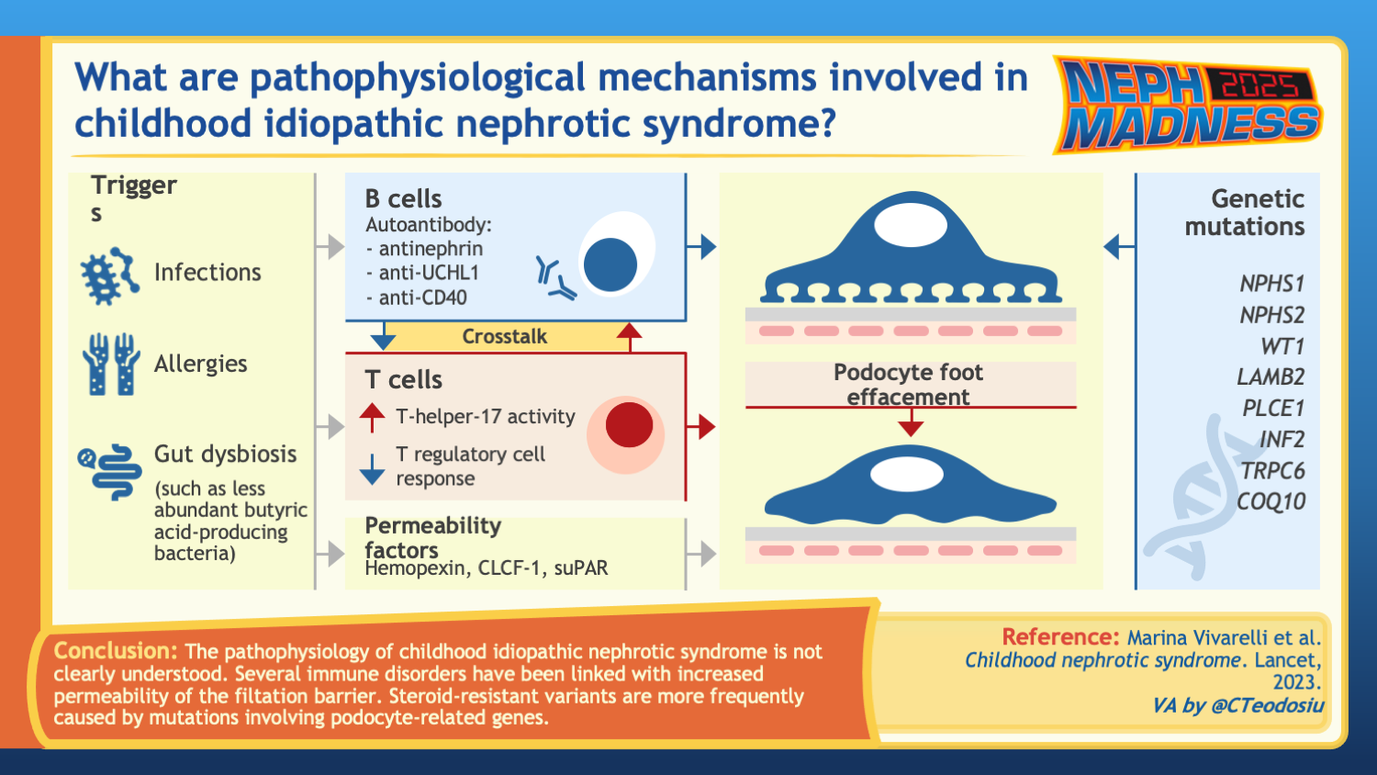

Slide 70
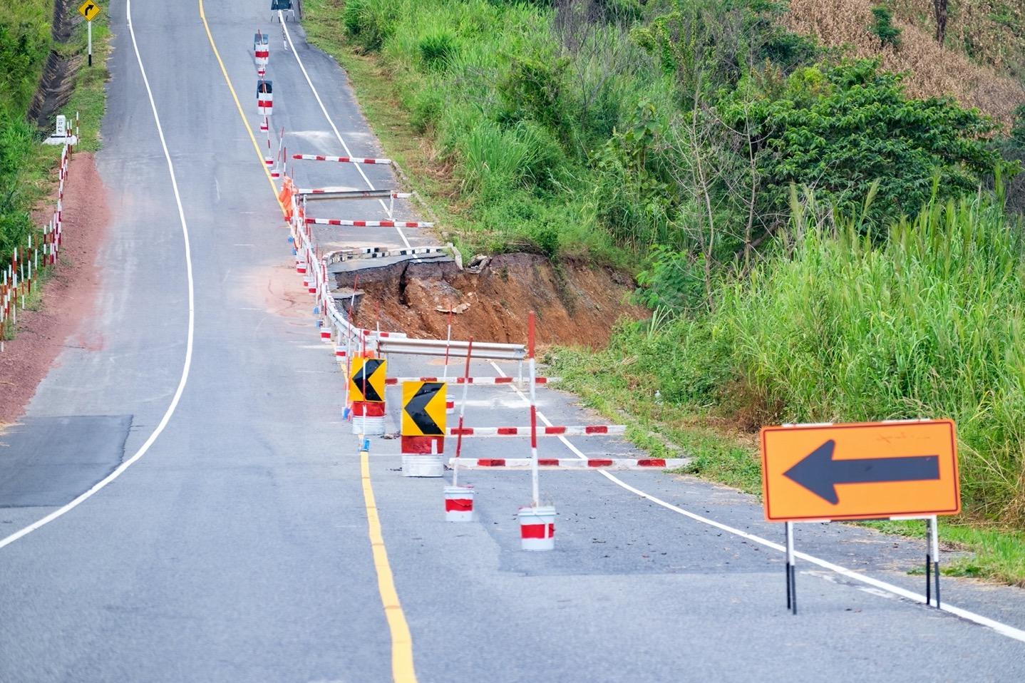
Minimal Change Disease Relapse

Slide 71
Minimal Change Disease Relapse
Initial treatment
Steroid-sparing drugs for childhood nephrotic syndrome
Prednisone or prednisolone:
60 mg/m²/day or 2 mg/kg/day for 4-6 weeks (with a maximum dose of 60 mg/day) and
40 mg/m²/ every other day or 1.5 mg/kg/ every other day for 4-6 weeks, for a total duration of 8-12 weeks for initial treatment [KDIGO Guidelines]
Calcineurin Inhibitors:
Tacrolimus or cyclosporine
Antiproliferative:
Mycophenolate Mofetil or Mycophenolic
Acid
Alkylating agents:
Cyclophosphamide
Antiparasitic:
Levamisole (not available in USA or
Canada)
Anti-CD20:
Rituximab, Ofatumumab and Obinutuzumab
Relapse treatment
The steroid-sparing drug of use depends on center practices, patient’s preference, availability and cost. No strong evidence about a specific drug being more effective.
Prednisone or prednisolone:
60 mg/m²/day or 2 mg/kg/day (maximum 60 mg/day) until the child remits completely for more than ≥3 days.
After achieving complete remission, reduce dose to 40 mg/m² or 1.5 mg/kg (maximum 50 mg) on alternate days for ≥ 4 weeks. [KDIGO Guidelines]

Slide 72
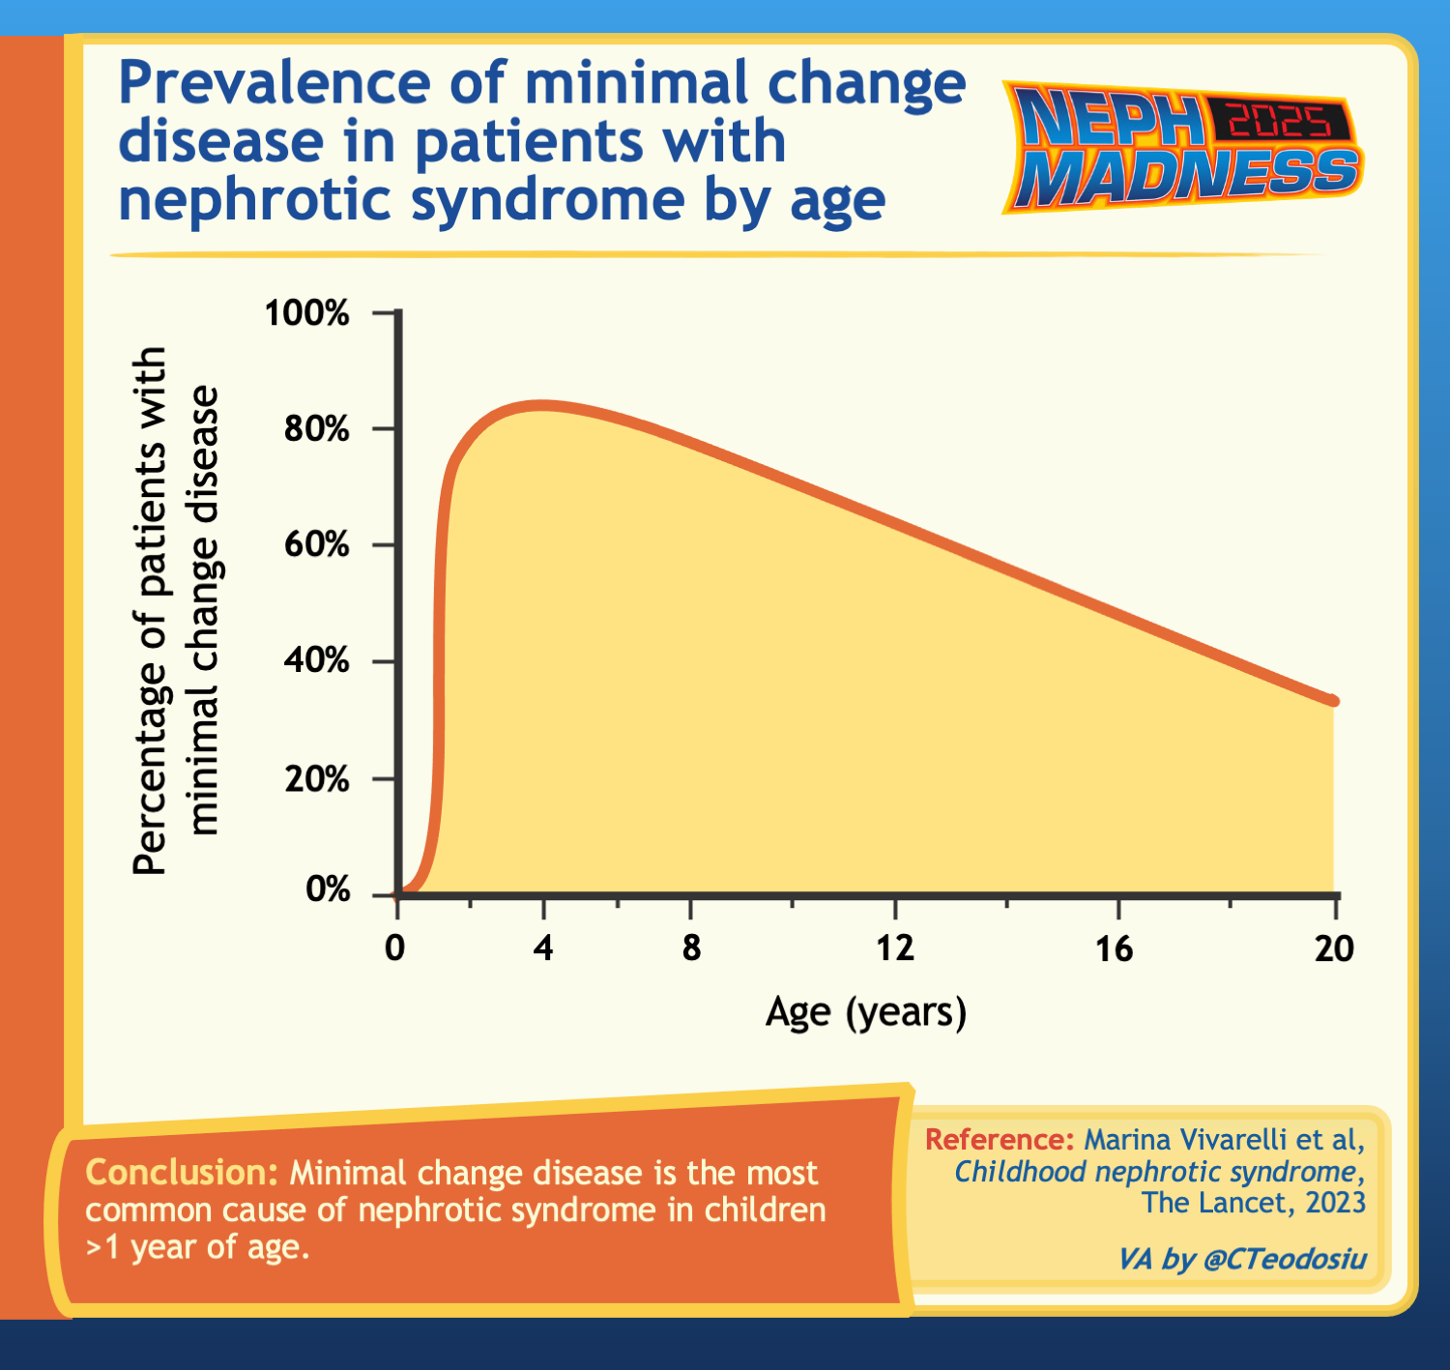

Slide 73


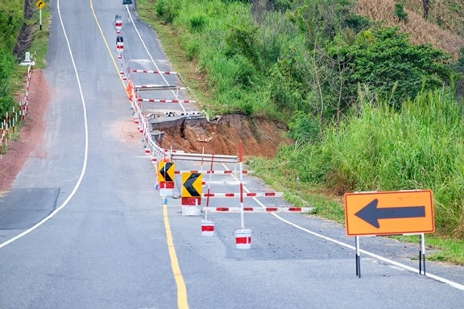
EFFLUENT EIGHT ROUND
Pick Your Champion for the Minimal Change Disease Region
vs
MCD Dx & Pathogenesis
MCD Relapse

Slide 74

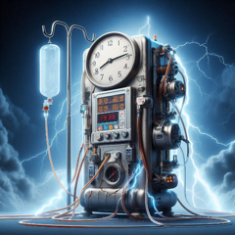






From your Effluent 8,
pick your Filtered 4

Slide 75
From your Filtered 4,
pick your Left and Right Kidneys
?
?
?
?

Slide 76
Crown your
NephMadness 2024
CHAMPION:

Slide 77
Thanks for playing and good luck!
Submit brackets by March 31, 2025 on Tourneytopia
Claim CME and MOC credit through NKF PERC
Discuss on social media using #NephMadness
Important Dates:
March 1, Saturday (7:00 am Eastern): Bracket entry opens
March 31, Monday (11:59 pm Eastern): Deadline for entering contest
April 2, Wednesday: Effluent 8 results
April 4, Friday: Filtered 4 results
April 7, Monday: Left & Right Kidney results
April 8, Tuesday: NephMadness Champion crowned

