Slide 1

Bracketology
www.AJKDBlog.org
March 1-31, 2026

Slide 2


Slides Prepared by the
NephMadness Executive Committee
Matthew Sparks
Anna Burgner
Anna Vinnikova
Jeffrey Kott
Ana Catalina Alvarez-Elías
Dia Waguespack
Samira Farouk
Krithika Mohan

Slide 3
What to do
Review the Regions & Teams on AJKDBlog
Submit your picks by March 31, 2026, on Tourneytopia
Discuss on social media using #NephMadness
Claim CME/MOC credit through NKF PERC

Slide 4

The BRP Has Chosen the Winning Bracket
To win, predict what the BRP thinks will bring the most practice change to nephrology!
Timothy Yau
Prabir Roy-Chaudhury
Kirk Campbell
Meredith Atkinson
Lori-Ann Fisher
William Whittier
Yara Mouawad
Christel Wekon-Kemeni
Giftay Kingston

Slide 5
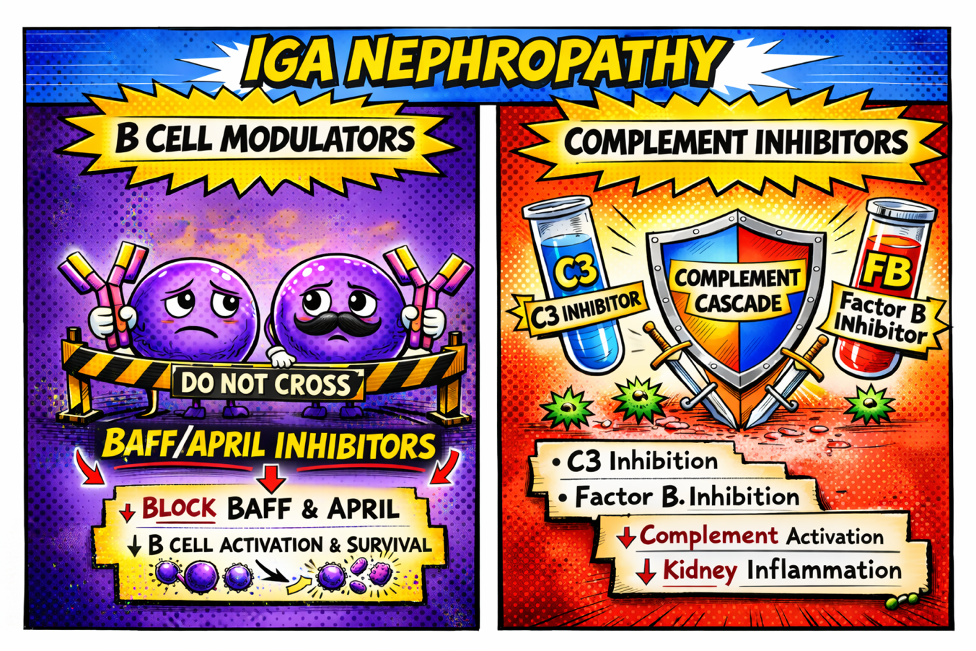
IgA Nephropathy
Writer:
Alessandra Tomasi
Expert:
Laura Mariani
Region Execs:
Matthew Sparks
Dia Waguespack

Slide 6
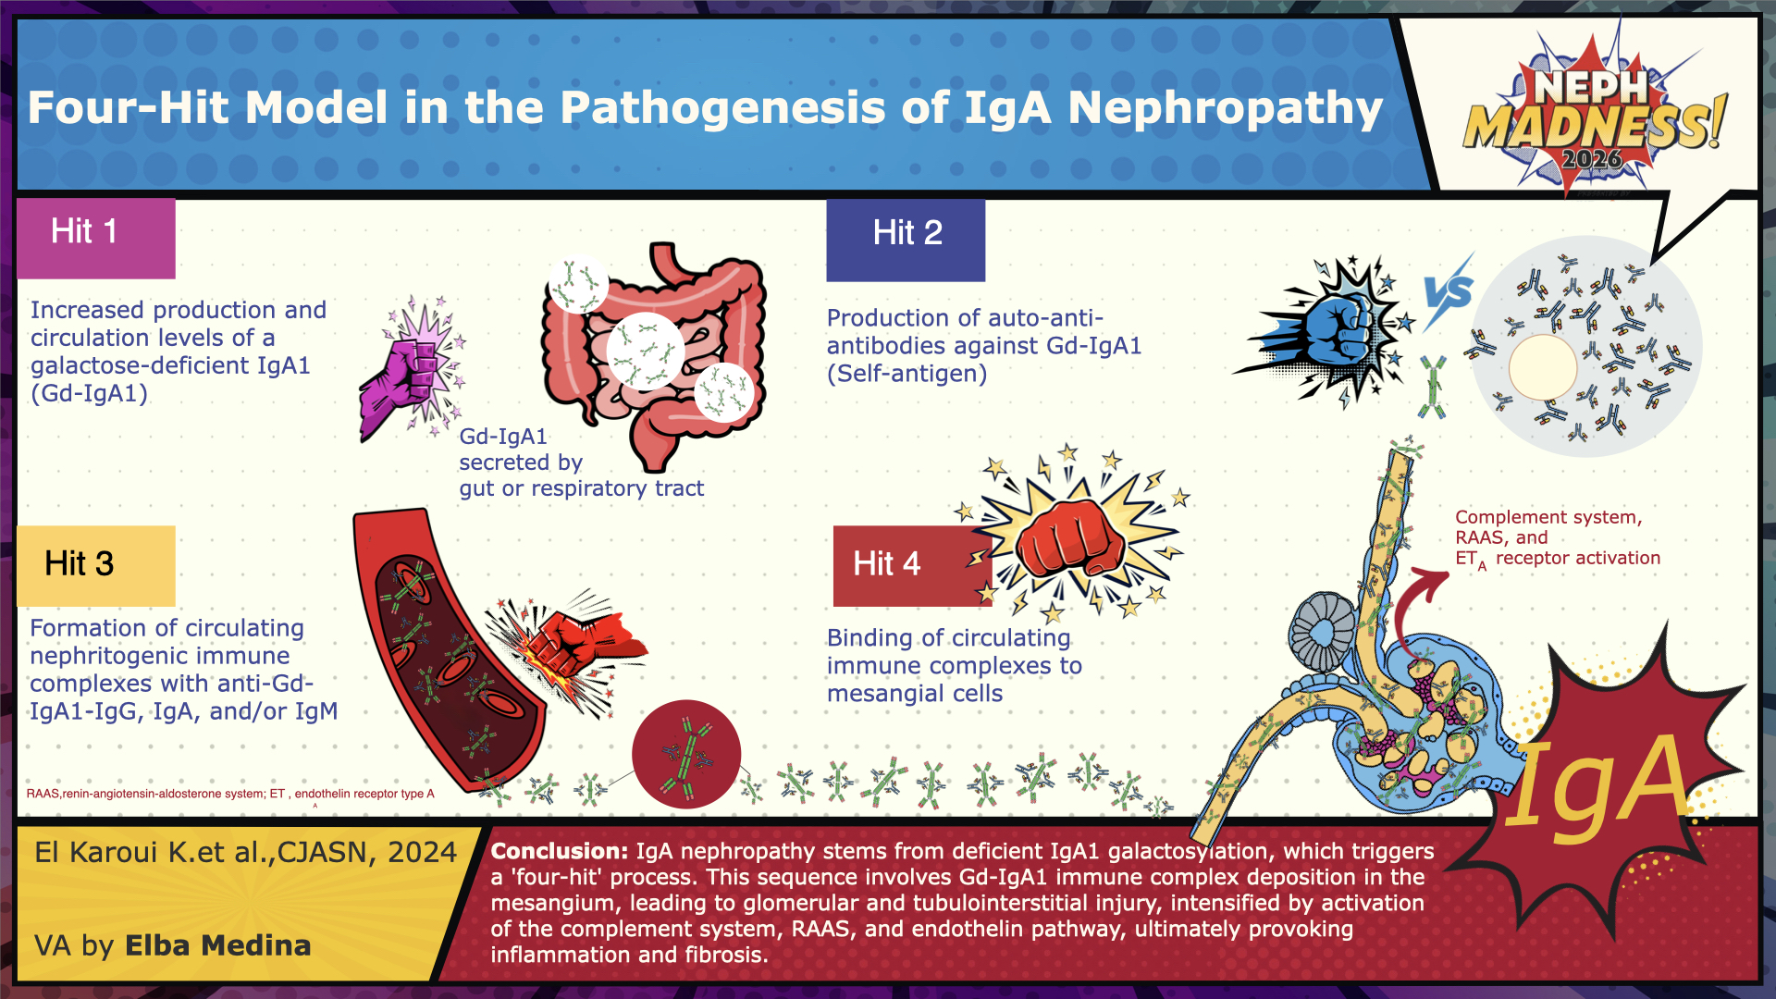

Slide 7
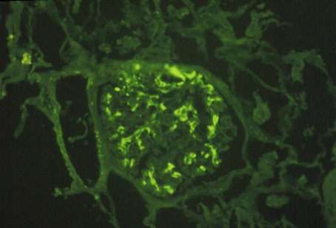
The Oxford classification, (MEST-C score), used as an initial assessment of disease severity.
5 key components:
Mesangial hypercellularity
Endocapillary hypercellularity
Segmental glomerulosclerosis
Tubular atrophy/interstitial fibrosis
Crescent formation
International IgAN Prediction Tool to help determine prognosis in adults with IgA nephropathy for up to two years following initial biopsy
2025 KDIGO Guidelines for IgA nephropathy
Stopping the production of pathogenic IgA and associated immune complex formation as well as resultant kidney injury
Reducing glomerular hyperfiltration and proteinuria
Managing hypertension.
Non-disease-specific interventions to manage BP, reduce glomerular hyperfiltration, proteinuria
-RAS inhibitors, -SGLT-2 inhibitors, -endothelin receptor antagonists (ERAs) or
-dual endothelin angiotensin receptor antagonists (DEARAs)
Disease modifying steroids, targeted-budesonide, B-Cell modulators, anti-complement

Slide 8

New B-Cell Targets

Slide 9
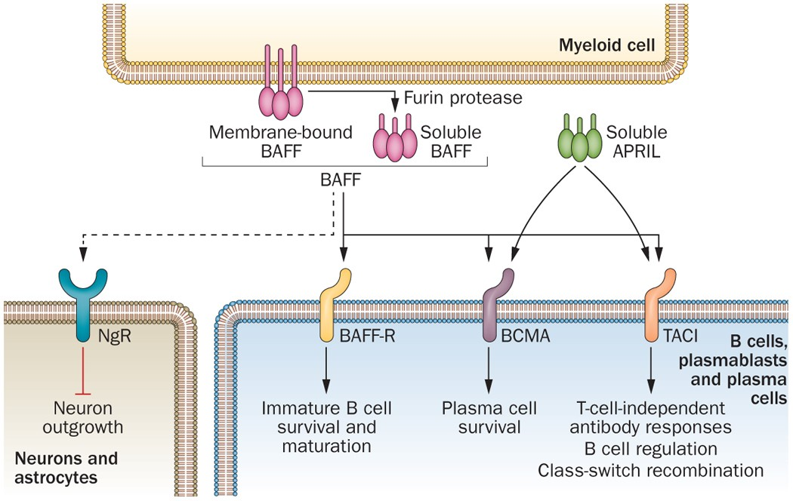
Team B-Cell Modulators
Let’s meet our two cytokines that will be targeted. Both are important for B-Cell function.
BAFF- B-cell Activating Factor Family
APRIL- A PRoliferation-Inducing Ligand
BAFF facilitates peripheral B cell selection and survival, as well as helps maintain follicular- and marginal-zone B cell populations.
APRIL allows for antibody class-switching and ultimately their differentiation into antibody-secreting plasma cells.
Work by reducing aberrant IgA molecule (Gd-IgA1), reduce the production of IgG and IgA autoantibodies against Gd-IgA1, and reduce the formation of immune complexes containing IgG, IgA, and Gd-IgA1.
Vincent FB, et al Nat Rev Rheumatol. 2014 PMID: 24614588.
The players
Atacicept- A fully human recombinant fusion protein provided as a once-weekly subcutaneous injection, atacicept targets both BAFF and APRIL.
Ongoing phase 3 ORIGIN trial
203 patients were included in this prespecified analysis (106 in the atacicept and 97 in the placebo group)
46% reduction in proteinuria (7% in the placebo)
Resolution of hematuria in 81% (21% in the placebo).
The phase 2 ORIGIN trial
60% decrease in circulating Gd-IgA1, 36% reduction in IgG, 64% in IgA, and 75% in IgM
The phase 2b extension trial
sustained reduction in proteinuria (by 52%), hematuria, and circulating Gd-IgA1 levels at 96 weeks
stabilization of eGFR (mean eGFR slope 0.6 mL/min/1.73 m2).
We are awaiting FDA approval at the time of this publication.
Sibeprenlimab- A humanized monoclonal antibody that targets APRIL alone as a monthly subcutaneous injection. Has received conditional FDA approval.

Slide 10
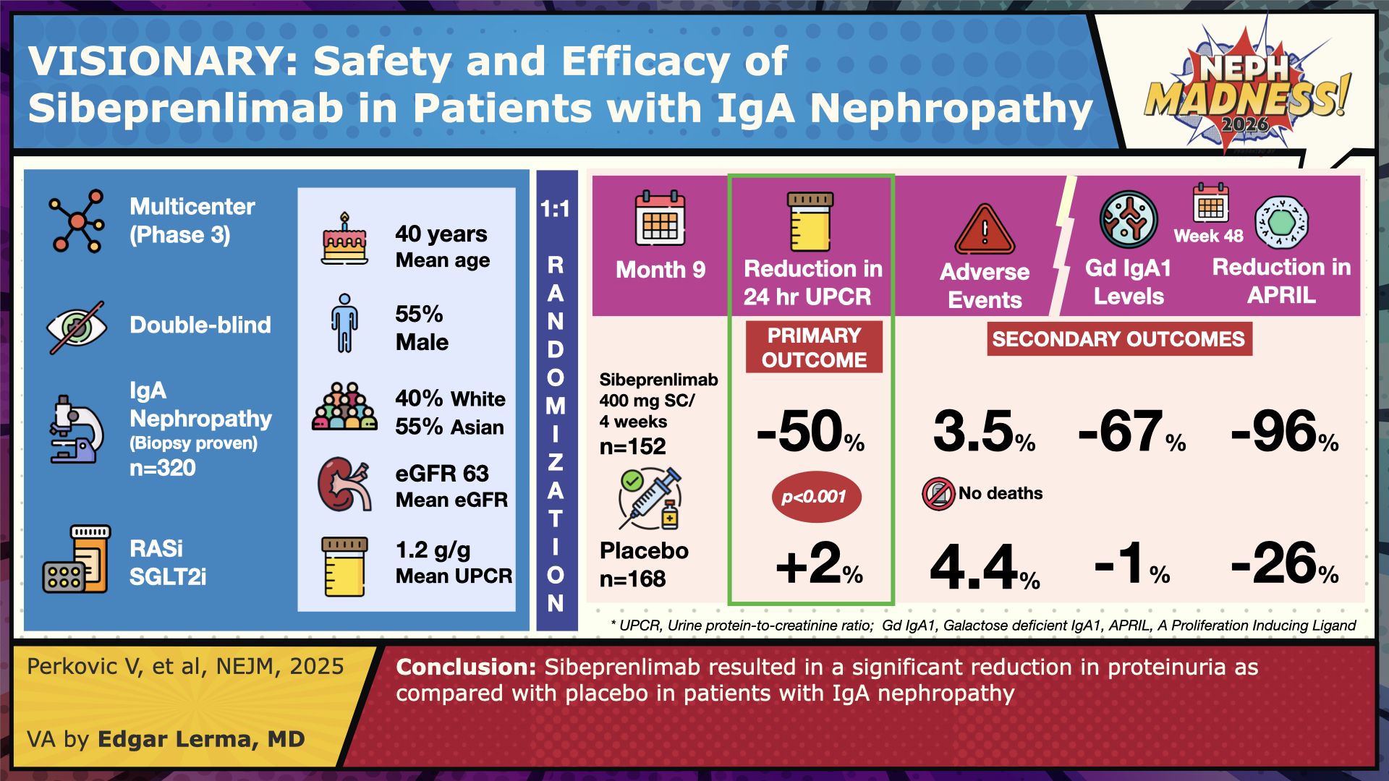

Slide 11

Complement Inhibition

Slide 12
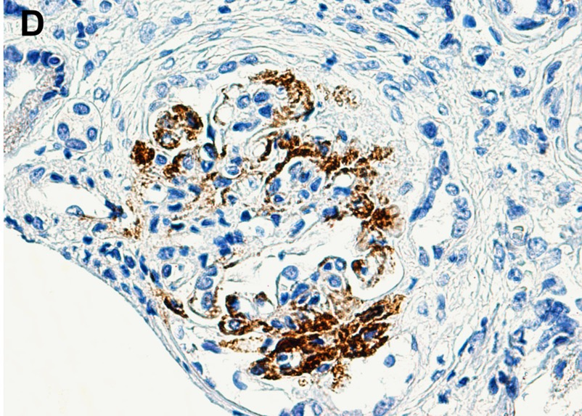
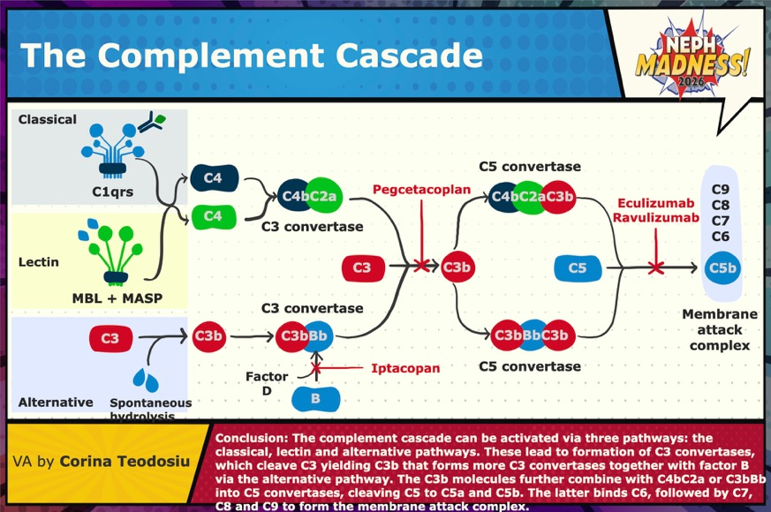
Team Complement Inhibitors
Evidence of complement deposition in glomeruli in IgA nephropathy is common.
The alternative and lectin pathways have been most implicated.
Role of complement inhibitors in the management of IgA nephropathy has gained significant traction.
Need vaccination to encapsulated bacteria- Streptococcus pneumoniae, Neisseria meningitidis
Faria B et al Am J Kidney Dis. 2020 PMID: 32439421.
Meet the players
Iptacopan (ip-TAH-kopan)- An oral complement factor B inhibitor, works by blocking the alternative complement pathway, inhibiting Factor B preventing the formation of C3 convertase (C3bBb), inhibiting the cleavage of C3 dampening inflammation. Has received conditional FDA approval.
Pegcetacoplan (Peg-sitta-co-plan) (a C3 inhibitor)- still under development.
Ravulizumab (Rav-u-Liz-ooh-mab)(a long-acting C5 inhibitor similar to eculizumab)- Phase 3 I CAN Trial Starting

Slide 13
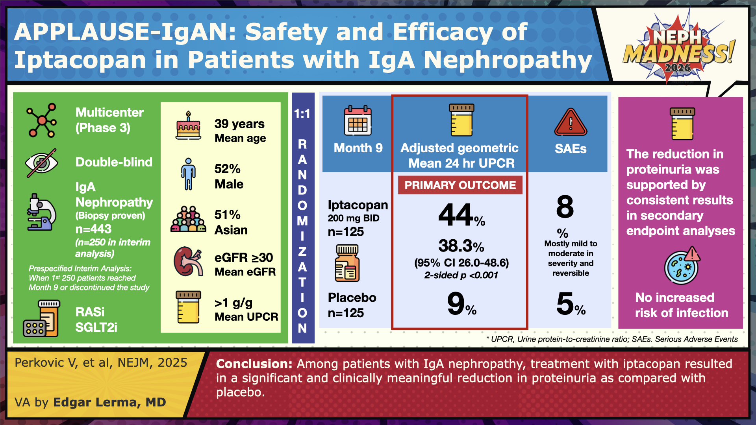

Slide 14



EFFLUENT EIGHT ROUND
Pick Your Champion for the IgA Nephropathy Region
vs
New B-Cell Targets
Complement Inhibition

Slide 15
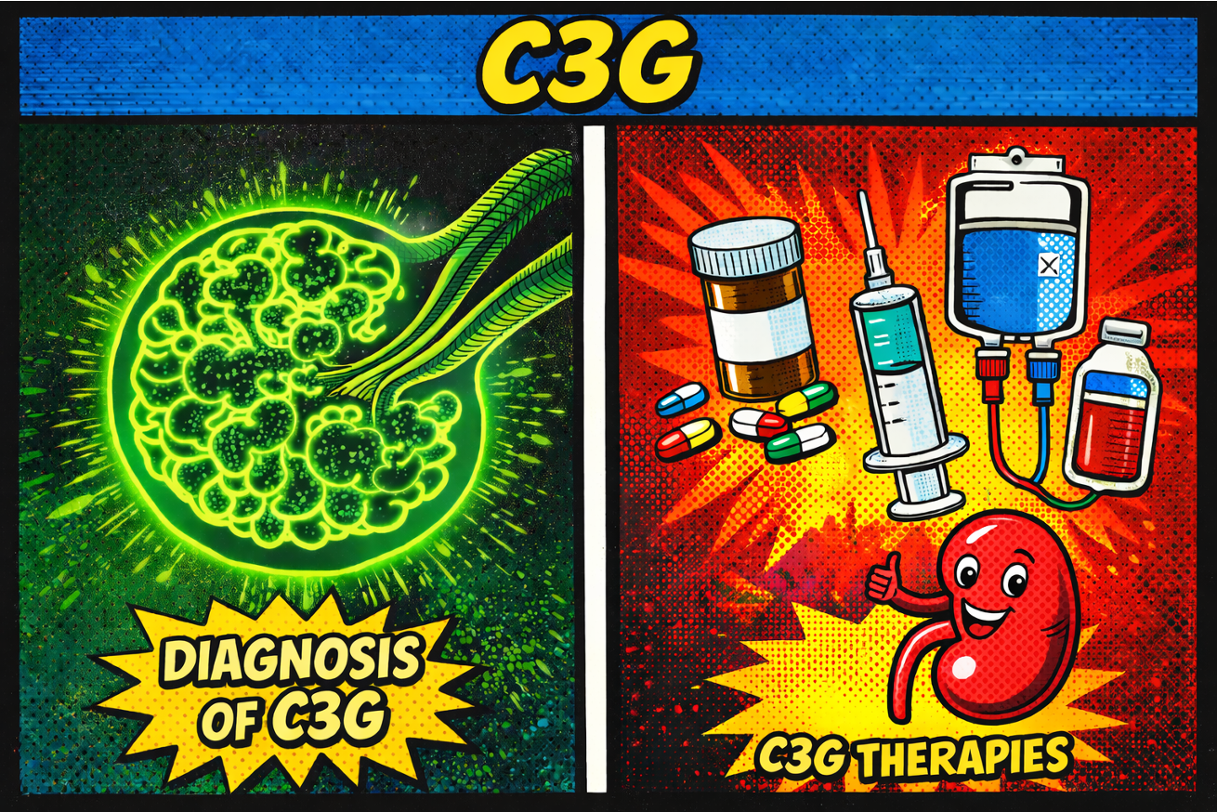
C3G
Writer:
Aarushi Varshney
Expert:
Bradley Dixon
Region Execs:
Matthew Sparks
Anna Vinnikova

Slide 16
C3G Region
C3 glomerulopathy (C3G) is an ultra-rare disorder that encompasses
C3 glomerulonephritis (C3GN)
dense-deposit disease (DDD)
Results from dysregulation of the alternative complement pathway
Leads to C3 dominant complement deposition in the kidney
50% progress to kidney failure in 10 years after diagnosis
High rate of recurrence in kidney transplantation
Usually from autoantibodies (C3/4/5 nephritic factors), for Factor B/H autoantibodies & genetic mutations (workup on next slide)
Kidney biopsy is the main diagnostic tool
Sits at the intersection of histologic overlap, subtle immunofluorescent interpretation, inadequate complement testing, and evolving terminology. (from infection, monoclonal diseases, to autoimmune diseases) (Figure to Right)
Which is why diagnosis is highlighted as a distinct Team
MPGN pattern of injury
Defined by Immunofluorescence
Immune complex-mediated
Complement-mediated
Immune complex-triggered
IgG and C3 staining
C3 Dominant Staining
Idiopathic primary MPGN
C3 Glomerulopathy (C3G)
Infection
Hep C
endocarditis
abscess, etc
Autoimmune
SLE, Sjogren
MCTD
Dense Deposit Disease (DDD)
C3 Glomerulonephritis (C3GN)
Monoclonal disease
Membranoproliferative glomerulonephritis (MPGN) underwent a nomenclature change in 2013 reflecting shift from morphology-based to pathogenesis-based classification. Pickering M et al. Kidney Int. 2013 PMID: 24172683
Treatment paradigm for C3G
Past expert recommendations suggested use of MMF and steroids to dampen immune system
-no RCTs -cohort retrospective studies provided mixed results
Use of terminal (C5) complement inhibitor (eculizumab) with mixed results as well and no RCTs exist
Use of plasma exchange and rituximab have both not demonstrated efficacy and no RCTs exist
Recent RCTs have led to the FDA approval of two drugs, pegcetacoplan (C3 inhibitor) and iptacopan (Factor B inhibitor)
-pegcetacoplan- ~65% reduction in proteinuria & reduction in C3 staining, -iptacoplan- ~35% proteinuria reduction
mandated to have immunization to encapsulated bacteria (meningococcal and pneumococcal vaccine)
Guidelines are still in development, but new approved drugs will likely dramatically alter this course of this disease

Slide 17
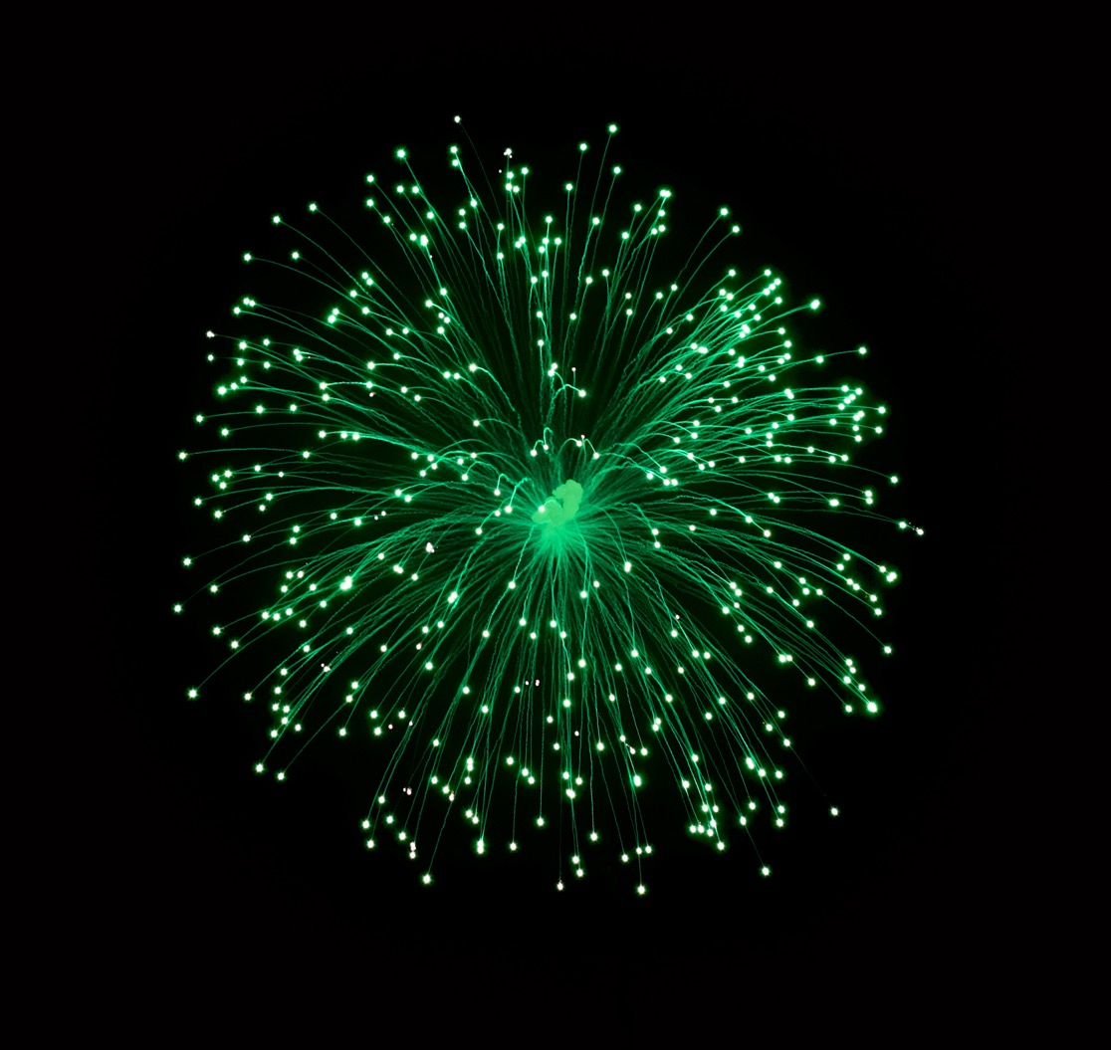
C3G Diagnosis

Slide 18
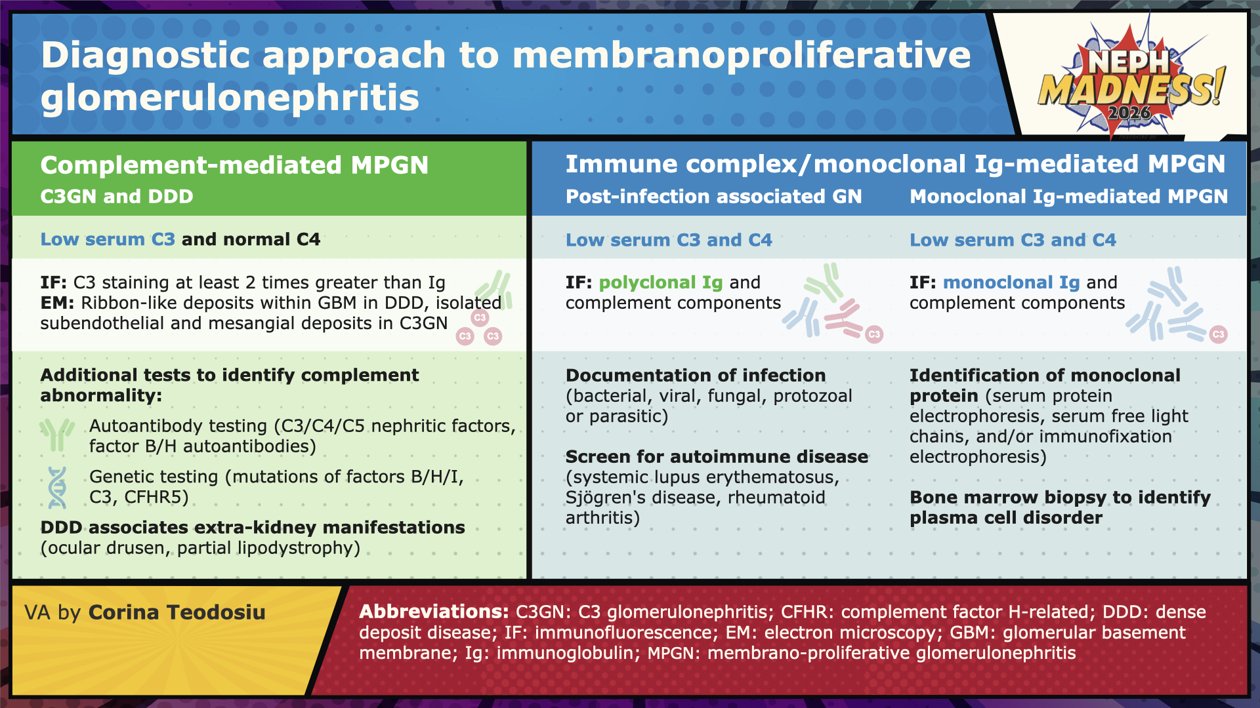

Slide 19


Slide 20
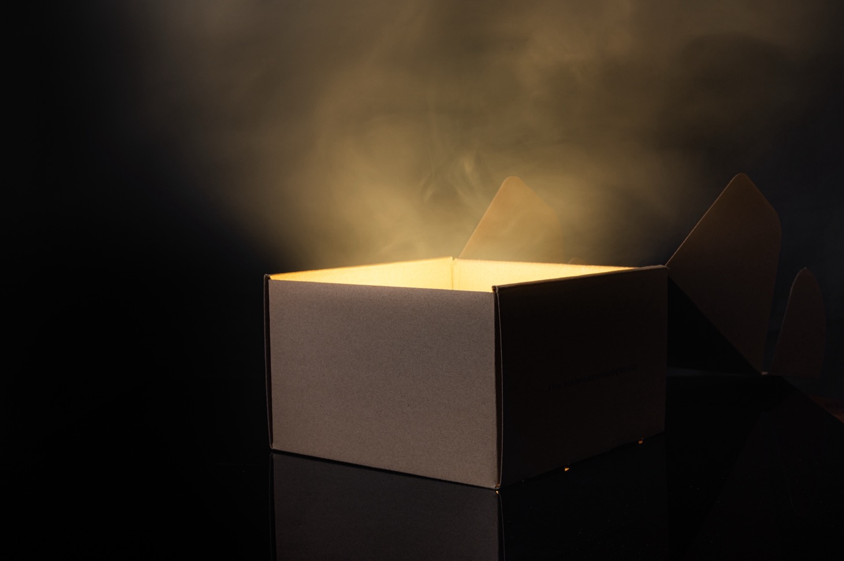
C3G Treatment

Slide 21
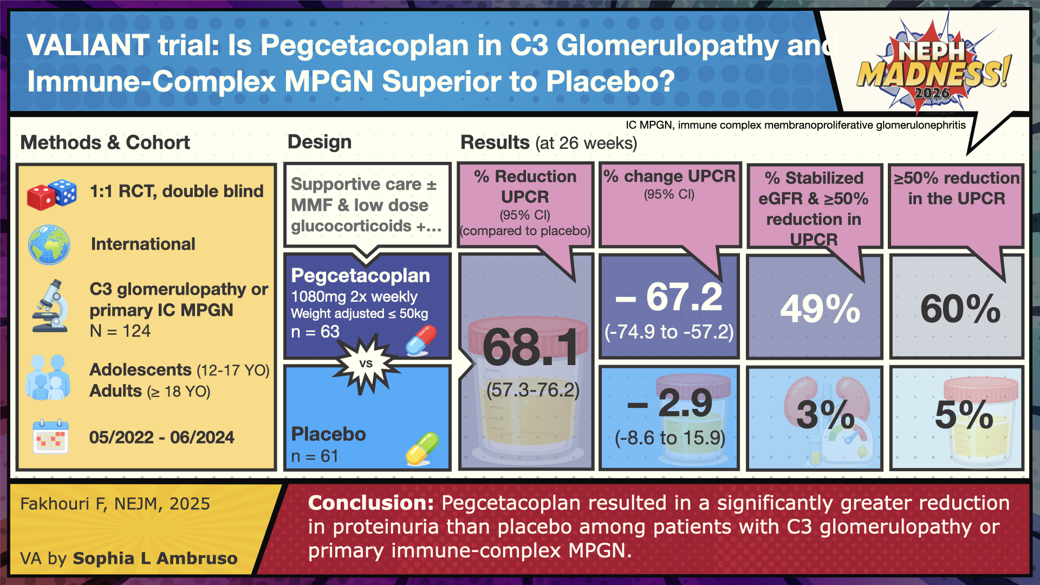

Slide 22
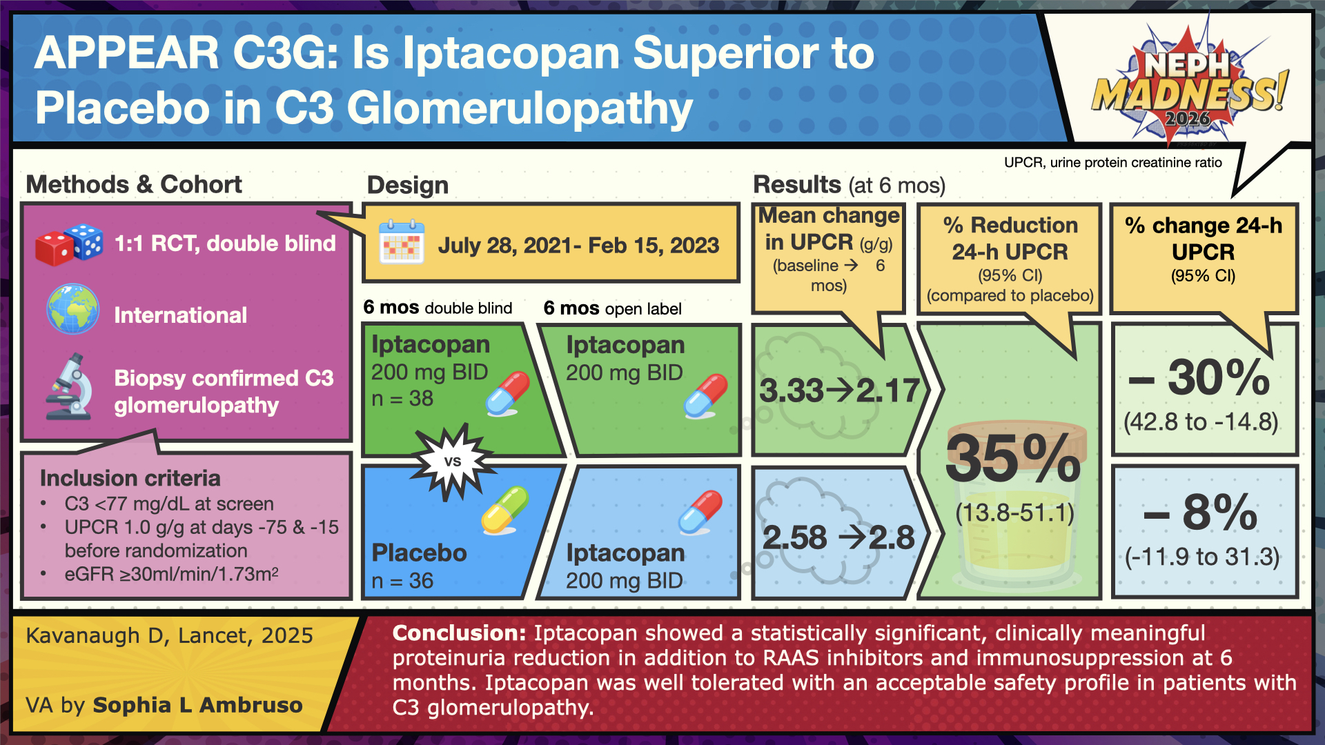

Slide 23



EFFLUENT EIGHT ROUND
Pick Your Champion for the C3G Region
vs
C3G Diagnosis
C3G Treatment

Slide 24
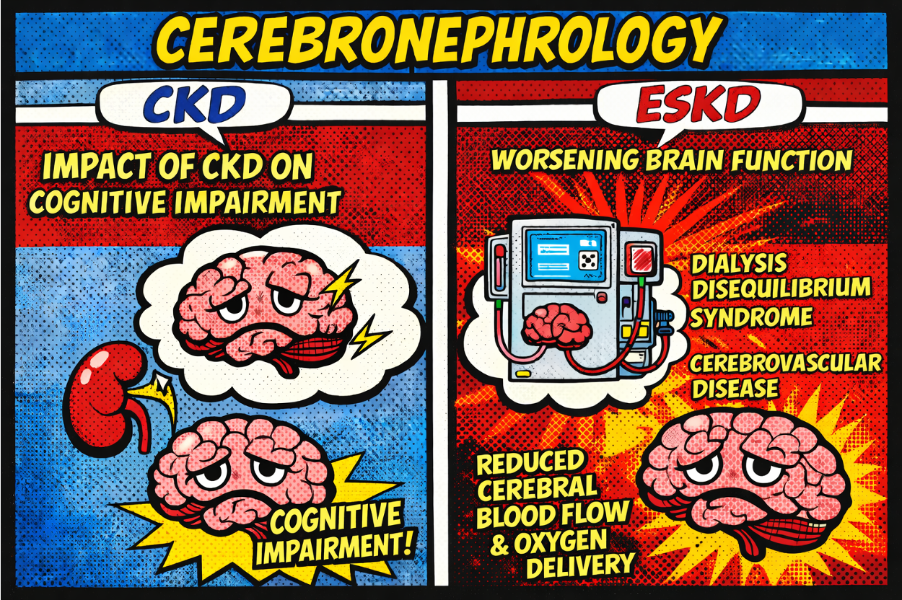
Cerebronephrology
Writer:
Colton Jensen
Expert:
David Drew
Region Execs:
Dia Waguespack
Jeff Kott

Slide 25

The Brain-Kidney Axis
Kidney & brain share vascular design
Low-resistance, high-flow organs that rely on autoregulation → vulnerable to chronic BP/vascular injury
Bidirectional cross-talk
CKD → ↑ cerebrovascular disease, blood–brain barrier disruption, exposure to uremic metabolites
Brain injury → ↑ sympathetic tone; impacts Na/H2O balance and kidney function
Why nephrologists should care
Cognitive impairment can be an underrecognized CKD complication and impacts adherence, self-management, and outcomes
“Team CKD” (chronic microvascular + metabolic injury) vs “Team ESKD” (added dialysis-related hemodynamic/osmotic stress)
Cognition is not “extra-renal”—it’s part of CKD/ESKD care.

Slide 26

in CKD

Slide 27

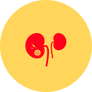
Team CKD
What it is
Cognitive impairment = deficit in ≥1 domain (executive function, memory, attention, language, visuospatial, learning) spanning mild → dementia
How common / who’s at risk
CKD is common (especially in older adults), and cognitive impairment often goes unnoticed
Studies highlighted in the post: ~48% prevalence of neurocognitive impairment in older CKD cohorts
Risk rises with lower eGFR, higher albuminuria, and higher systolic BP
Pathophysiology - multifactorial
Cerebral small vessel disease
Anemia/oxygen delivery mismatch: even with ↑ cerebral blood flow, oxygenation may be impaired
Glymphatic dysfunction (CNS waste clearance) and uremic metabolites accumulating earlier than “overt uremia”
Prevention focus:
control BP and albuminuria

Slide 28
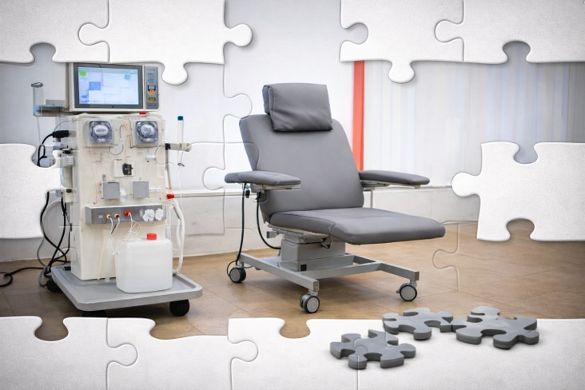
in ESKD

Slide 29
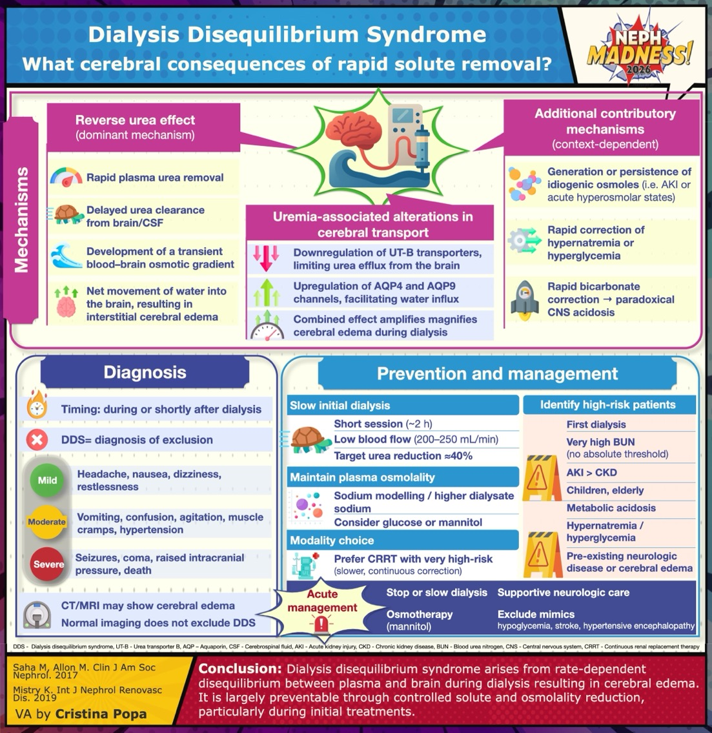
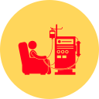
Team ESKD
Core concept
Kidney replacement therapy necessarily lowers osmolality, intravascular volume, and MAP → can provoke transient ischemia + ICP fluctuations
Cerebrovascular + structural brain injury
ESKD patients have high stroke/CVD burden
MRI/DTI studies: more atrophy/WMH and DTI shows reduced white matter integrity
PD vs CKD imaging: PD associated with lower gray matter volume and greater decline over 2 years
Hemodynamics during HD: often “silent” brain stress
Near-infrared spectroscopy measurements with ≥15% cerebral oxygen drop; most episodes asymptomatic
Transcranial Doppler: mean flow velocity drops (~10%); correlates with UF and with subsequent cognitive/WMH signals
ICP monitoring and MRI data: HD can raise ICP and increase cerebral water
Dialysis physiology can stress the brain

Slide 30
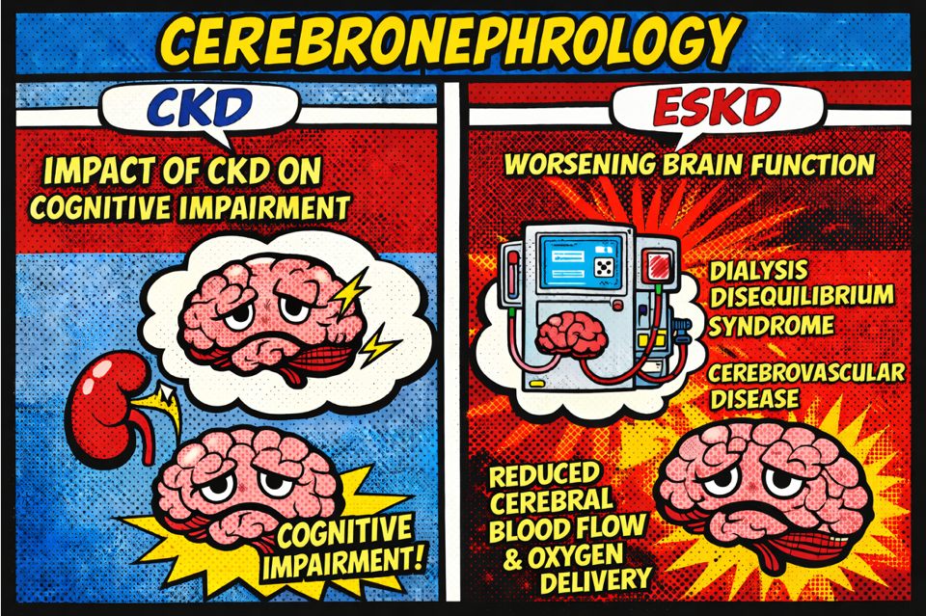


EFFLUENT EIGHT ROUND
Pick Your Champion for the Cerebronephrology Region
vs
in CKD
in ESKD

Slide 31
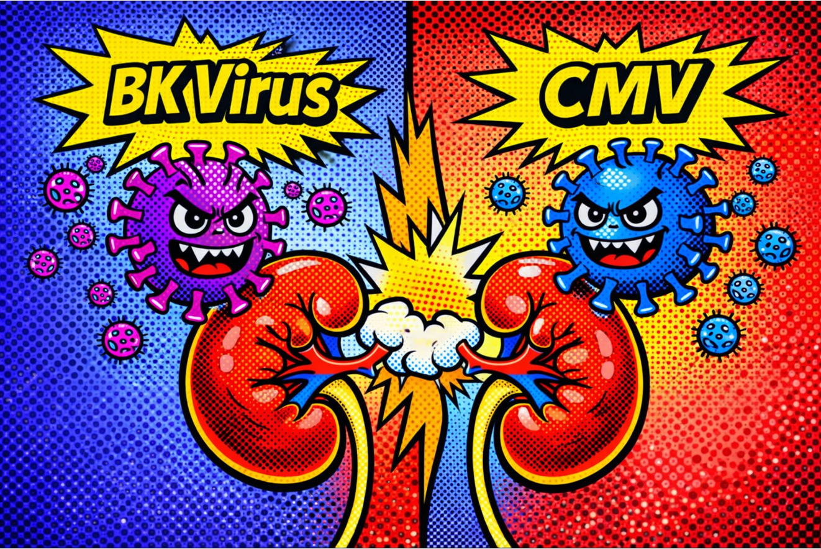
Trolls of Transplantation
Writers:
Hariharasudan Natarajan
Caitlyn Vlasschaert
Experts:
Sam Kant
Jeannina Smith
Region Execs:
Samira Farouk
Ana Catalina Alvarez-Elías

Slide 32
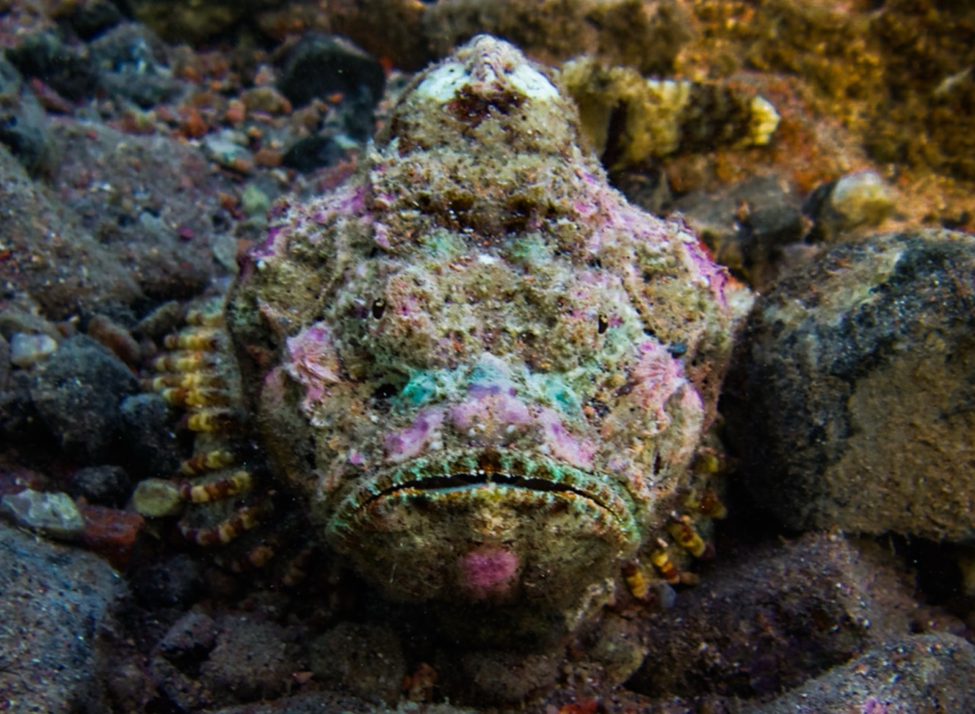
BK

Slide 33
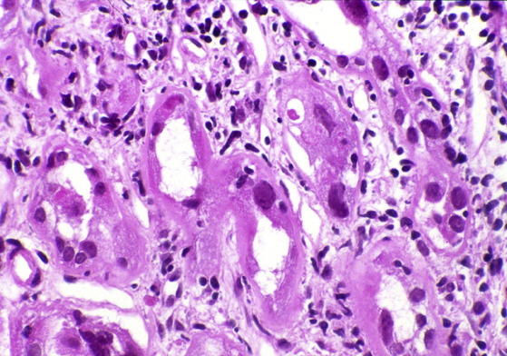
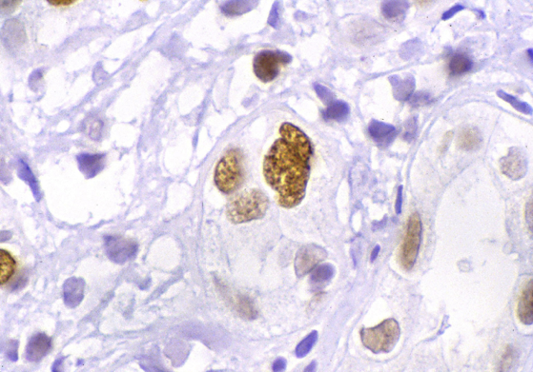
BKV: A Silent Passenger With A Heavy Toll
Meet BK virus (BKV): Identified in 1971 in Sudanese kidney transplant recipient (KTR) BK 🇸🇩 🇬🇧 (BKV = cousin of JCV: named for John Cunningham)
BKV is a “sleeper”: 90% of adults seropositive; enters urothelial & tubular cells → lifelong latency in an episomal form (as extra-chromosomal circles of DNA tucked into the nucleus without producing viral proteins); can awaken/reactivate in immunosuppressed host
Recipient age, prior KT, recent rejection, specific HLA class profiles: linked to BKV reactivation
BK viremia (we actually measure DNA-emia 🧬 ) > 10K copies = presumptive BKVAN*
BKVAN: in up to 10% of KTR; up to 50% allograft loss
Donor-derived cell-free DNA assays have shown promise to distinguish viral injury from alloimmune rejection.
Antivirals that have failed: fluoroquinolones, leflunomide, cidofovir. For now, KISS**: just lower immunosuppression!
Potentially promising therapies: viral-like particle vaccines, monoclonal antibodies (potravitug, MAU868), BKV-specific T cells (e.g. posoleucel), targeting agnoprotein & viral mRNA splicing
(Top) Dark purple (basophils) inclusions in tubular epithelial cells suggest BKV associated nephropathy; (Bottom) SV40 Immunohistochemistry confirms BKV.
Adapted from the AJKD Atlas of Renal Pathology
*BKV-associated nephropathy (BKVAN)
**Keep it simple stupid

Slide 34
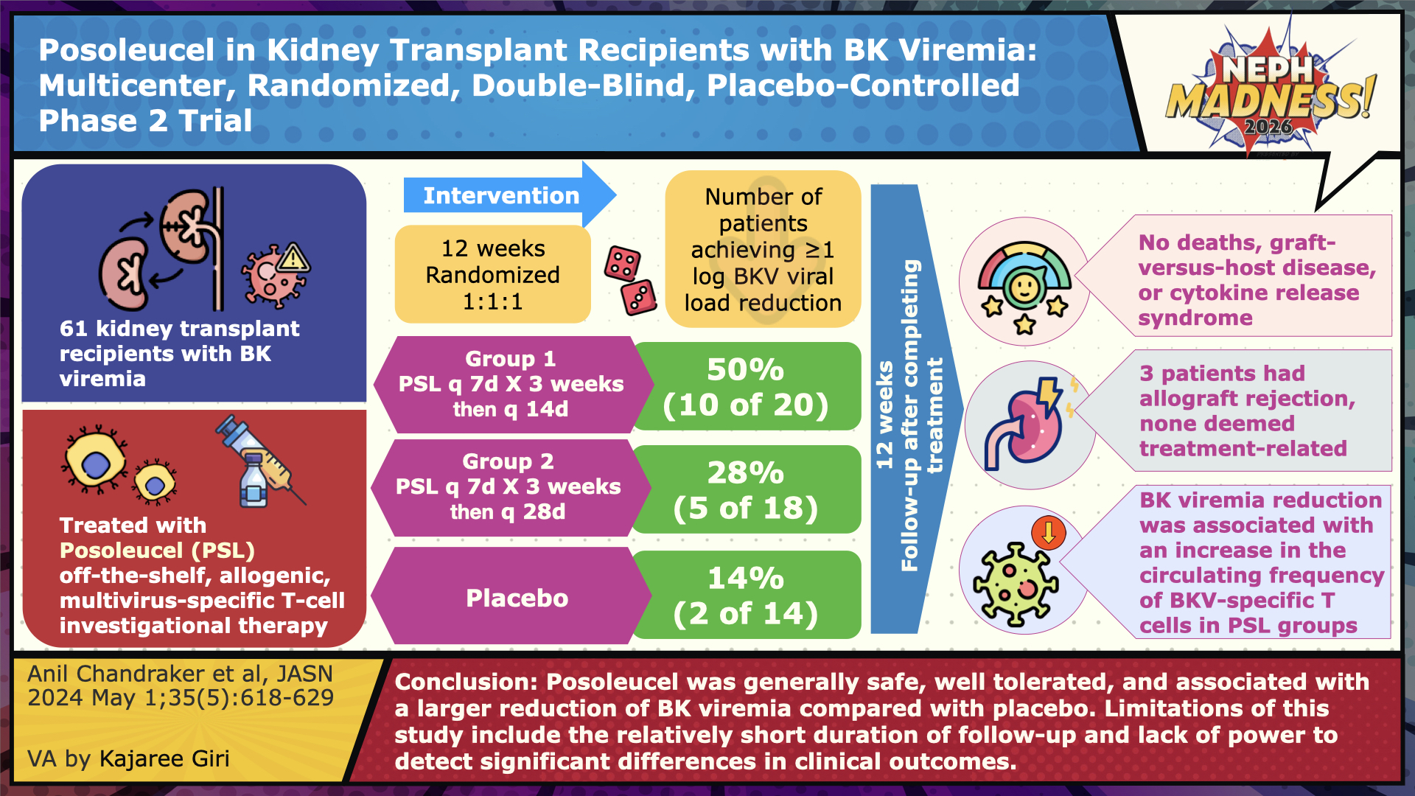

Slide 35
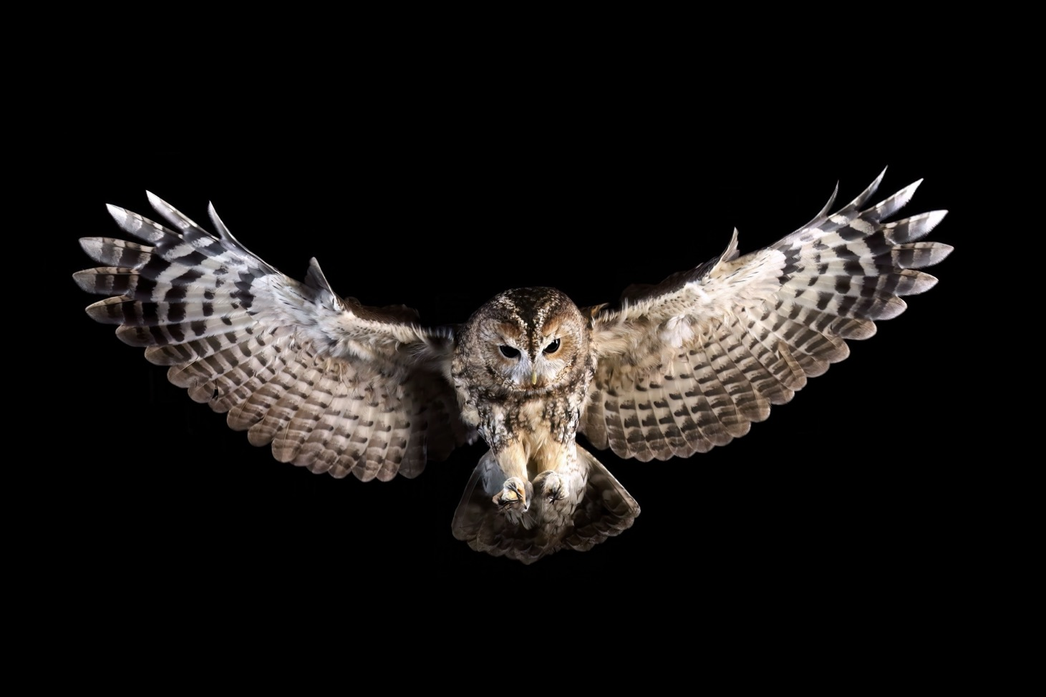
CMV

Slide 36

🦉CMV: Whether Asymptomatic or Deadly, Always Harmful 🦉
Meet cytomegalovirus (CMV): AKA human herpes virus 5 (HHV5); Identified in 1956 in infants
Most common opportunistic infection among KTR
CMV genome: highest level of genetic diversity of all known HHV → antiviral resistance is a problem
2 phases: lytic (active viral replication and contagion) & latent (viral “hibernation”)
2 preventative strategies
Universal: initiation on anti-viral drug for finite duration (valgancivlovir or letermovir ↓ leukopenia)
Preemptive: screen for CMV DNAemia, treat if you find it
First line therapies: PO valganciclovir & IV ganciclovir (both activated by CMV kinase pUL97 & inhibit DNA polymerase pUL54)
Options for refractory infections (+/- resistance): pUL54 inhibitors (foscarnet, cidofovir), pUL97 inhibitor (maribavir)
Potential promising future therapies: CMV-specific T-cells, vaccines, monoclonal antibodies, adoptive T-cell therapies
CMV-related kidney injury mimics BKV: tubulointerstitial nephritis, intranuclear glassy, basophilic inclusions with a surrounding halo ( “owl’s eye”). Collapsing FSGS has been reported

Slide 37
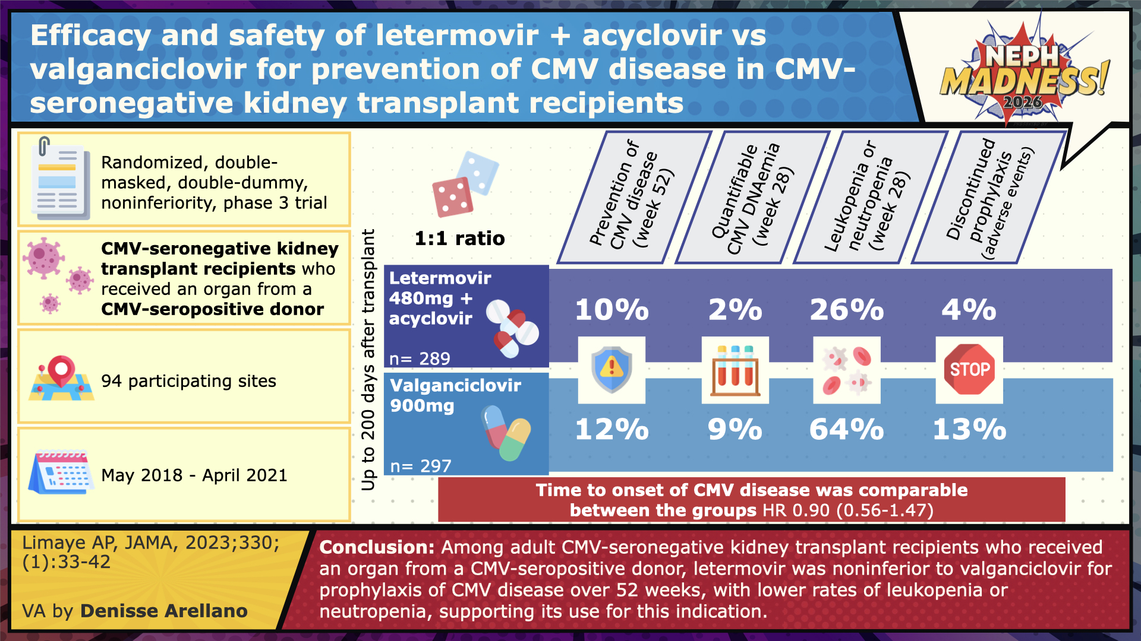

Slide 38



EFFLUENT EIGHT ROUND
Pick Your Champion for the Trolls of Transplantation Region
vs
BK
CMV

Slide 39
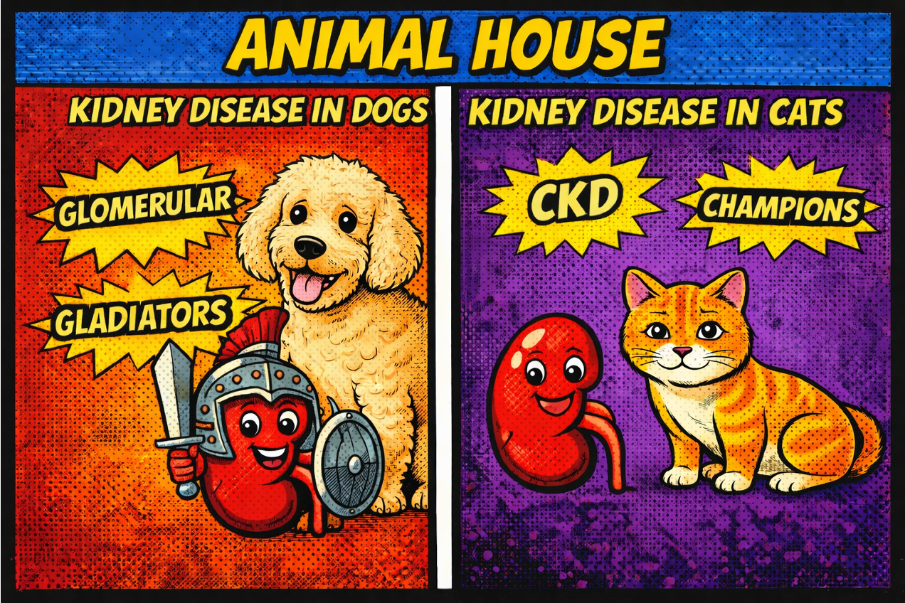
Animal House
Writers:
Autumn Harris
Kelly Hyndman
Experts:
Sarah Street
Susan DiGiovanni
Region Execs:
Anna Vinnikova
Matthew Sparks

Slide 40
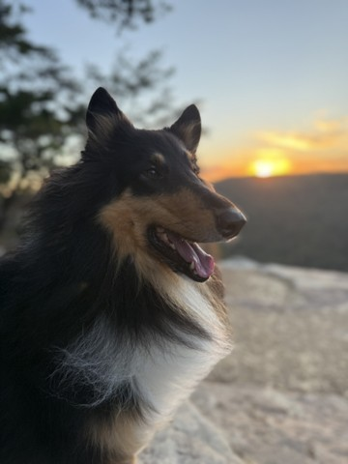
Dogs

Slide 41
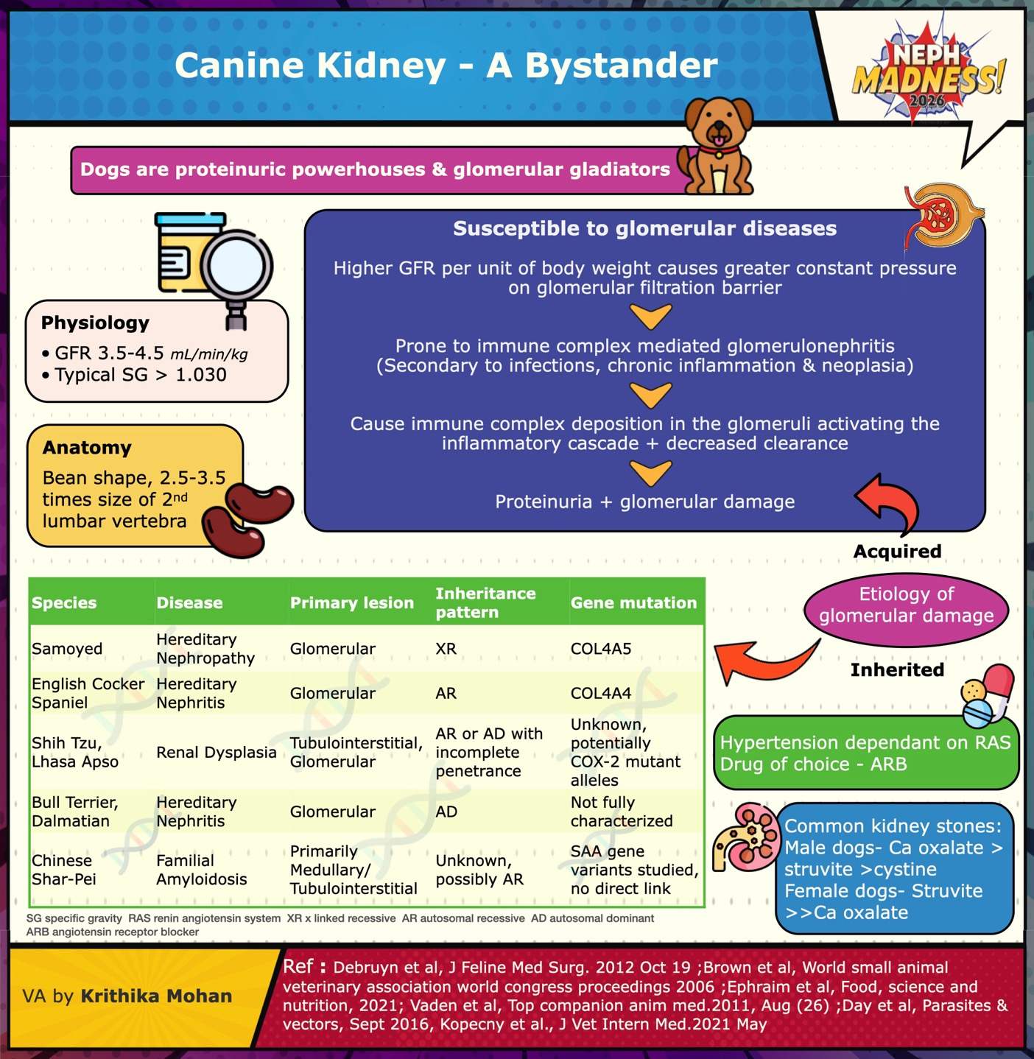

Slide 42



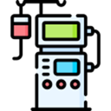
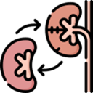
AKI, CKD and ESKD in
AKI: driven by ischemic/inflammatory conditions (58%), infections (8%) unknown causes (24%) and nephrotoxins (6%)
- Common nephrotoxins are grapes, ethylene glycol, NSAIDs (especially human-use), antibiotics, vit D
- IRIS AKI grading I-V uses creatinine, urine output and RRT requirement
CKD: persistent urinary abnormalities > 3 mo
- IRIS CKD staging 1-4 uses creatinine, proteinuria and blood pressure
Dialysis: treatment of severe AKI and sometimes ESKD
- Viewed as “bridge to recovery”, rarely “bridge to nowhere”(ESKD) (ethical dilemmas)
- Cost: $3,000-5,000 for the first 2-3 treatments, $10,000-20,000 total including ICU care
- Success rate: 50% survival to hospital discharge, higher in infections (eg. leptospirosis)
- Prognosis: fair to good for reversible AKI
Transplant:
- High morbidity and mortality, rarely successful
- Intense host immune response, rapid rejection
- Requires potent, multi-agent protocols with severe side effects
- Opportunistic infections are common due to dogs’ behavior and exploration of the environment
- Cost upwards of $20,000 + high annual drug costs

Slide 43
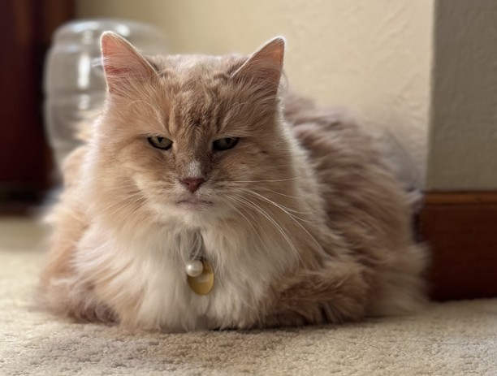
Cats

Slide 44
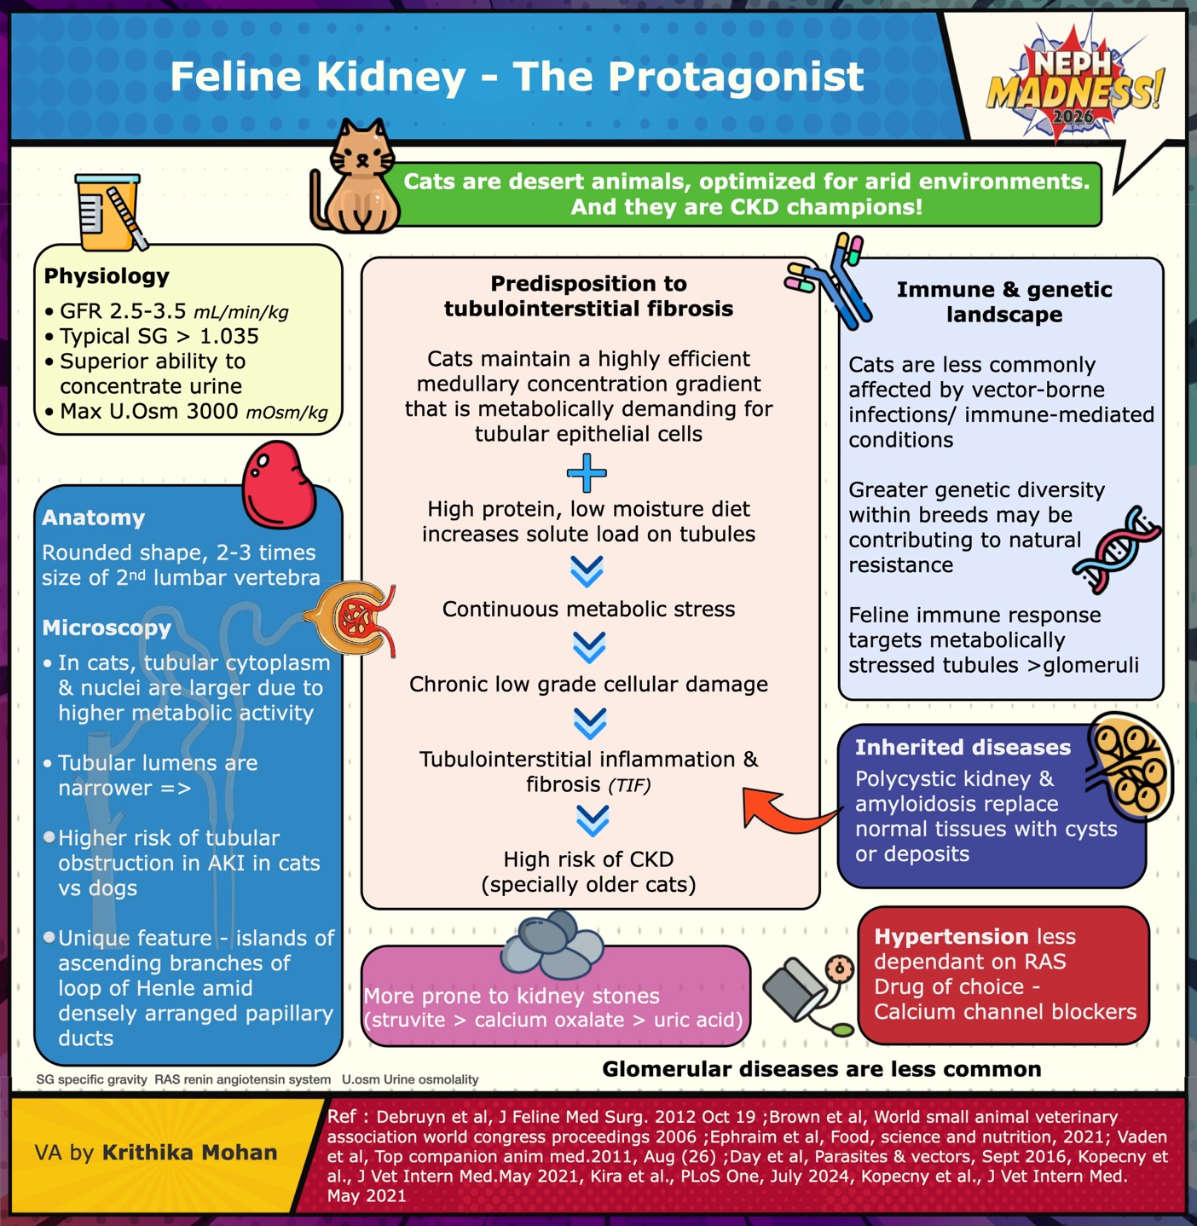

Slide 45




AKI, CKD and ESKD in
AKI: less common than CKD
- Common causes are trauma, obstruction, volume depletion and toxins such as lilies
CKD Champions: prevalence 20% in all cats and 80% in geriatric cats; treatment:
- Hydration (Hydra Care, water fountains, e-tubes)
- Antiemetics and appetite stimulants
- Darbepoetin or Molidustat for anemia
- Phosphate binders
- New: uremic toxin binders (Renaltec)
Dialysis: treatment of severe AKI and intoxications
- Cost: same as in dogs
- Success rate: 50% survival to hospital discharge, less in intoxications (eg. lilies)
- Prognosis: guarded to fair
Transplant:
- Survival 60-70% at 1 yr, 40% at 3 yrs
- Tolerant immune response, cyclosporine is a key component of immunosuppressive regimen
- Cost $8,000-15,000 for surgery + $500 - $1,500 annually for drugs
- Ethical consensus: offered at specialized centers, donor must be adopted by recipient’s owner

Slide 46


EFFLUENT EIGHT ROUND
Pick Your Champion for the Animal House Region
vs
Dogs
Cats

Slide 47

Artificial Intelligence
Writers:
Neil Evans
Aditya Yelamanchi
Experts:
Lili Chan
Kuang-Yu Jen
Region Execs:
Ana Catalina Alvarez-Elías
Jeff Kott

Slide 48

Computational Pathology

Slide 49

Natural Language Processing

Slide 50
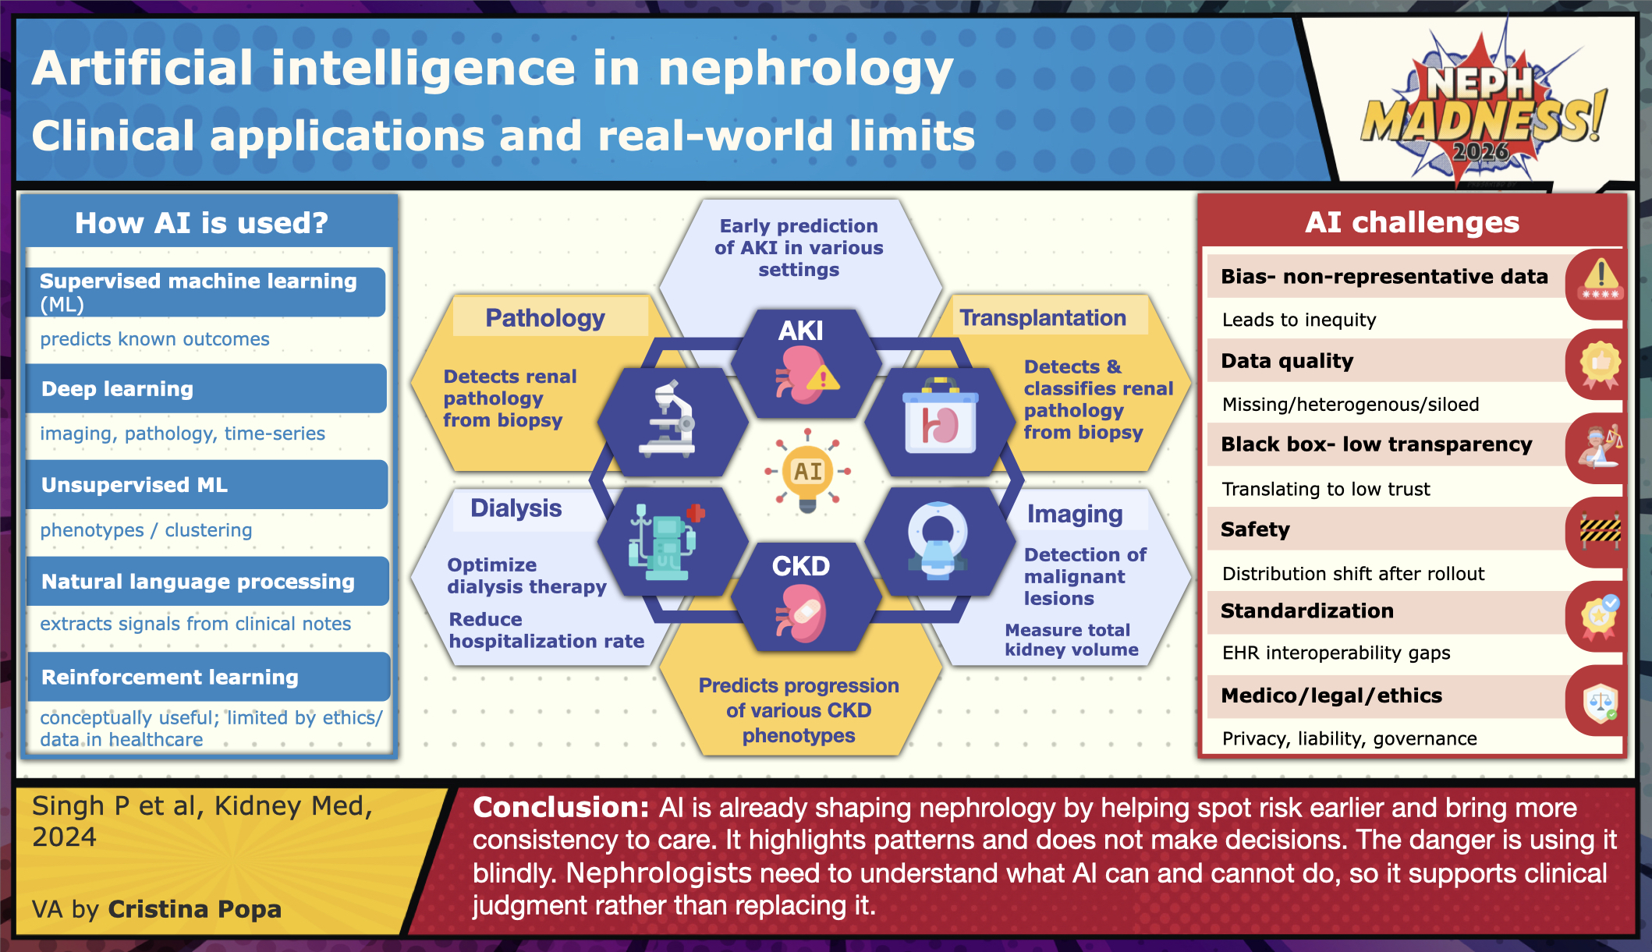

Slide 51
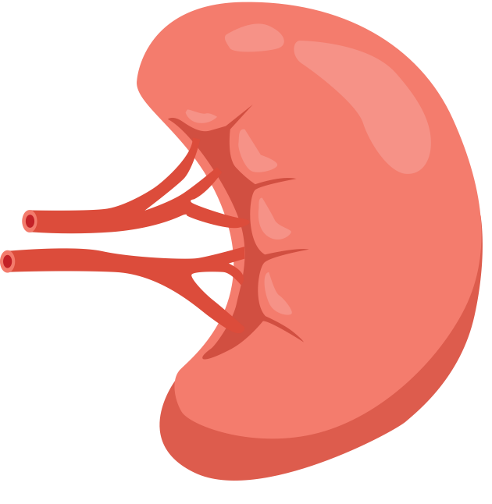


Two Different Engines, Two Different Problems
Computational Pathology
Natural Language Processing (NLP)
Data source: Digitized histology images
Data source: Clinical documentation
Unit of analysis: Pixels → Structures
Unit of analysis: Words → Concepts
Strength: Quantification (fibrosis, lesions, segmentation)
Strength: Pattern extraction across time
Best for: Morphology-driven questions
Best for: Phenotypes, medication signals, trajectories
AI in nephrology is not one tool — it is fundamentally different approaches solving different clinical problems

Slide 52
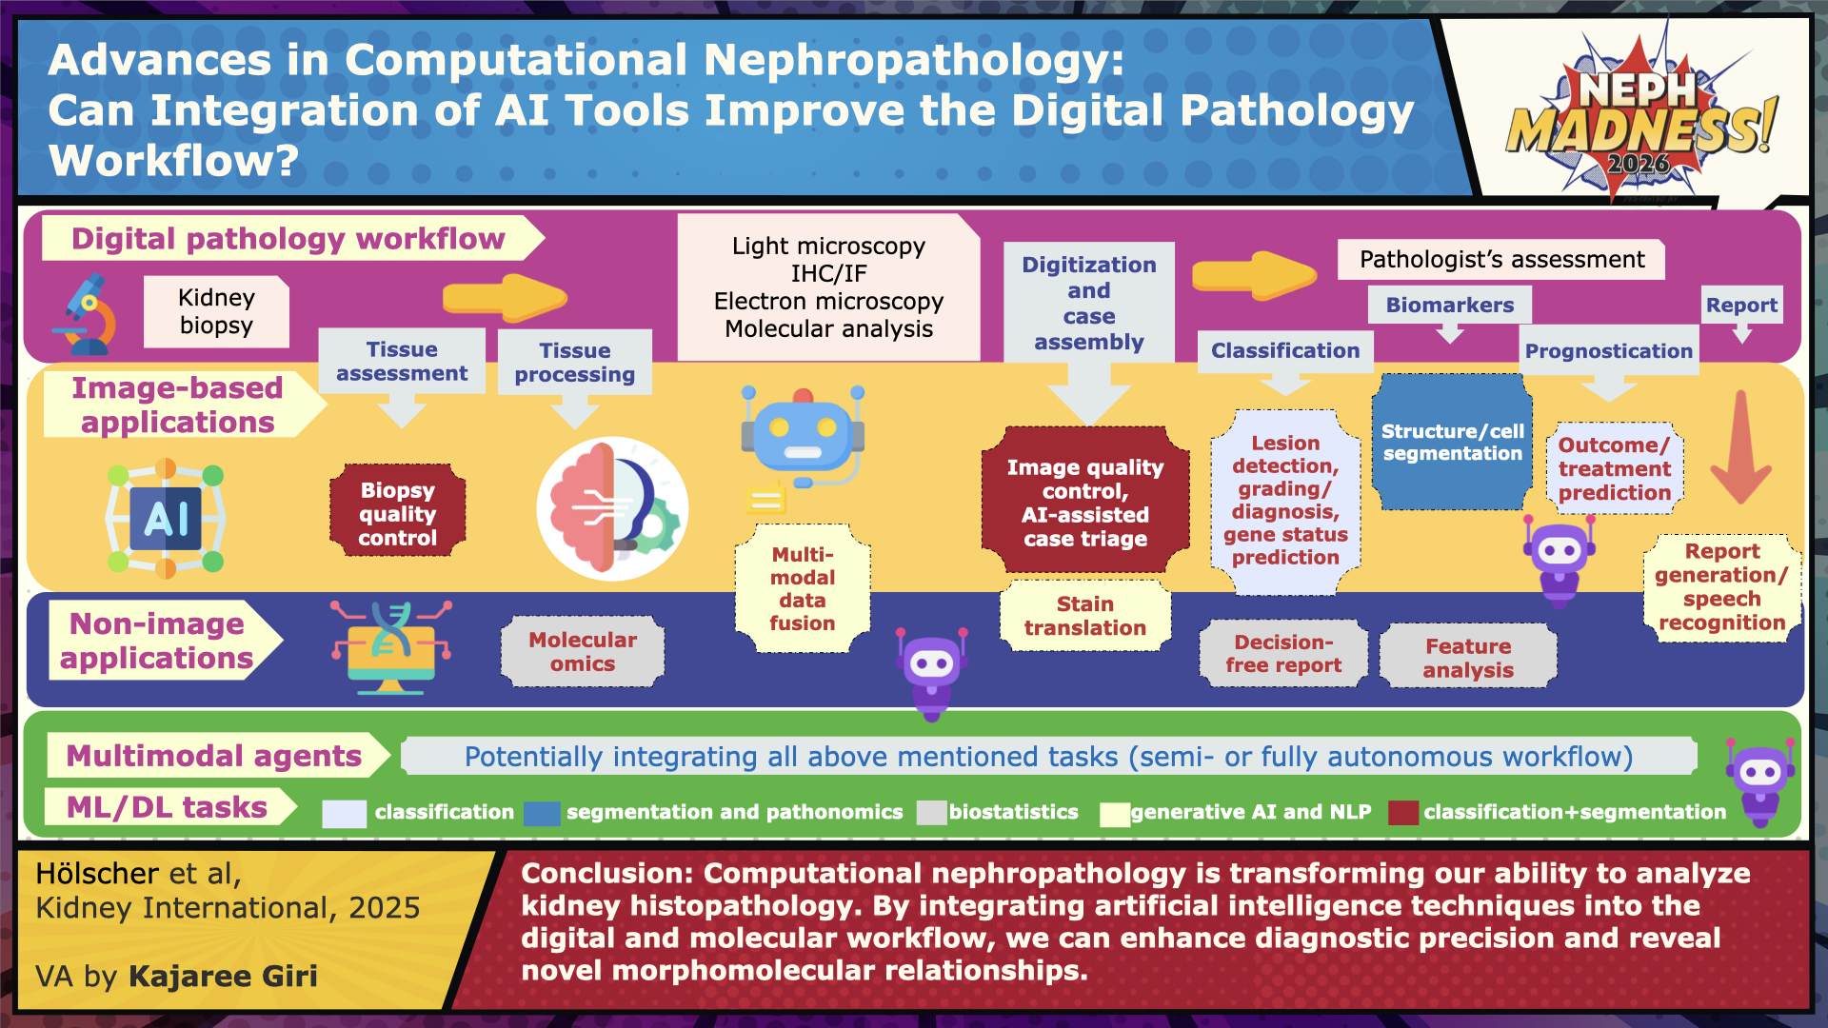

Slide 53
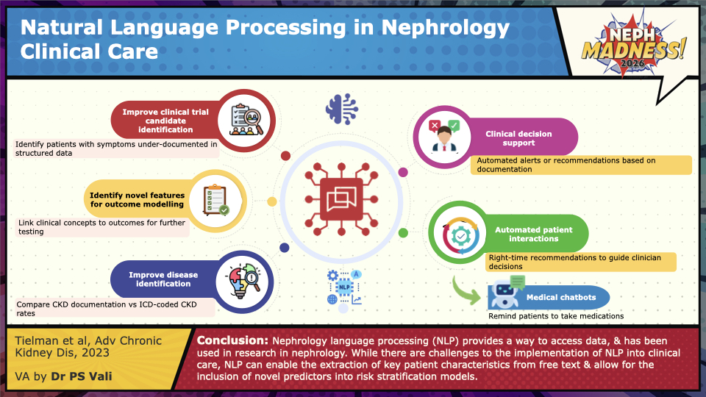

Slide 54



Where Do They Add Value?
Clinical Domain | Computational Pathology |  | Natural Language Processing (NLP)
Tissue-level diagnosis |  | Strong |  | Limited
Longitudinal risk detection |  | Emerging |  | Strong
Workflow efficiency |  | Lab-based |  | System-wide
Standardization |  | High reproducibility |  | Dependent on documentation
Different scalability paths:
Pathology AI = specialized centers, digital infrastructure
NLP = health system–wide deployment

Slide 55




From Innovation to Implementation
Shared implementation requirements for Computational Pathology and NLP:
External validation
Bias Detection
Data Governance
Workflow integration
Clinical Interpretability
1. Research
2. Validation
Are we evaluating AI by accuracy or by clinical usefulness?
4. Routine Use
3. Clinical Integration
Computational pathology and NLP are complementary, but neither replaces clinical reasoning.
Both must earn trust before routine adoption.

Slide 56



EFFLUENT EIGHT ROUND
Pick Your Champion for the Artificial Intelligence Region
vs
Computational Pathology
Natural Language Processing

Slide 57
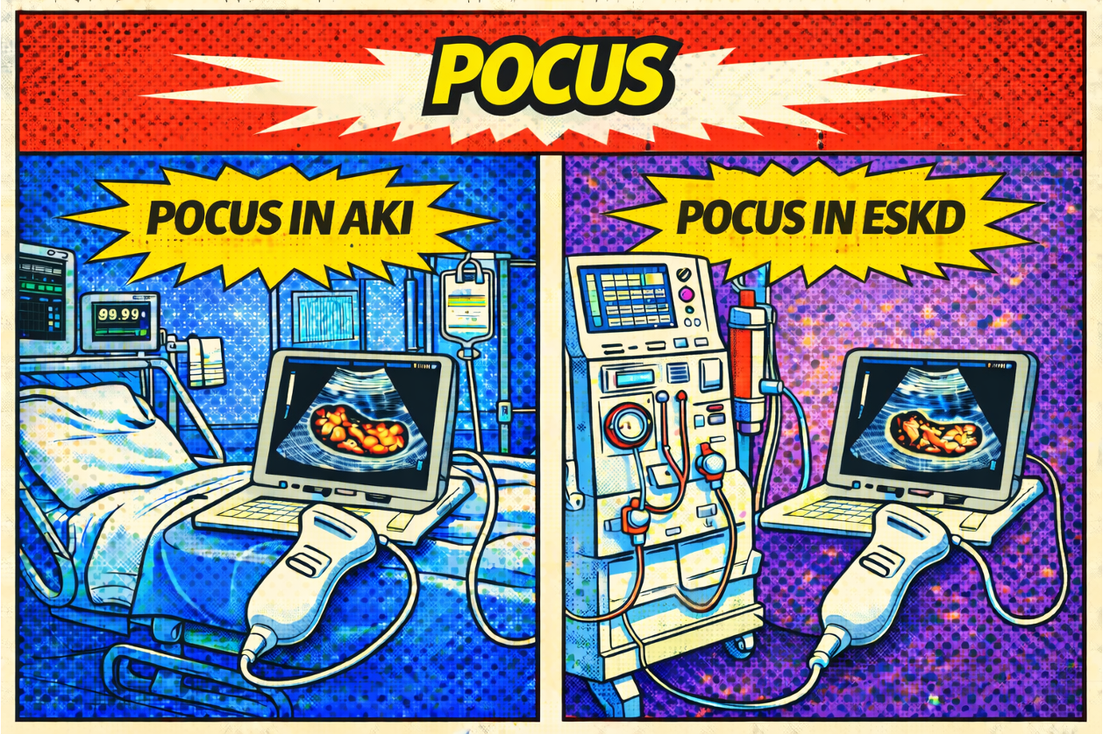
POCUS
Writer:
Priyal Sakhuja
Experts:
Mohamed Hassan Kamel
Vandana Niyyar
Region Execs:
Jeff Kott
Anna Burgner

Slide 58
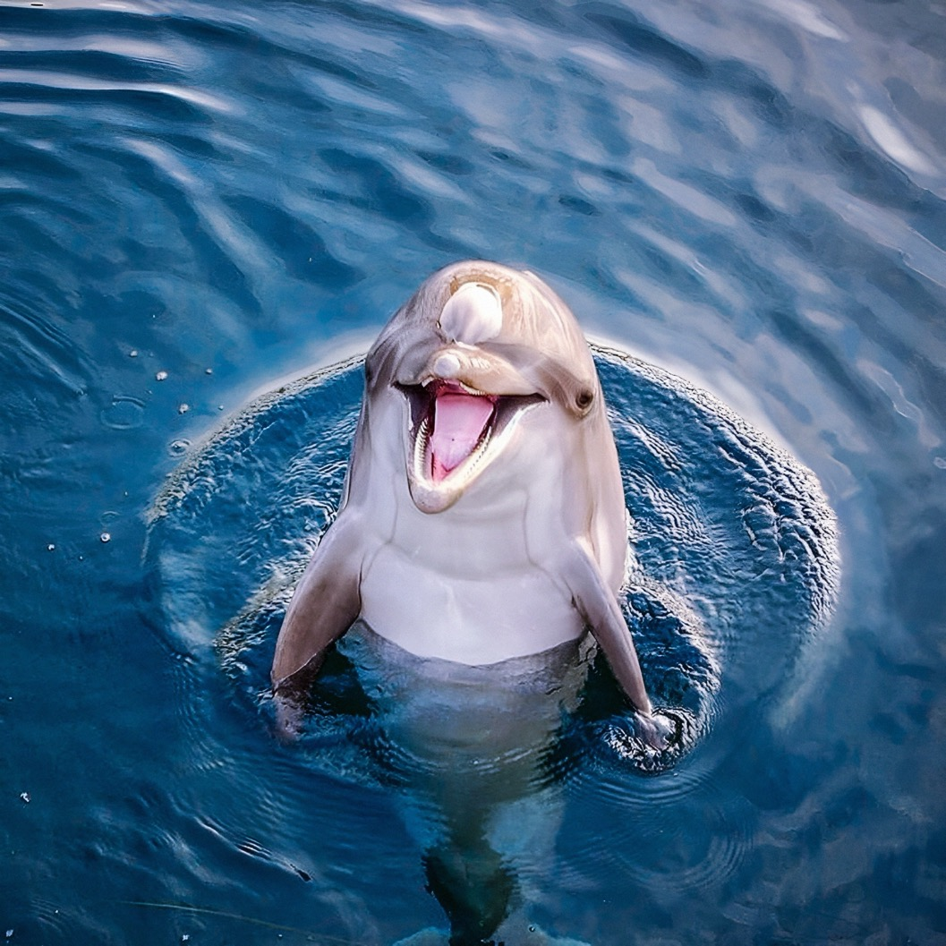
POCUS in AKI

Slide 59
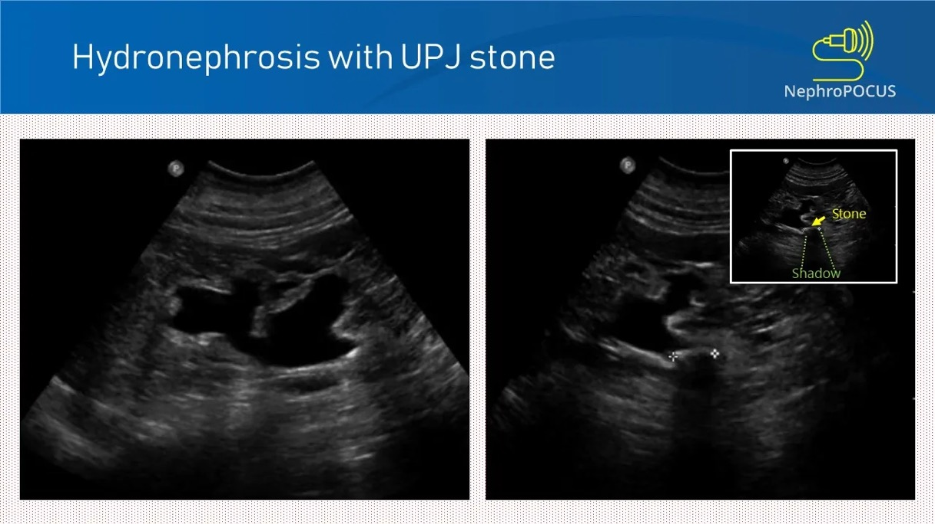
POCUS for Acute Kidney Injury
POCUS for Obstruction
Obstructive Nephropathy Accounts for 5-10% of AKI
Formal renal-bladder ultrasounds can be unnecessary and costly in low-risk patients
POCUS of the Kidney can provide data regarding
Hydrouretonephrosis
Bladder Distention/Post-Void retention
Kidney Size (can give clues of acute vs chronic kidney disease)
Cortex Size and Echogenicity (acute vs chronic kidney disease)
Nephrolithiasis (echogenic focus with acoustic shadowing)
Kidney POCUS has been demonstrated to be:
sensitive and specific (~90%) at identifying obstruction in the AKI population as Gold standard Studies (Renal Bladder Ultrasound and CT Abdomen)
Significantly faster at identifying obstruction
Particularly accurate in moderate – high risk patients
False negatives for obstructive Nephropathy may occur in early obstruction, volume depletion or retroperitoneal fibrosis

Slide 60
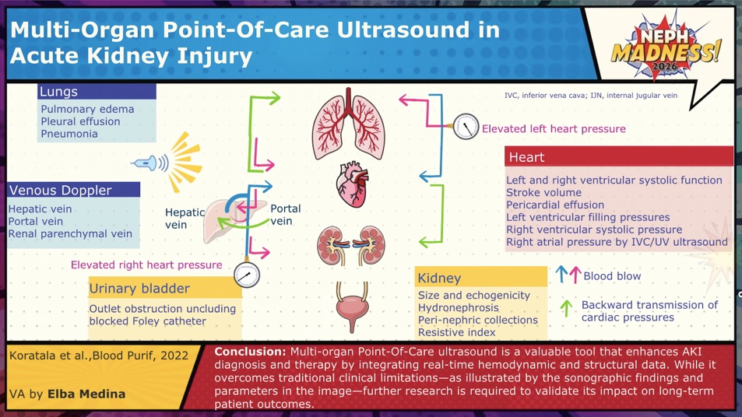
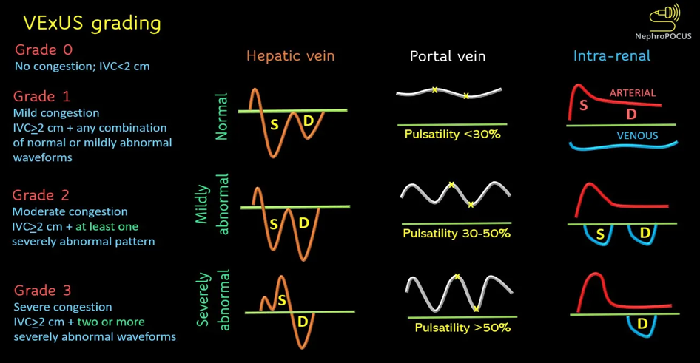
POCUS for Acute Kidney Injury
POCUS for Volume Assessment
Volume assessment is physiologically complex, POCUS offers a comprehensive framework but requires understanding of the test strengths/limitations.
Cardiovascular Ultrasound – To assess left and right sided pressure/function
Lung/Abdominal Ultrasound– To assess for extravascular fluid
IVC ultrasound - marker for central venous pressure rather than fluid responsiveness.
VExUS– Assesses doppler flow patterns in larger proximal veins in liver/kidneys to assess for organ impacts of venous congestion
VExUS > 2 has been validated in the post-cardiac surgery population as a risk factor for Acute Kidney Injury due to venous congestion
A decrease in VExUS score in the critically ill population has shown improved kidney outcomes and lower in-hospital mortality in small prospective cohort studies

Slide 61
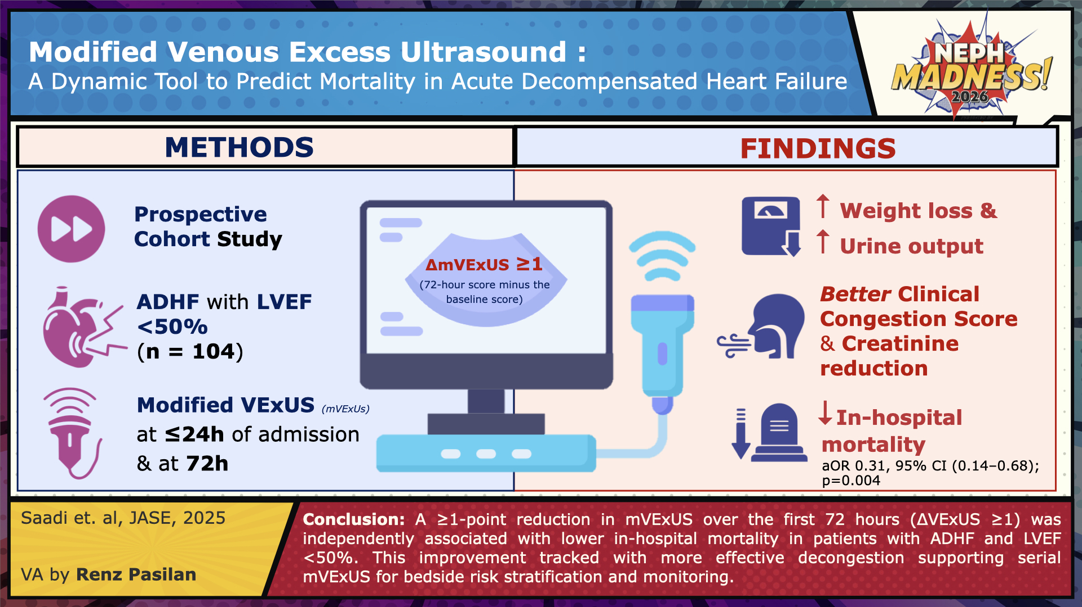

Slide 62
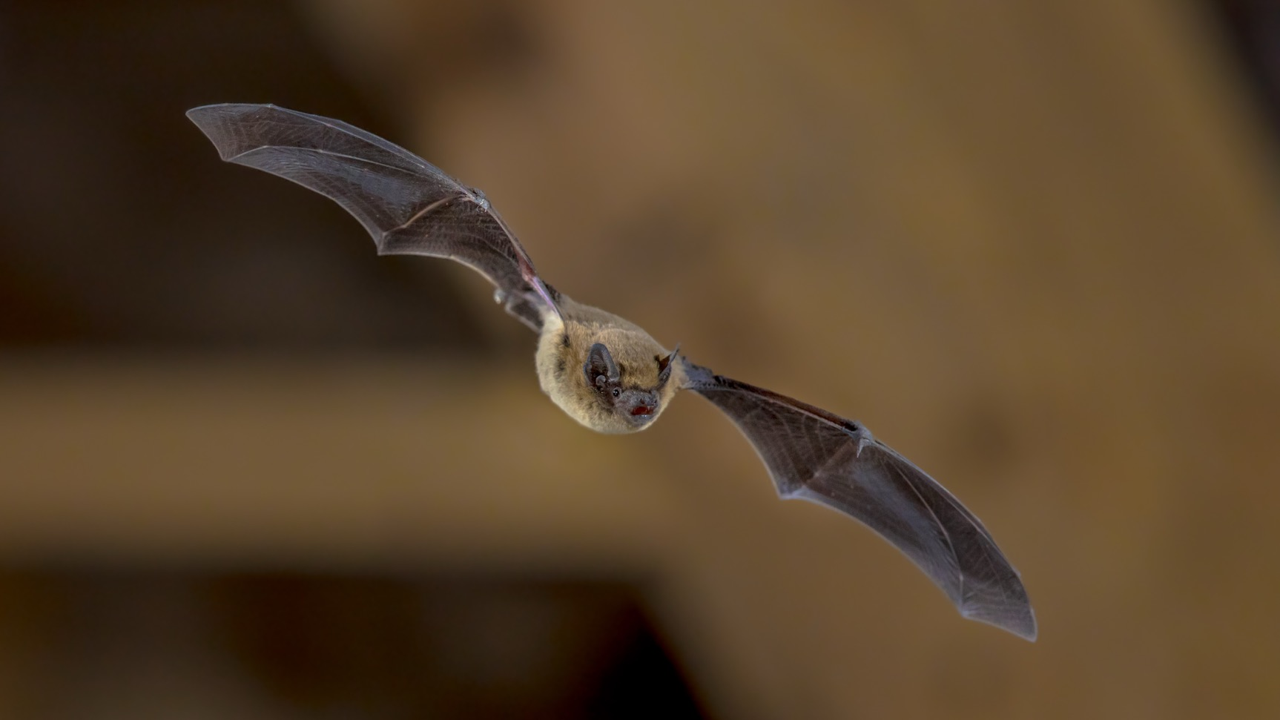
POCUS in ESKD

Slide 63
POCUS for End Stage Kidney Disease
VEXUS
No studies looking to date at long-term outcomes
One small cohort study showed that ultrafiltration did improve VExUS score over the course of a single dialysis session
Case reports have detailed how VExUS can guide Ultrafiltration in overloaded, hospitalized patients
POCUS for Volume
Dry Weight determination remains imprecise
BP and Intradialytic weight gain are crude surrogates
No universally accepted gold standard.
IVC Ultrasound
Due to its limitations in interpretation, has only been studied in the critically ill dialysis population
POCUS for vascular access is accessible and may lead to earlier canulation with improved patient experience and outcomes
Is used for perioperative vein assessment
May lead to earlier cannulation
One study found POCUS led to a a quicker time to canulation for AVFs with a diameter >6mm, <6mm deep, and >6mm long when compared standard of care with no difference in complications between groups
May lead to better AVF/AVG related outcomes, patient satisfaction and is Is teachable to dialysis unit staff
Lung Ultrasound (LUS)
Lung Ultrasound guided ultrafiltration has shown impove both dry weight/BP and cardiac parameters
A multicenter RCT (LUST Trial) evaluated a LUS guided UF protocol vs Standard of Care and found no significant difference in major adverse cardiovascular events between groups despite improved relief of lung congestion.

Slide 64
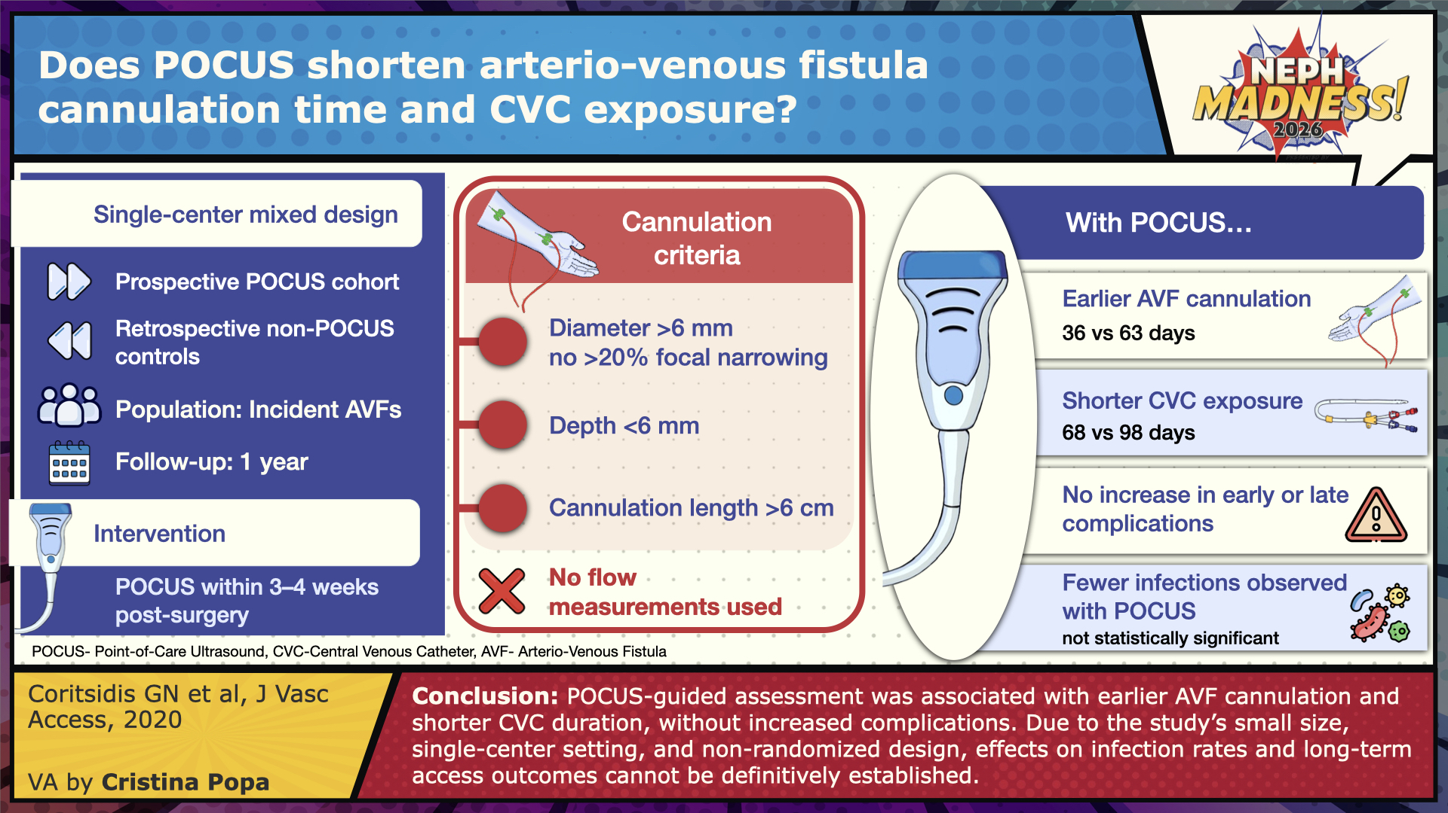

Slide 65
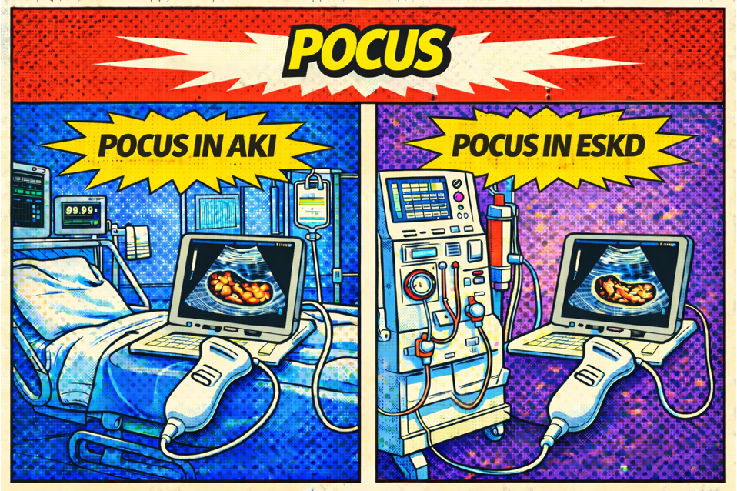
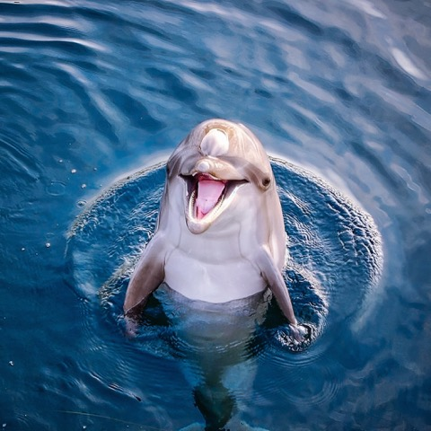

EFFLUENT EIGHT ROUND
Pick Your Champion for the POCUS Region
vs
POCUS in AKI
POCUS in ESKD

Slide 66
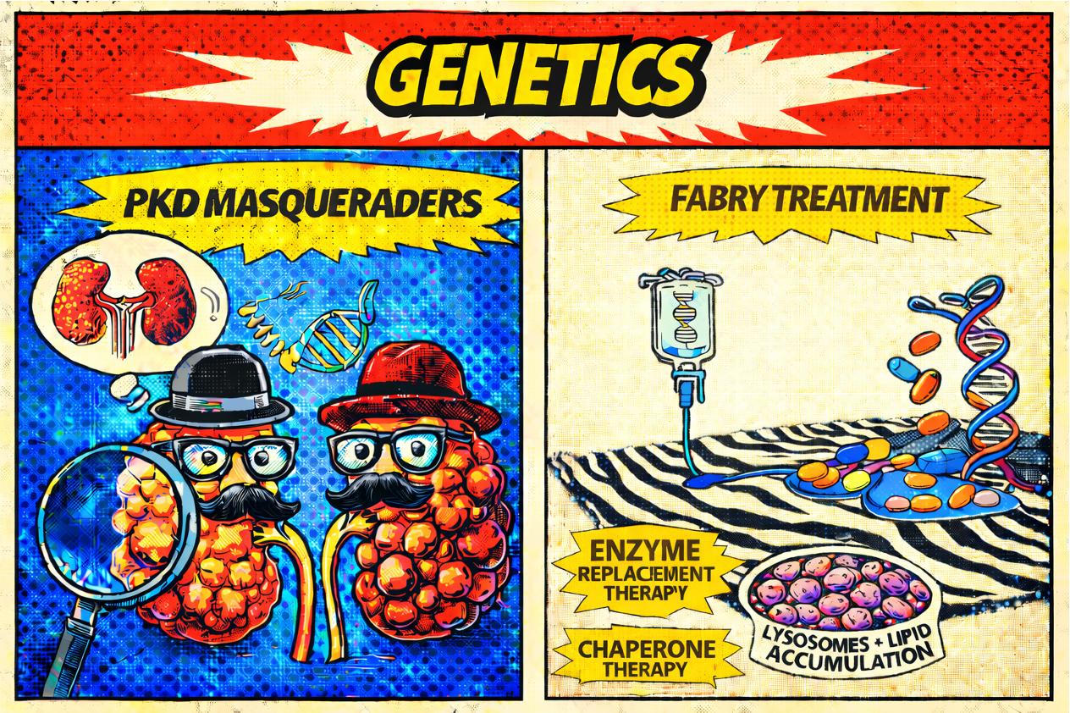
Genetics
Writers:
Steven Clapp
Alyssa Steitz
Expert:
Eric Wallace
Region Execs:
Anna Burgner
Samira Farouk

Slide 67
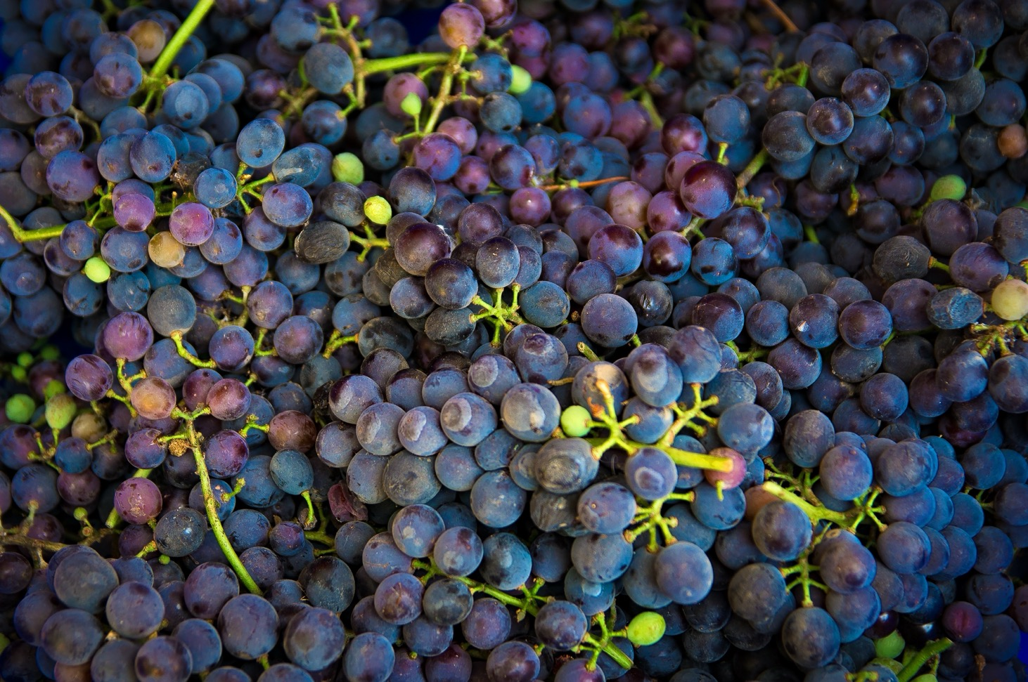
PKD Masqueraders

Slide 68

Ciliopathies and Their Cystic Kidney Diseases
Cilia are hair-like organelles found on nearly all eukaryotic cells
Key roles in development including proliferation, differentiation, and migration.
Cilia Dysfunction →Ciliopathies are associated with diseases of multiple organ systems
Ciliopathies in the kidneys are associated with cystic kidney disease
Polycystic Kidney Disease Masqueraders
Autosomal Dominant PKD
Autosomal Recessive PKD
Nephronophthisis
Medullary Sponge Kidney
HNF1B related Autosomal Dominant Tubulointerstitial Kidney Disease

Slide 69
Our Understanding of the Genetics of Cystic Kidney Disease is Evolving
Autosomal Dominant Polycystic Kidney Disease (ADPKD)
Mutations in the PKD1 and PKD2 genes are the most common cause
Threshold model → cyst formation is triggered if polycystin is reduced below a critical threshold in tubular epithelial cells
Leading to the discovery of multiple other gene mutations found that can cause ADPKD
GANAB, DNAJB11, ALG8, ALG9, PRKCSH, SEC63, and SEC61B among others
HNF1B mutations
Also known as renal cysts and diabetes (RCAD) syndrome and HNF1B-MODY or MODY5
Kidney manifestations are highly variable, even within a family! (See next slide) →. the exact mutation doesn’t predict the kidney disease!

Slide 70


Slide 71

Fabry Treatment

Slide 72

Fabry Disease
X-linked lysosomal storage disorder caused by mutations in the galactosidase A (GLA) gene
Deficiency of lysosomal enzyme alpha galactosidase A → accumulation of lysosomal Gb3
End Organ Disease
Proteinuric kidney diseased → kidney failure
Cardiomyopathy
Stroke
Neuropathy
Skin lesions (angiokeratomas)
Other noteworthy symptoms:
Severe debilitating pain, irritable bowel syndrome-like symptoms, and anhidrosis (leading to heat intolerance)
Classic Zebra Bodies in Podocytes (Yellow Arrow)

Slide 73

Growing List of Treatment Options for Fabry Disease
Felis A, Whitlow M, Kraus A, Warnock DG, Wallace E. Current and Investigational Therapeutics for Fabry Disease. Kidney Int Rep. 2019 Dec 6;5(4):407-413

Slide 74



EFFLUENT EIGHT ROUND
Pick Your Champion for the Genetics Region
vs
Fabry Treatment
PKD Masqueraders

Slide 75








From your Effluent 8,
pick your Filtered 4

Slide 76
From your Filtered 4,
pick your Left and Right Kidneys
?
?
?
?

Slide 77
Crown your
NephMadness 2026
CHAMPION:

Slide 78
Thanks for playing and good luck!
Submit brackets by March 31, 2026 on Tourneytopia
Claim CME and MOC credit through NKF PERC
Discuss on social media using #NephMadness
Important Dates:
March 1, Sunday (7:00 am Eastern): Bracket entry opens
March 31, Tuesday (11:59 pm Eastern): Deadline for entering contest
April 2, Thursday: Effluent 8 results
April 6, Monday: Filtered 4 results
April 8, Wednesday: Left & Right Kidney results
April 10, Friday: NephMadness Champion crowned

